Slide 1
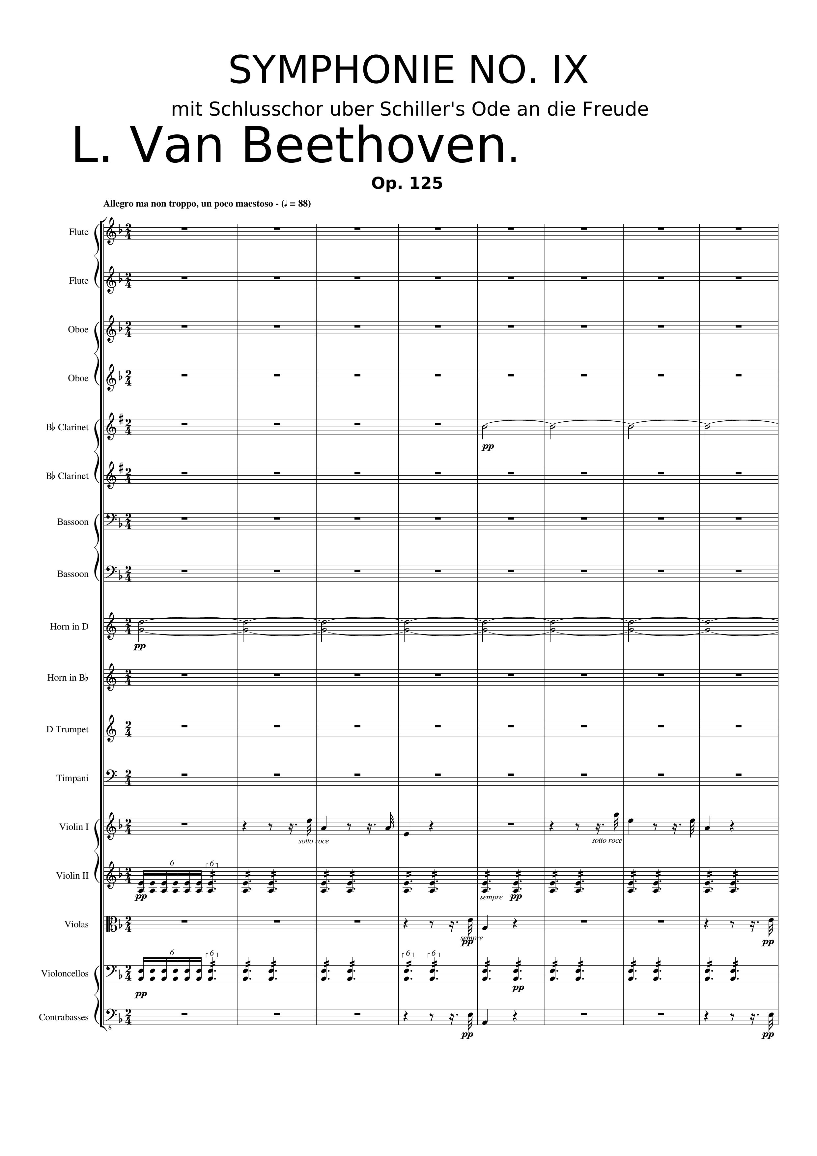
harm
harm
mel
mel
rhythm
mel
mel
rhythm
mel
mel
0 | 2 | 4 | 6 | 8 | 10 | 12 | 14
Notes:
(2) Beethoven 9 - Chicago Symphony Orchestra - Riccardo Muti – YouTube
1:51

Slide 2
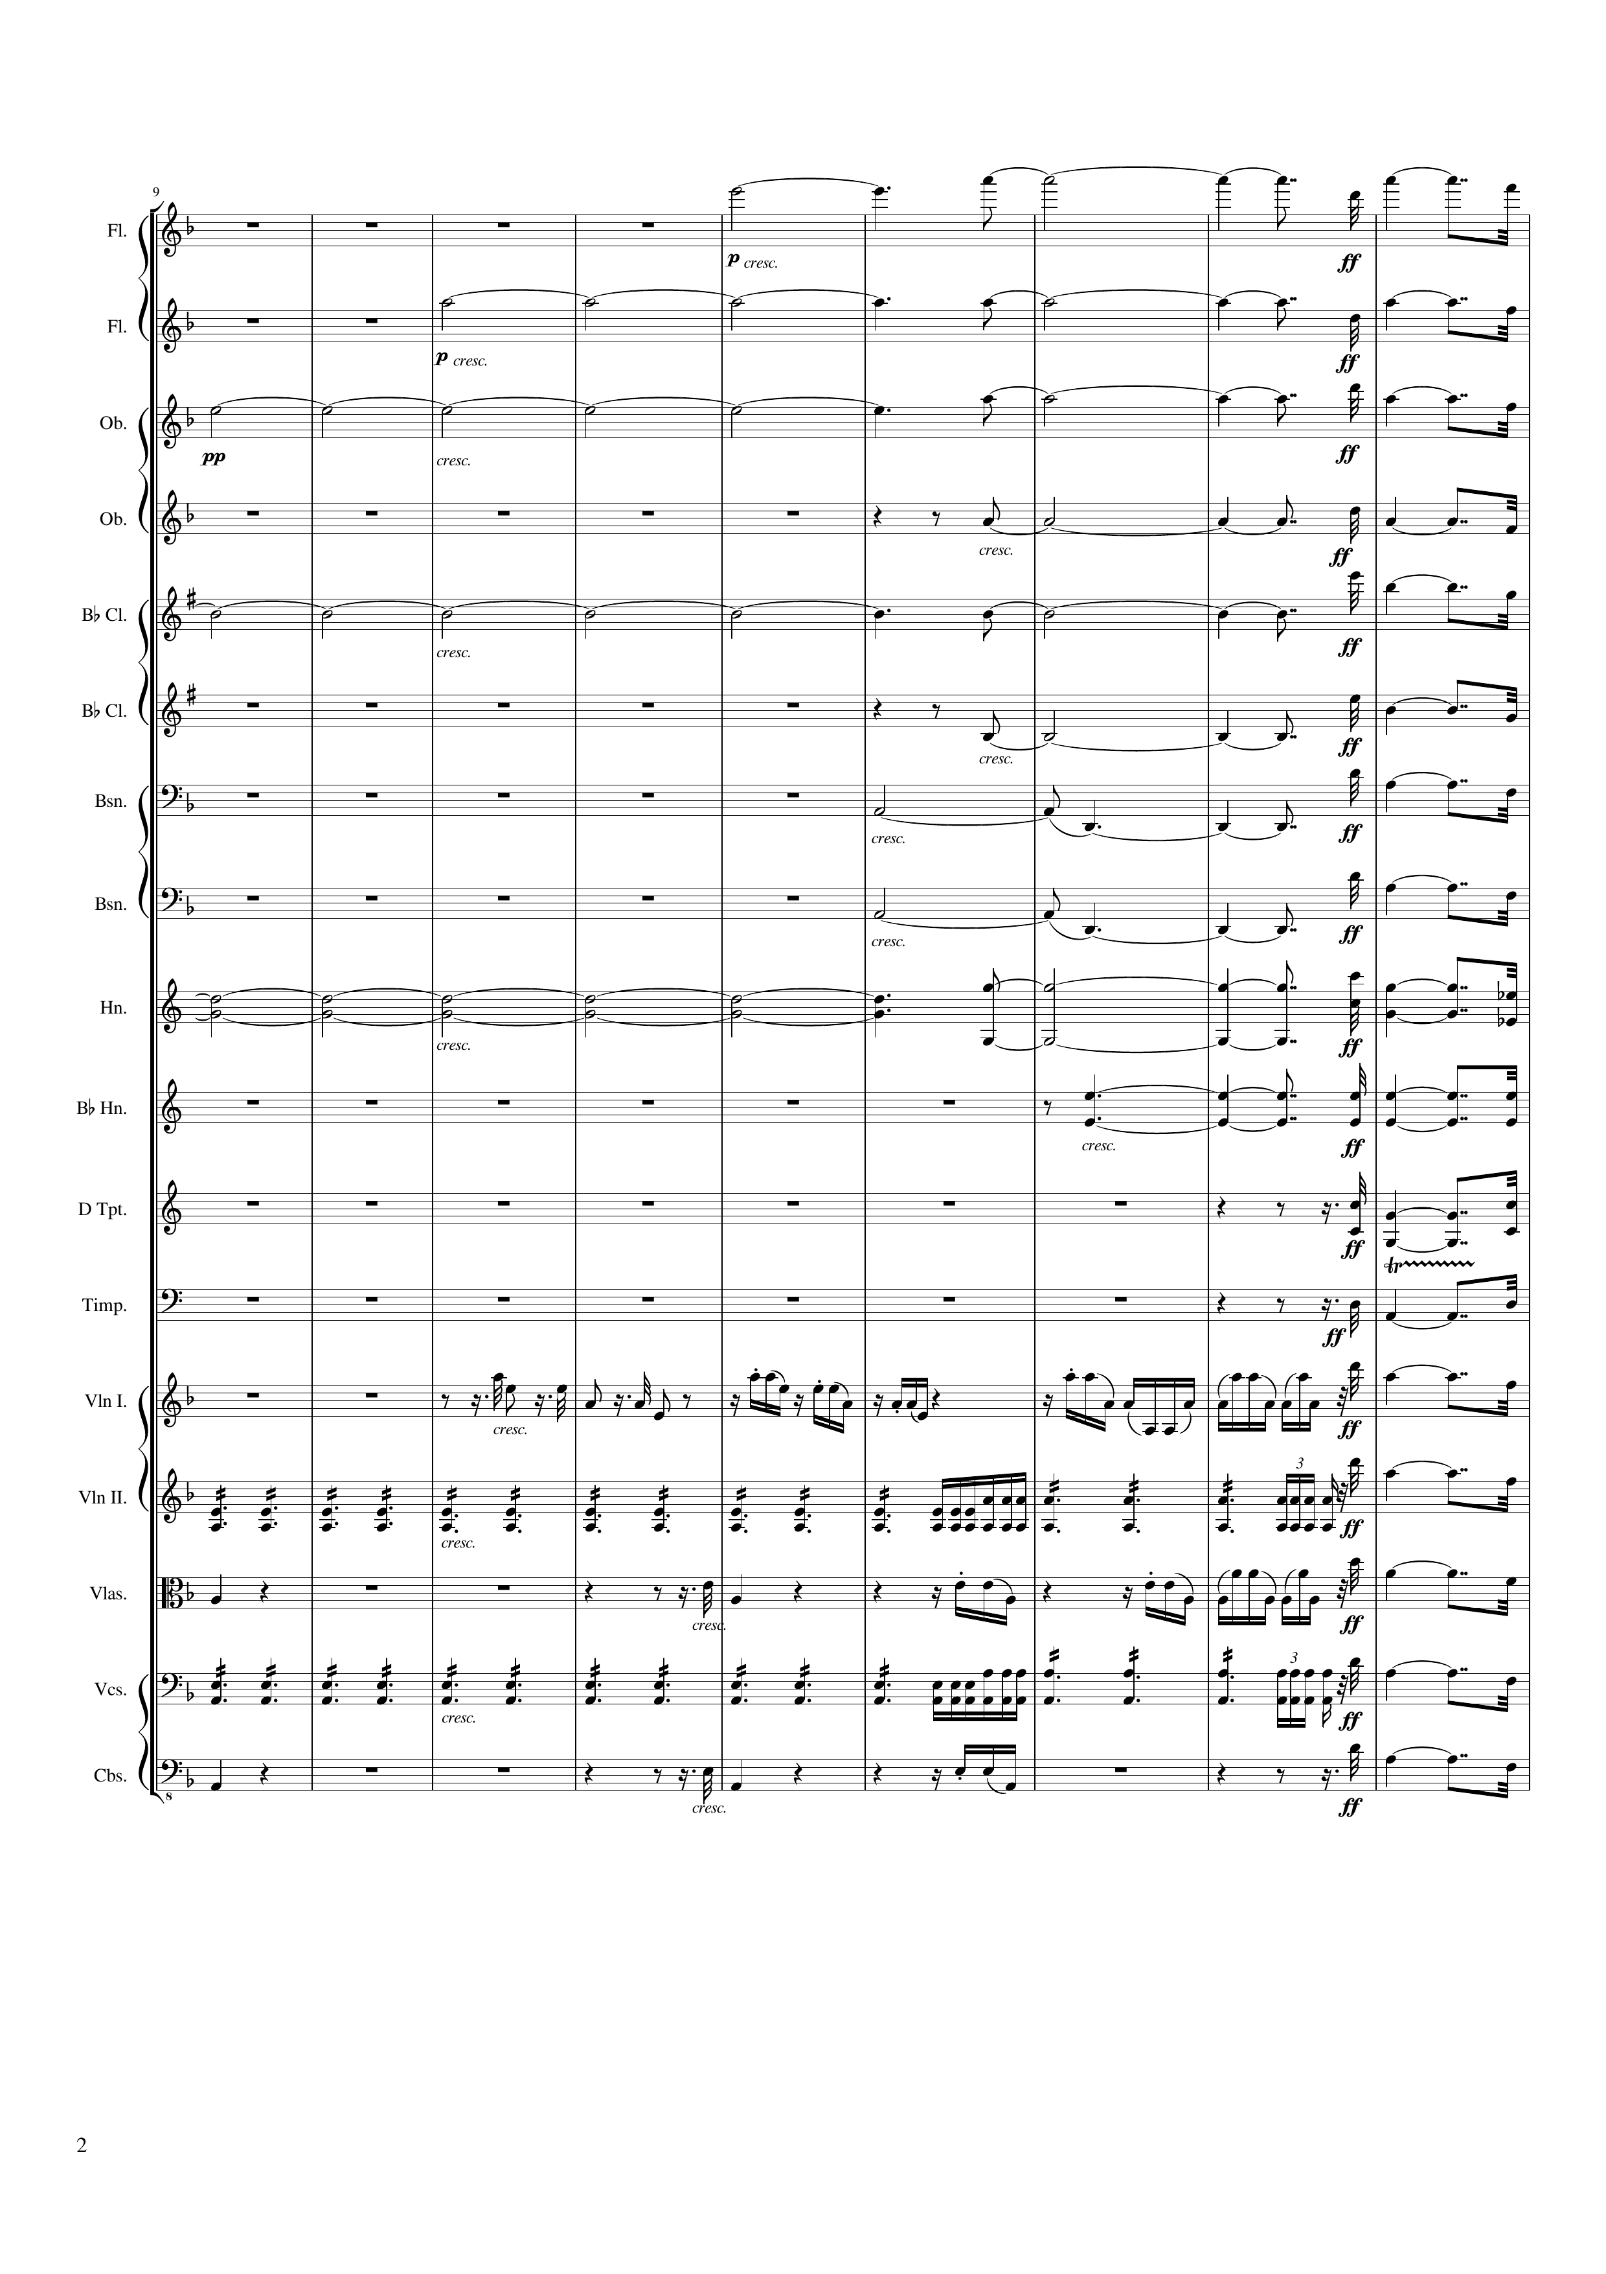
harm
mel
harm
mel
harm
mel
harm
mel
harm
mel
harm
mel
harm
mel
harm
mel
harm
mel
harm
rhythm
rhythm
rhythm
mel
mel
rhythm
mel
mel
mel
mel
rhythm
mel
mel
mel
mel
16 | 18 | 20 | 22 | 24 | 26 | 28 | 30 | 32
Notes:
2:06

Slide 3
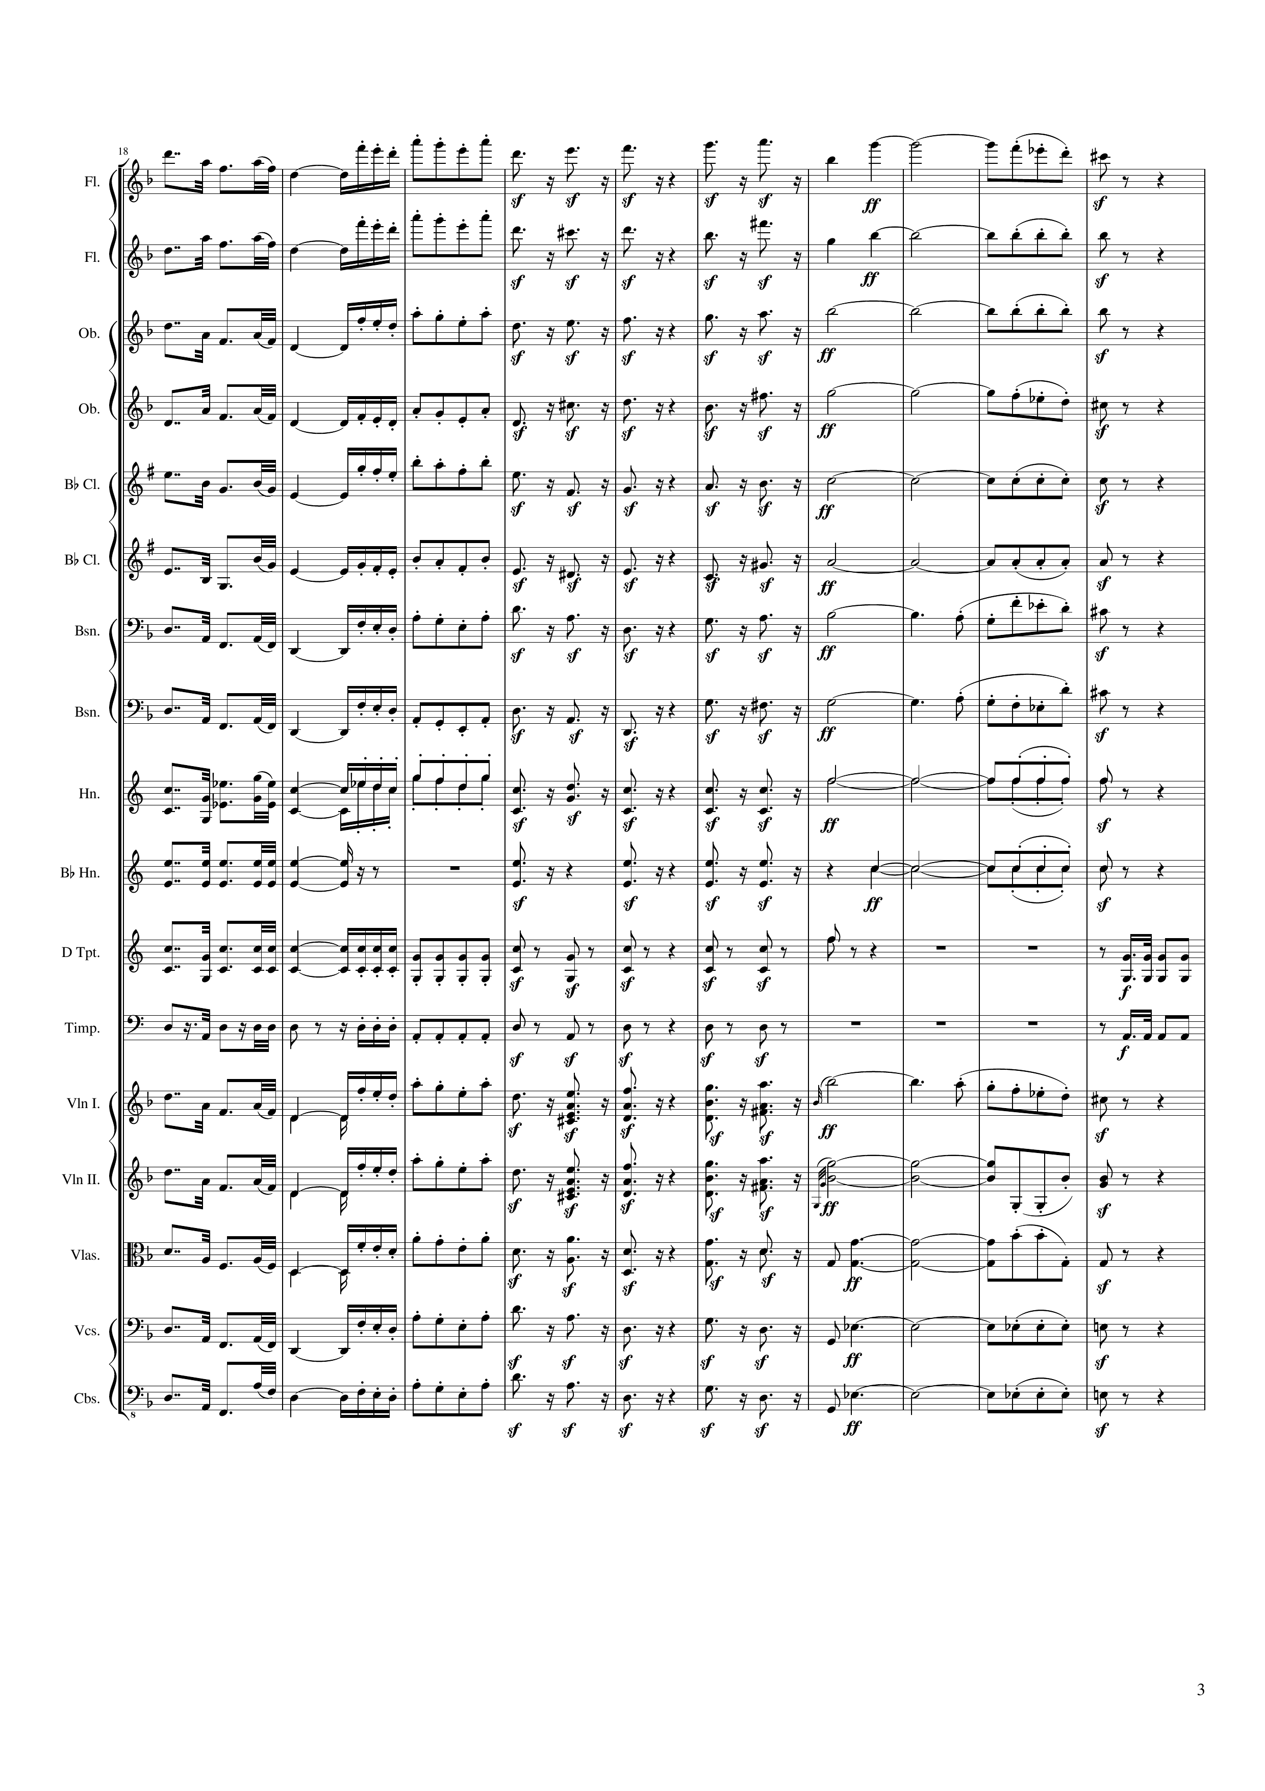
mel
mel
mel
mel
rhythm+harm
rhythm+harm
mel
mel
rhythm+harm
mel
rhythm+harm
mel
mel
rhythm+harm
rhythm+harm
mel
rhythm+harm
rhythm+harm
mel
rhythm+harm
mel
mel
rhythm+harm
mel
mel
rhythm+harm
rhythm+harm
rhythm
rhythm+harm
rhythm+harm
rhythm
rhythm+harm
rhythm
rhythm
rhythm+harm
rhythm
mel
mel+rhythm+harm
mel
mel
mel+rhythm+harm
rhythm+harm
mel
rhythm+harm
rhythm+harm
mel
rhythm+harm
rhythm+harm
mel
rhythm+harm
rhythm+harm
34 | 36 | 38 | 40 | 42 | 44 | 46 | 48 | 50 | 52
Notes:
2:25

Slide 4
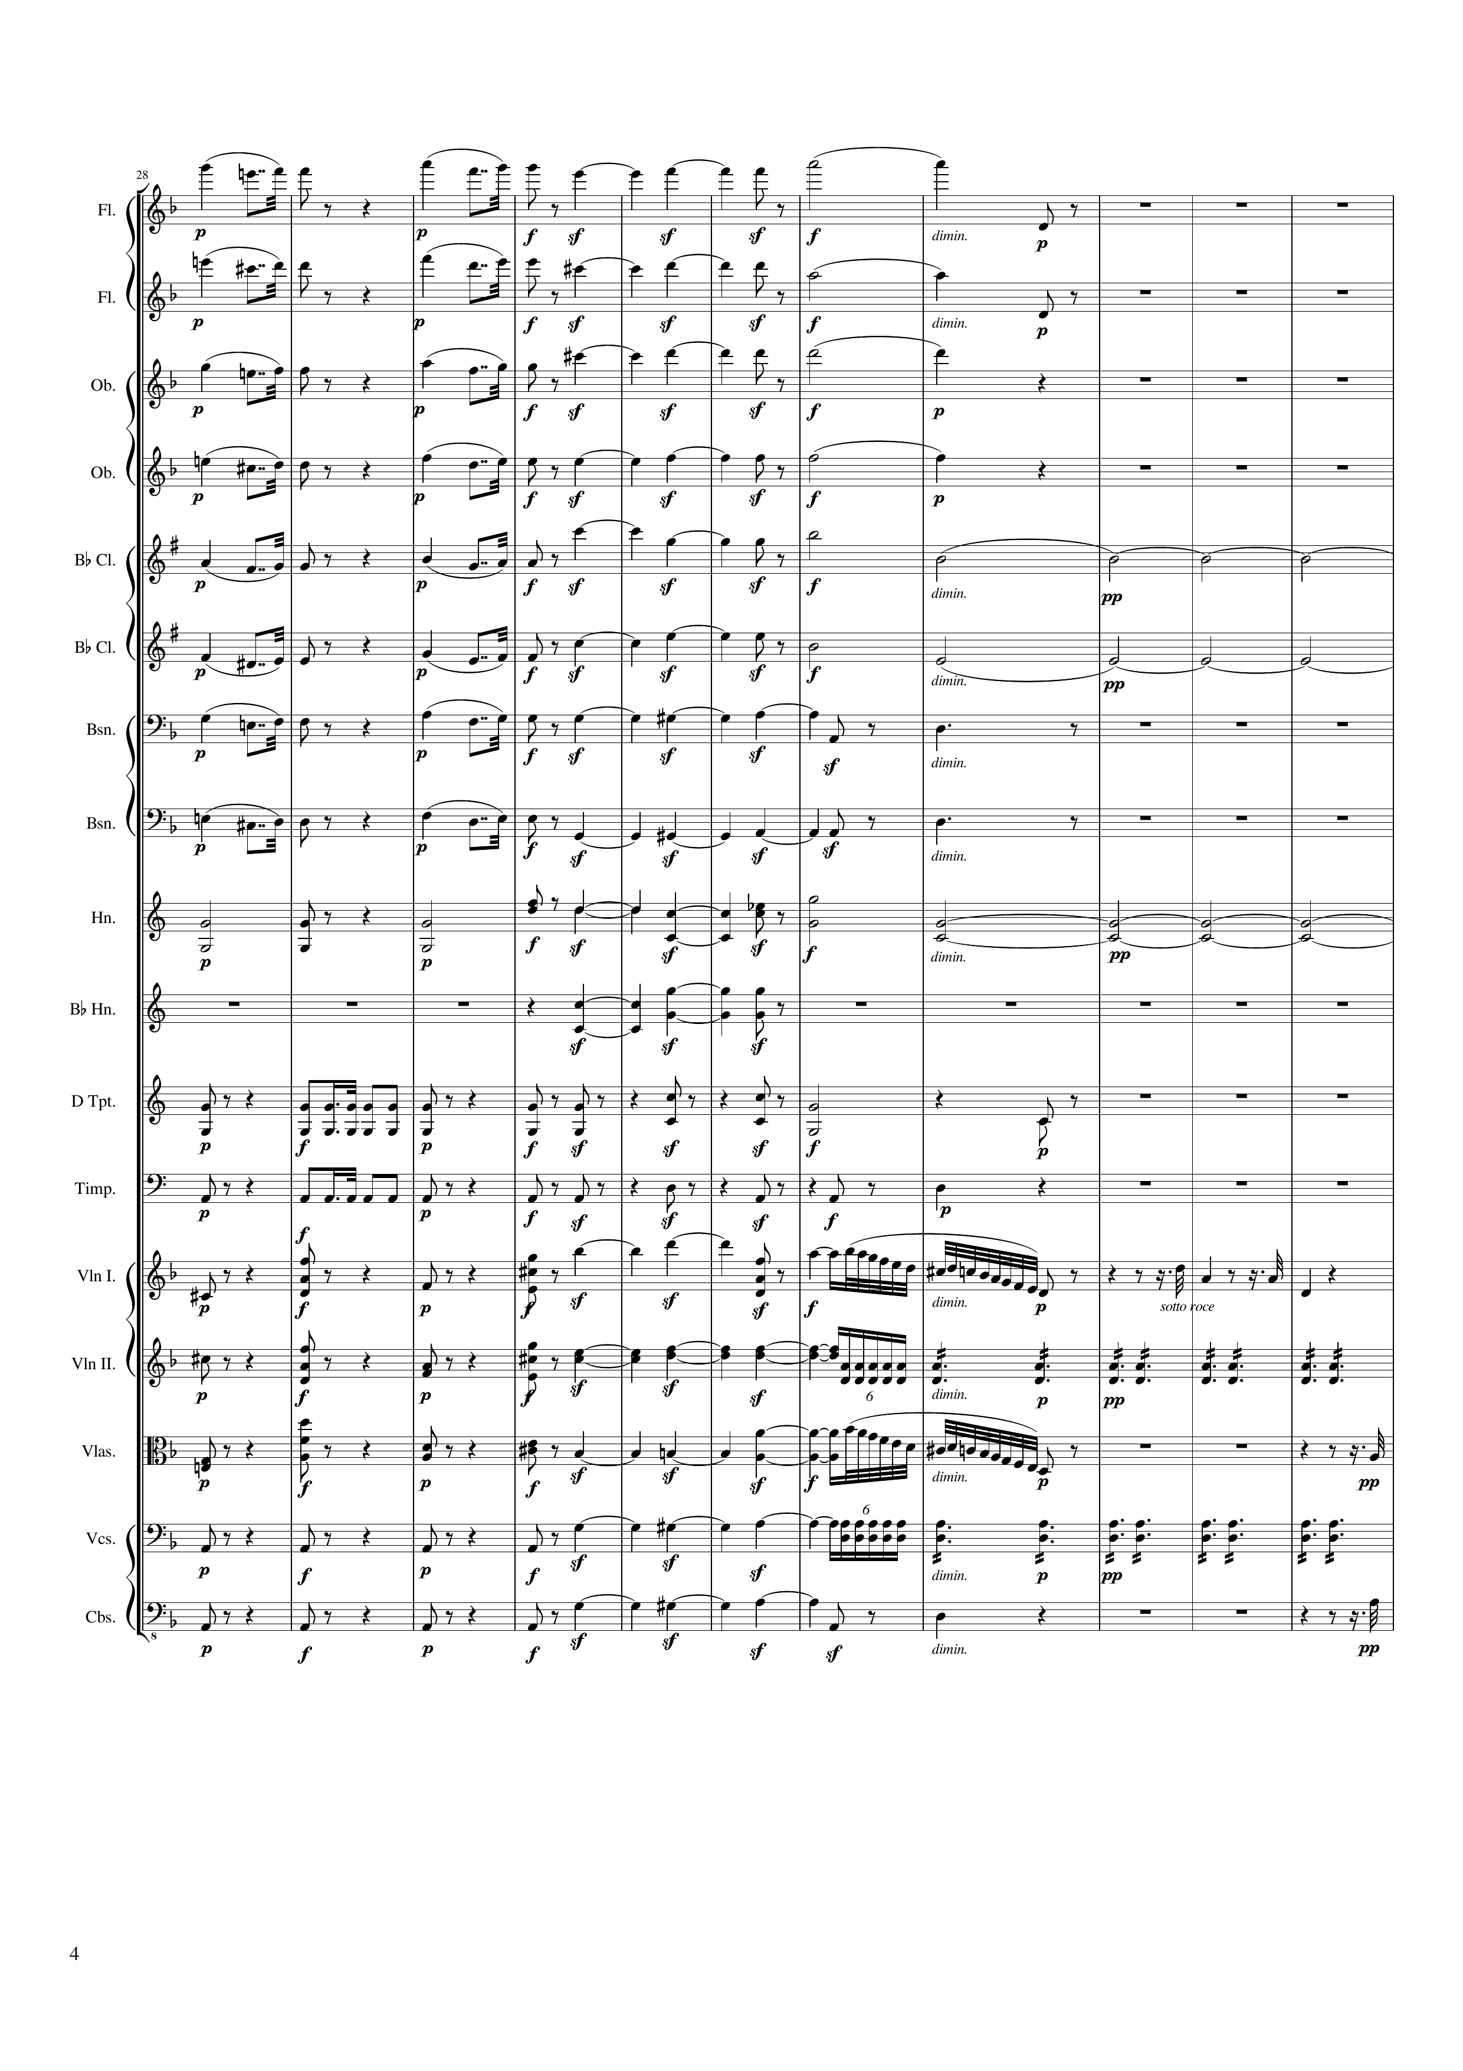
mel
rhythm+harm
mel
rhythm+harm
mel
rhythm+harm
mel
rhythm+harm
mel
rhythm+harm
harm
mel
rhythm+harm
harm
mel
rhythm+harm
mel
rhythm+harm
harm
rhythm+harm
harm
rhythm+harm
rhythm
rhythm+harm
rhythm
rhythm+harm
rhythm+harm
rhythm+harm
mel+rhythm
mel
rhythm+harm
rhythm+harm
rhythm
rhythm+harm
rhythm+harm
mel+rhythm
mel
rhythm+harm
rhythm+harm
rhythm
rhythm+harm
rhythm+harm
mel
54 | 56 | 58 | 60 | 62 | 64 | 66 | 68 | 70 | 72 | 74
Notes:
2:44

Slide 5
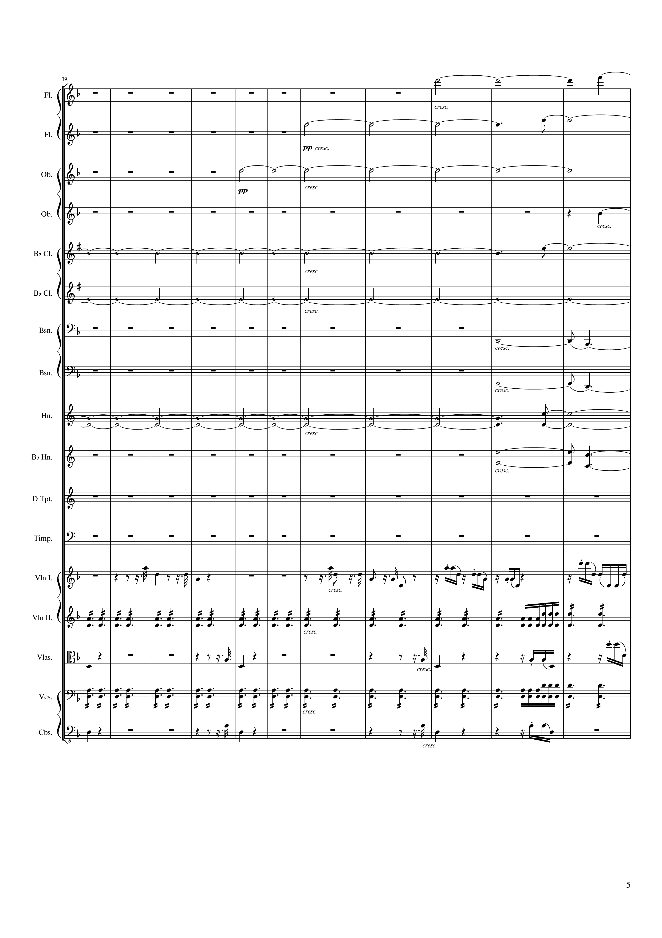
harm
harm
harm
harm
harm
harm
harm
harm
harm
harm
mel
mel
rhythm
mel
mel
mel
rhythm
mel
mel
mel
76 | 78 | 80 | 82 | 84 | 86 | 88 | 90 | 92 | 94 | 96
Notes:
3:05

Slide 6
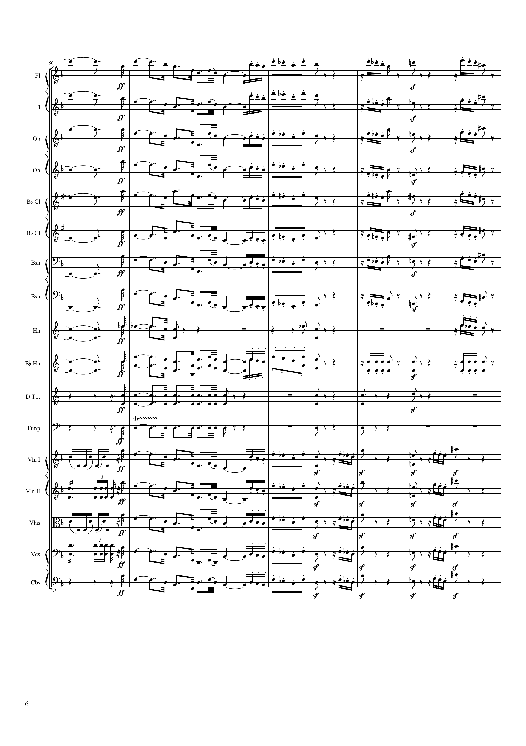
harm
c
mel
harm
c
mel
harm
c
mel
harm
c
mel
harm
c
mel
harm
c
mel
harm
c
mel
harm
c
mel
harm
c
rhythm
mel
harm
c
mel
rhythm
rhythm
rhythm
mel
mel
rhythm
mel
mel
mel
rhythm
mel
mel
98 | 100 | 102 | 104 | 106 | 108 | 110 | 112 | 114
Notes:
3:26

Slide 7
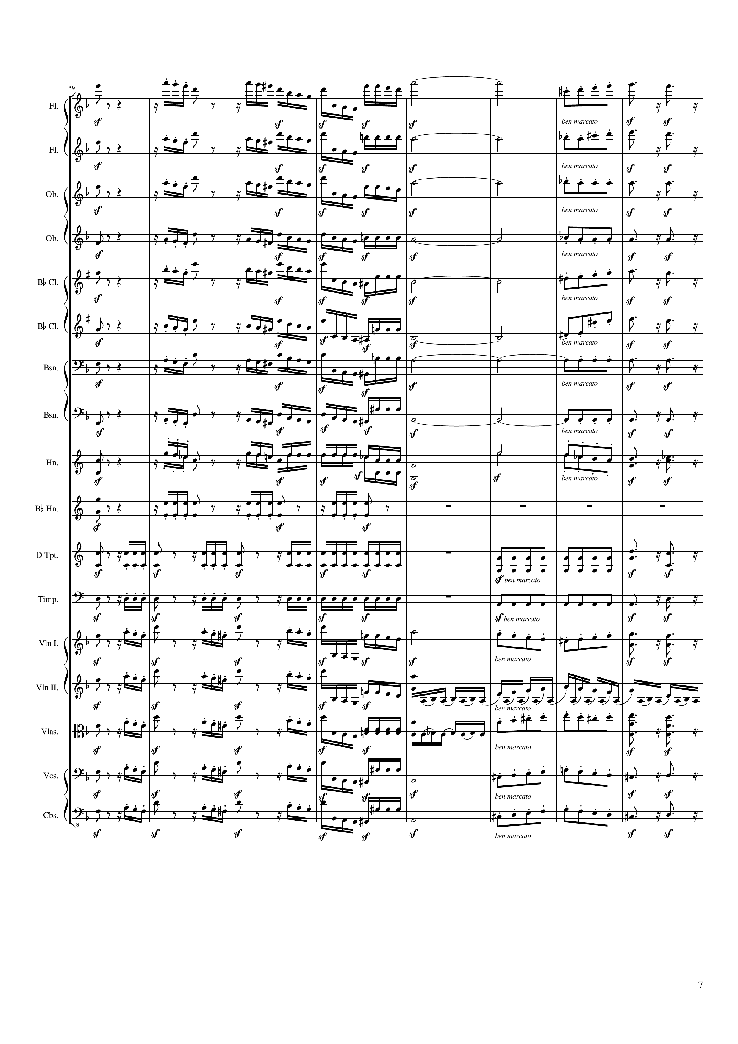
mel
mel
mel
mel+harm
mel
rhythm
mel
rhythm
mel
mel
mel
mel+harm
mel
rhythm
mel
rhythm
mel
mel
rhythm
rhythm
rhythm
rhythm
rhythm
mel
mel
mel
rhythm
mel
rhythm
mel
mel
mel
mel
mel
116 | 118 | 120 | 122 | 124 | 126 | 128 | 130
Notes:
3:44

Slide 8
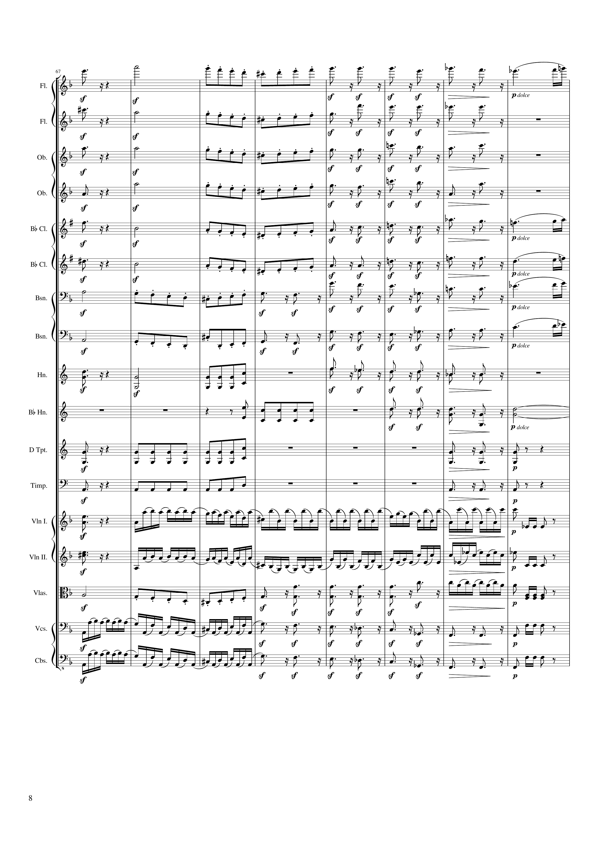
mel
mel
rhythm+harm
mel
mel+harm
mel
rhythm+harm
rhythm
mel
rhythm+harm
rhythm
mel
rhythm+harm
mel
mel
rhythm+harm
mel
mel+harm
mel
rhythm+harm
mel
rhythm
mel
rhythm+harm
mel
rhythm
mel
rhythm+harm
mel
mel
rhythm
rhythm+harm
rhythm
rhythm+harm
harm
rhythm
rhythm+harm
rhythm
rhythm+harm
mel
mel+rhythm
rhythm
rhythm
rhythm
mel+rhythm
rhythm
rhythm
mel
rhythm+harm
rhythm
rhythm
mel+rhythm
rhythm+harm
rhythm
mel+rhythm
rhythm+harm
rhythm
132 | 134 | 136 | 138 | 140 | 142 | 144 | 146
Notes:
3:58

Slide 9
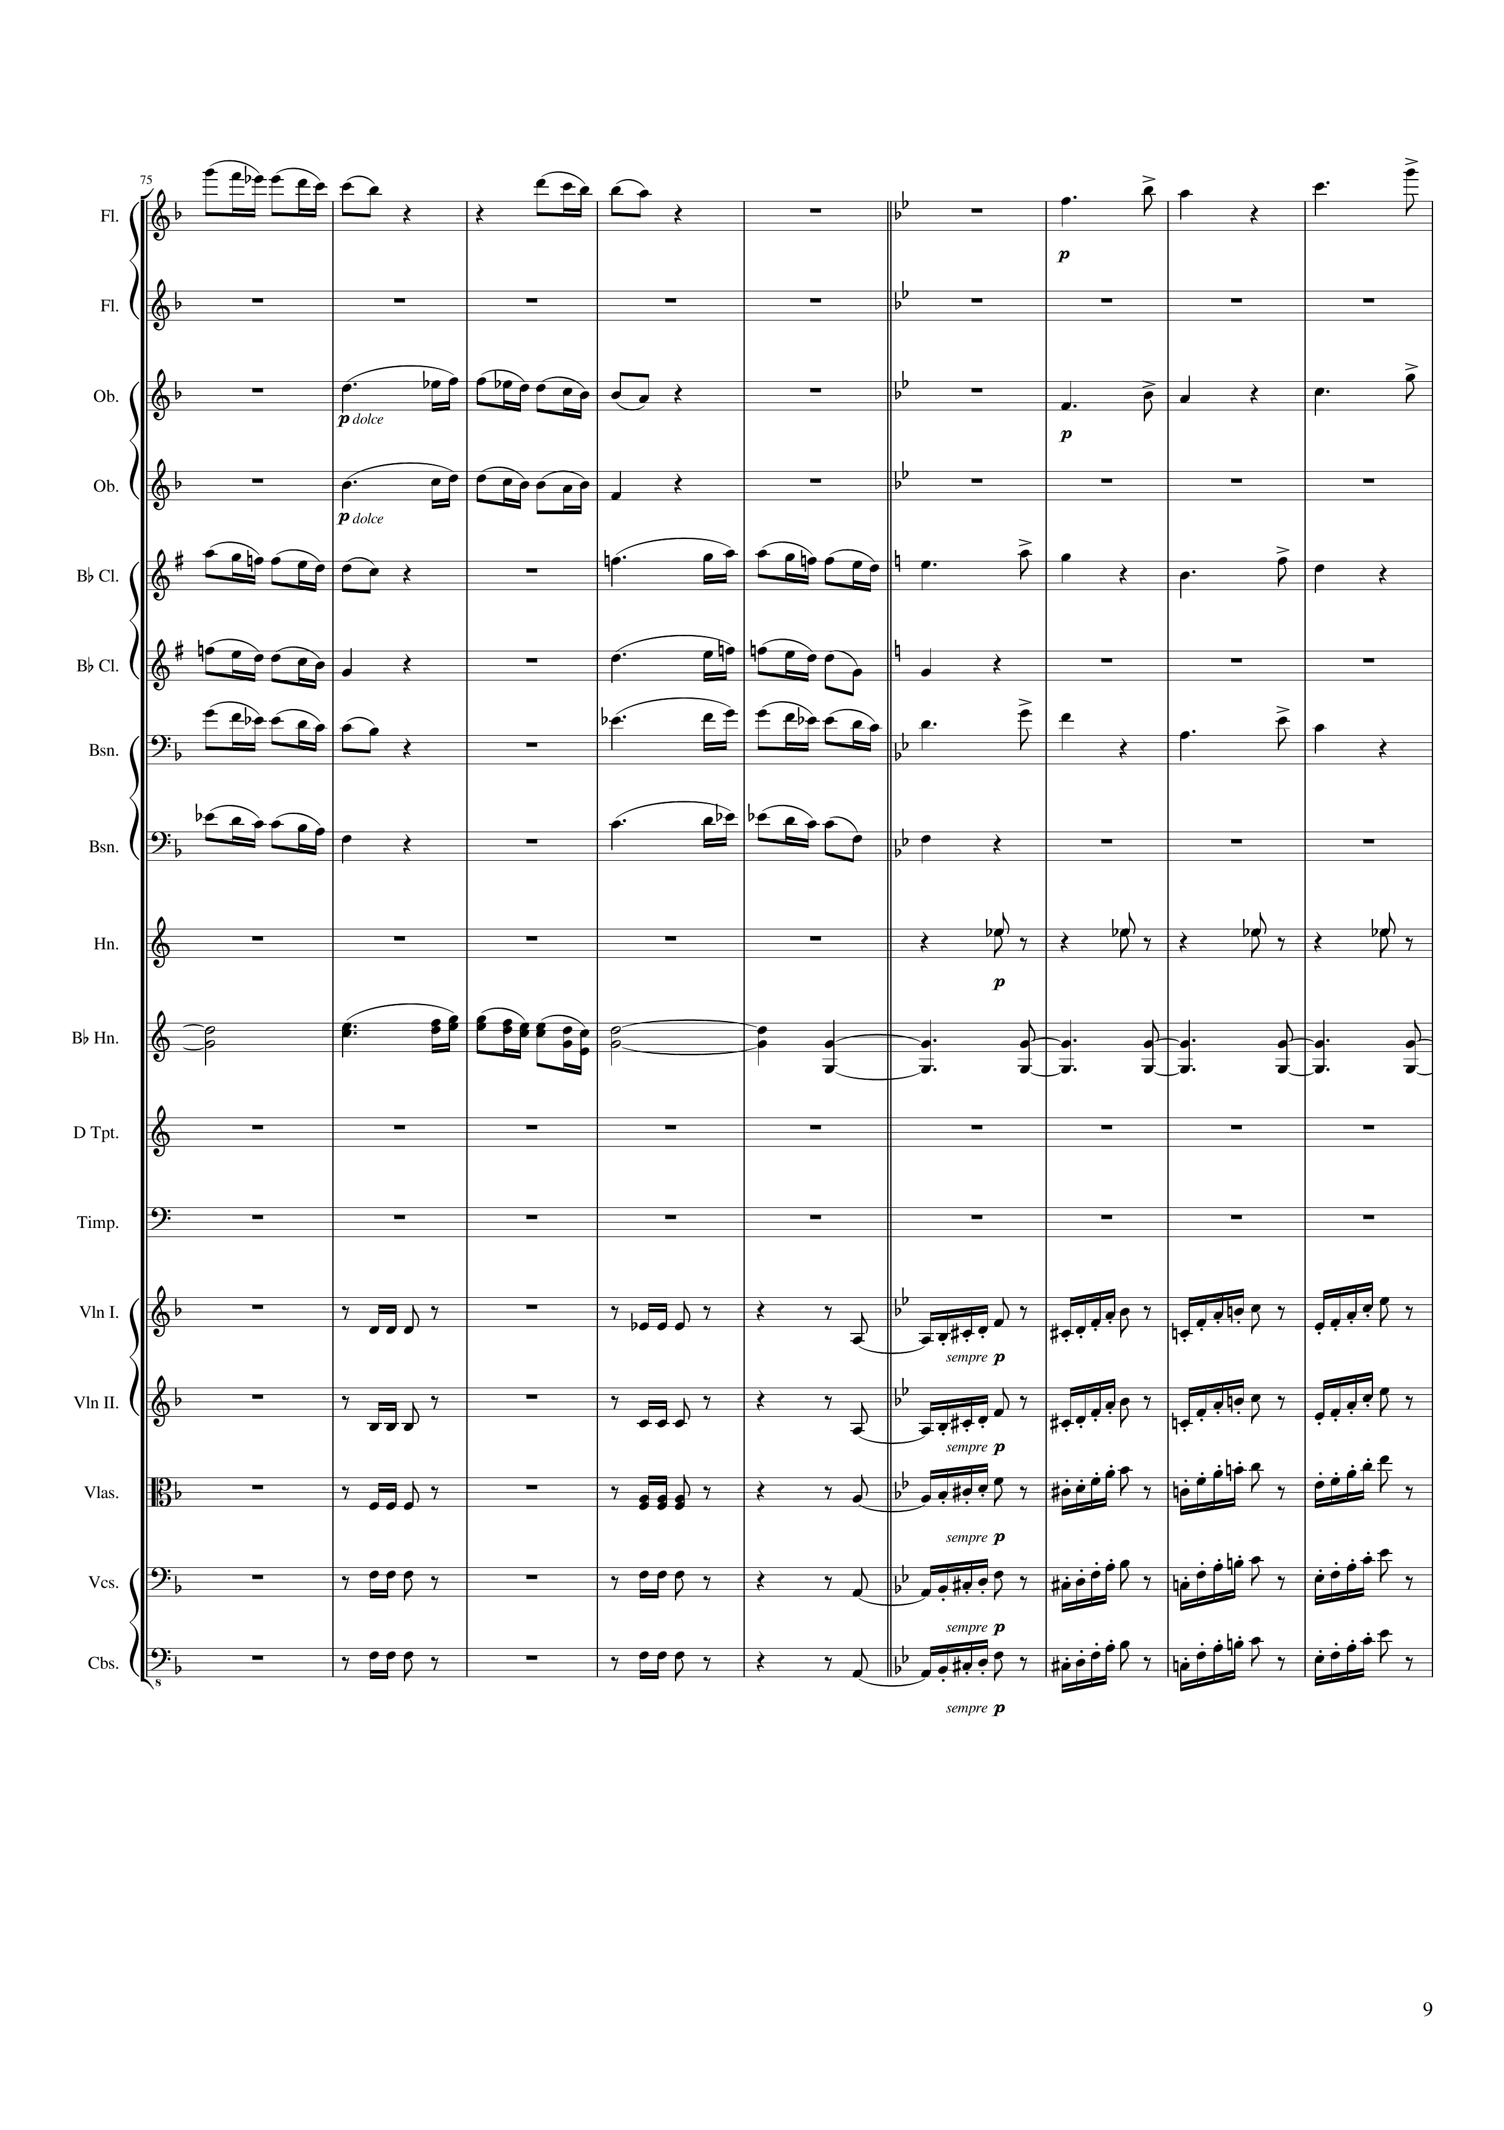
mel
mel
mel
mel
mel
mel
mel
mel
mel
mel
mel
rhythm
harm
mel
harm
rhythm
rhythm
rhythm
rhythm
rhythm
rhythm
rhythm
rhythm
rhythm
rhythm
148 | 150 | 152 | 154 | 156 | 158 | 160 | 162 | 164
Notes:
4:13

Slide 10
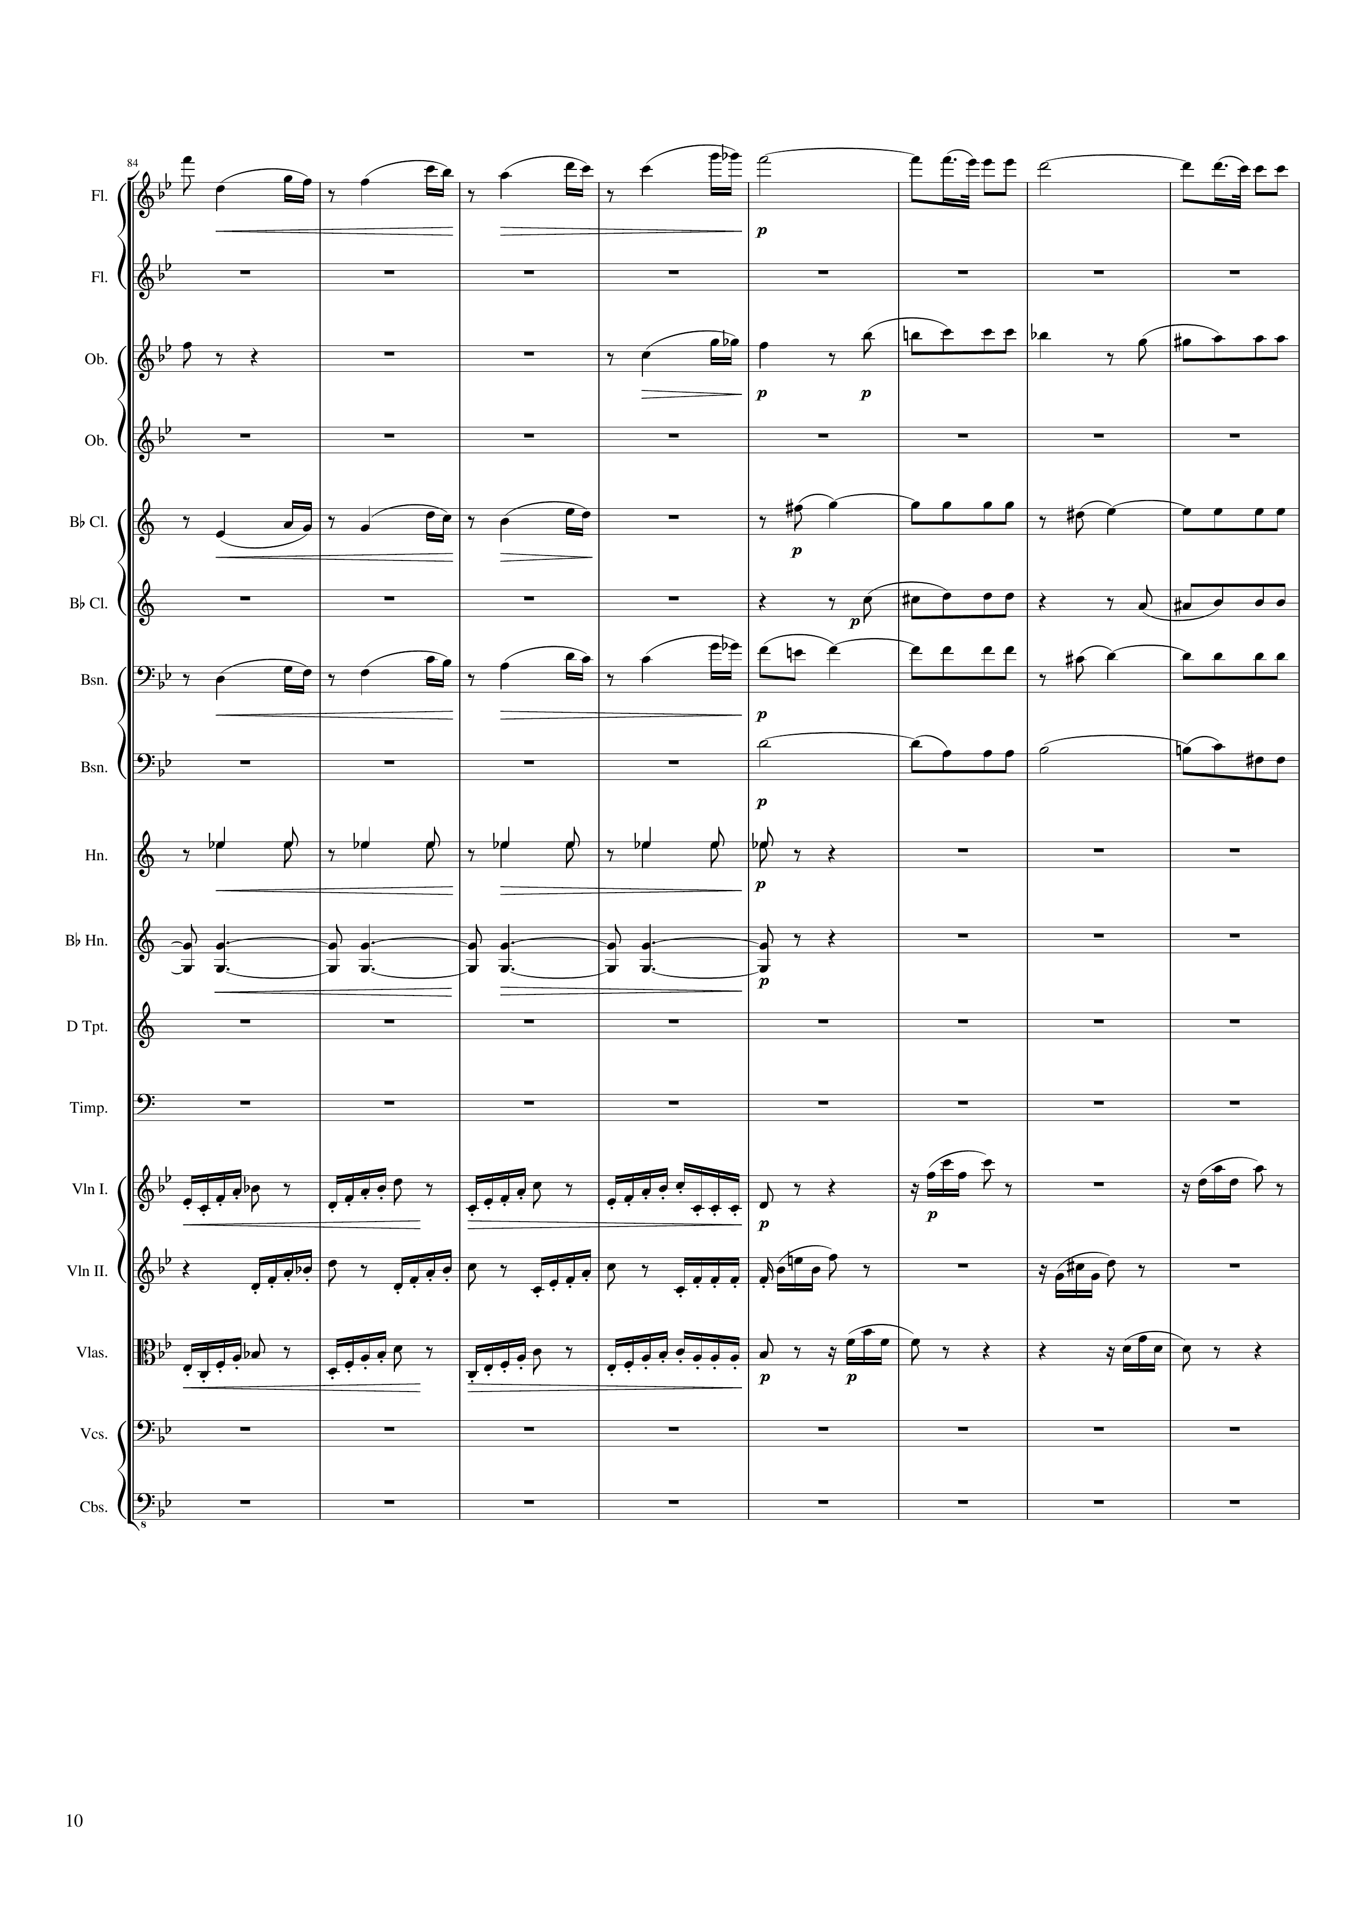
mel
mel
mel
mel+harm
mel
mel+harm
mel+harm
mel
mel+harm
mel+harm
rhythm
harm
rhythm
rhythm
rhythm
rhythm
rhythm
rhythm
166 | 168 | 170 | 172 | 174 | 176 | 178 | 180
Notes:
4:31

Slide 11
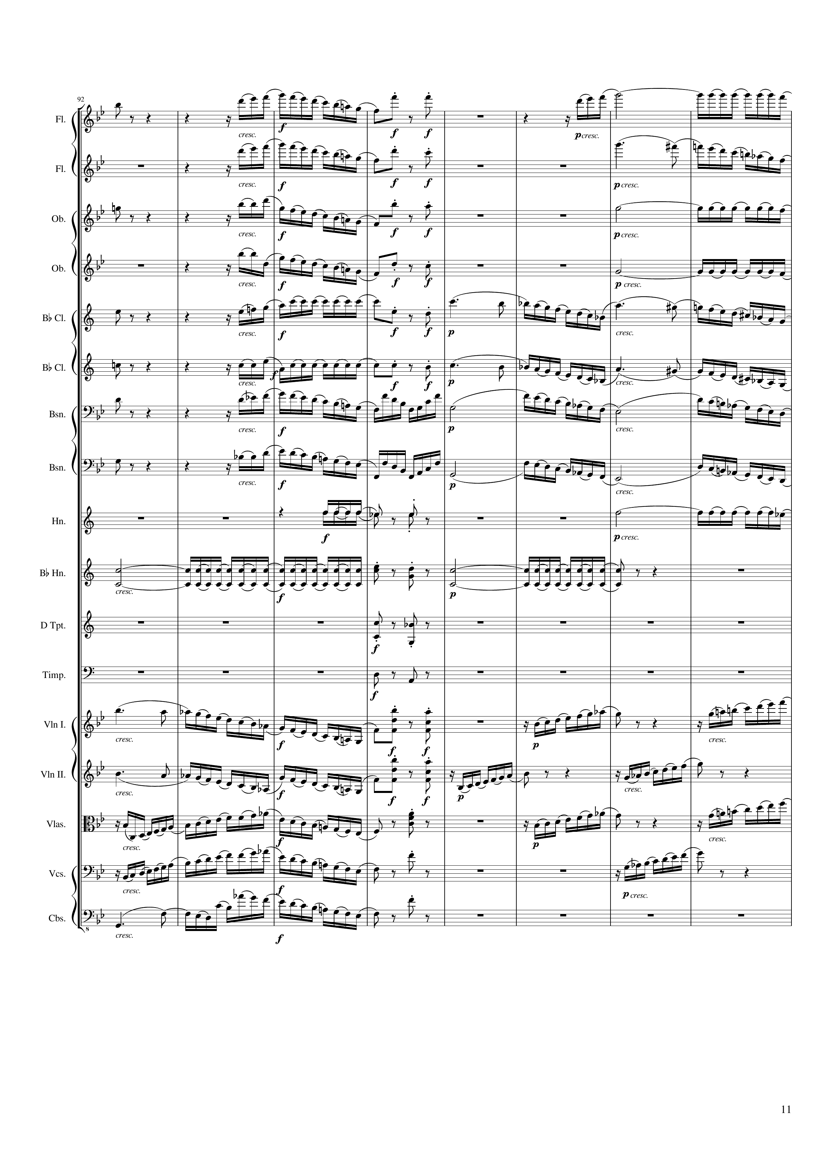
mel
mel
rhythm+harm
rhythm
mel
rhythm+harm
mel
mel+harm
mel
rhythm+harm
rhythm
mel
rhythm+harm
rhythm
mel+harm
mel
rhythm+harm
mel
mel+harm
mel
rhythm+harm
mel
mel+harm
mel
rhythm
mel
mel+harm
mel
rhythm
mel
rhythm
rhythm
rhythm
rhythm+harm
rhythm
rhythm+harm
rhythm+harm
mel
rhythm+harm
mel
mel
rhythm+harm
mel
mel
rhythm+harm
mel
mel
rhythm+harm
mel
mel
rhythm+harm
182 | 184 | 186 | 188 | 190 | 192 | 194 | 196
Notes:
4:46

Slide 12
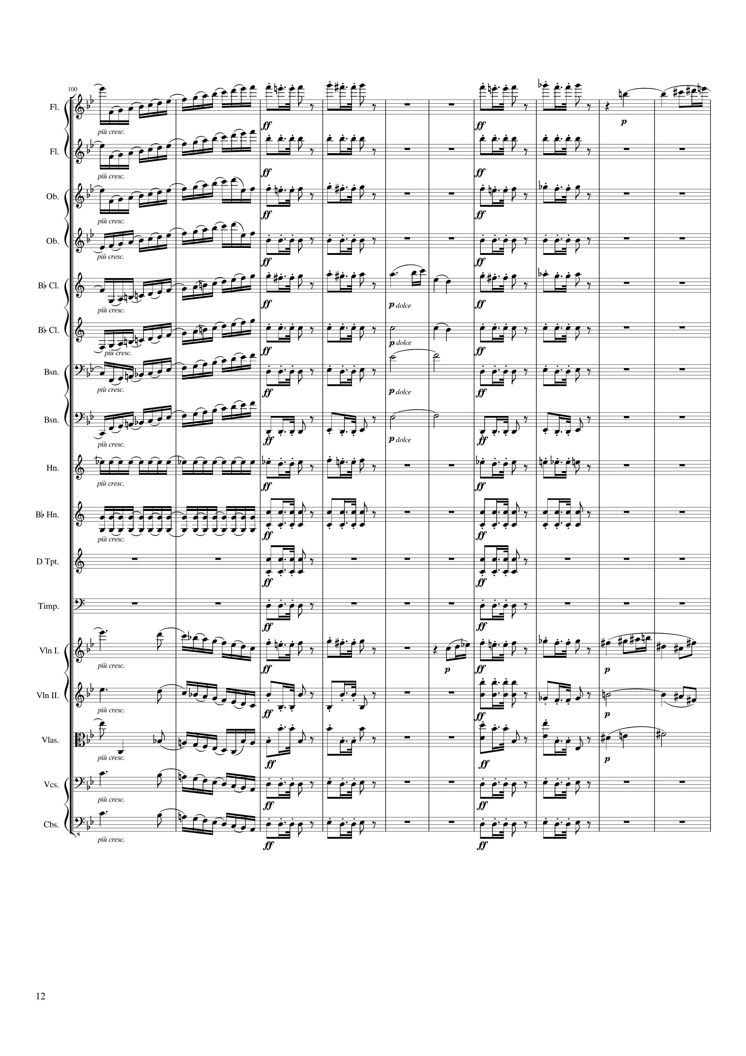
mel
mel
mel
mel
mel
rhythm+harm
rhythm+harm
mel
mel
mel
mel
rhythm+harm
rhythm+harm
mel
mel
mel
mel
mel
rhythm+harm
harm
rhythm+harm
mel
rhythm+harm
harm
rhythm+harm
mel
rhythm+harm
harm
rhythm+harm
rhythm
mel
mel
rhythm
rhythm+harm
rhythm+harm
rhythm+harm
rhythm+harm
rhythm+harm
rhythm+harm
mel
mel
mel
mel
mel
rhythm+harm
rhythm+harm
harm
mel
rhythm+harm
rhythm+harm
harm
mel
rhythm+harm
rhythm+harm
mel
rhythm+harm
rhythm+harm
198 | 200 | 202 | 204 | 206 | 208 | 210 | 212 | 214 | 216
Notes:
5:01

Slide 13
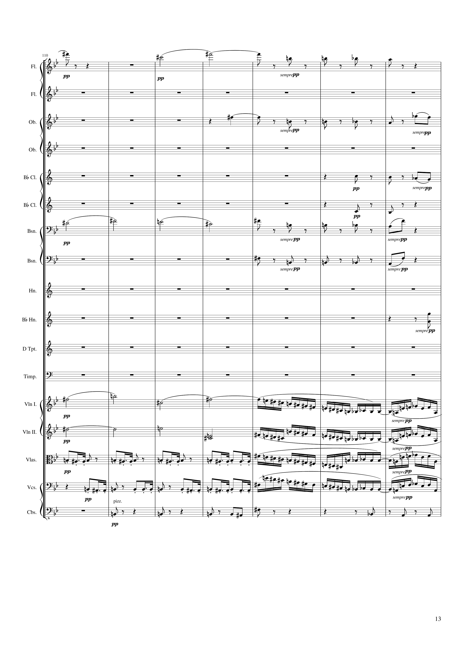
mel
rhythm+harm
rhythm+harm
mel
rhythm+harm
mel
rhythm+harm
harm
rhythm+harm
mel
rhythm+harm
mel
rhythm+harm
mel
mel+rhythm
harm
mel+rhythm
rhythm
mel+rhythm
rhythm
mel+rhythm
rhythm
rhythm+harm
218 | 220 | 222 | 224 | 226 | 228 | 230
Notes:
5:21

Slide 14
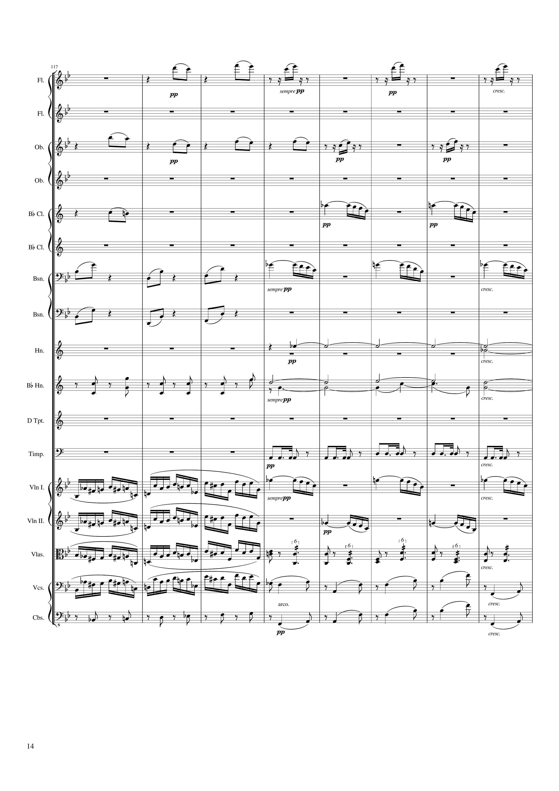
mel
mel
mel
mel
mel
mel
mel
harm
rhythm+harm
harm
rhythm
mel+rhythm
mel
mel+rhythm
mel
mel+rhythm
rhythm+harm
mel+rhythm
rhythm+harm
rhythm+harm
rhythm+harm
232 | 234 | 236 | 238 | 240 | 242 | 244 | 246
Notes:
5:35

Slide 15
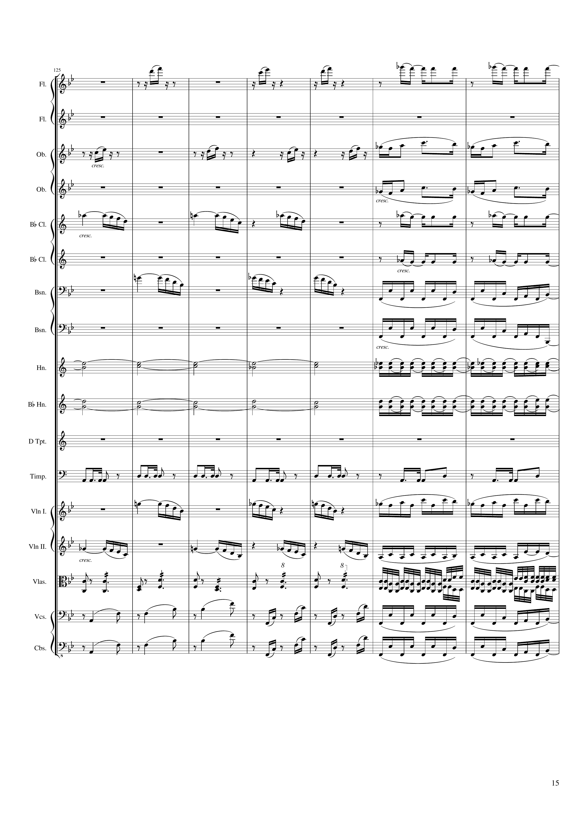
mel
rhythm
mel
mel
mel
mel
rhythm
rhythm
mel
rhythm
rhythm
harm
rhythm
harm
rhythm
rhythm
rhythm
mel
mel+rhythm
mel
rhythm
rhythm+harm
rhythm
rhythm+harm
rhythm
rhythm+harm
rhythm
248 | 250 | 252 | 254 | 256 | 258 | 260
Notes:
5:50

Slide 16
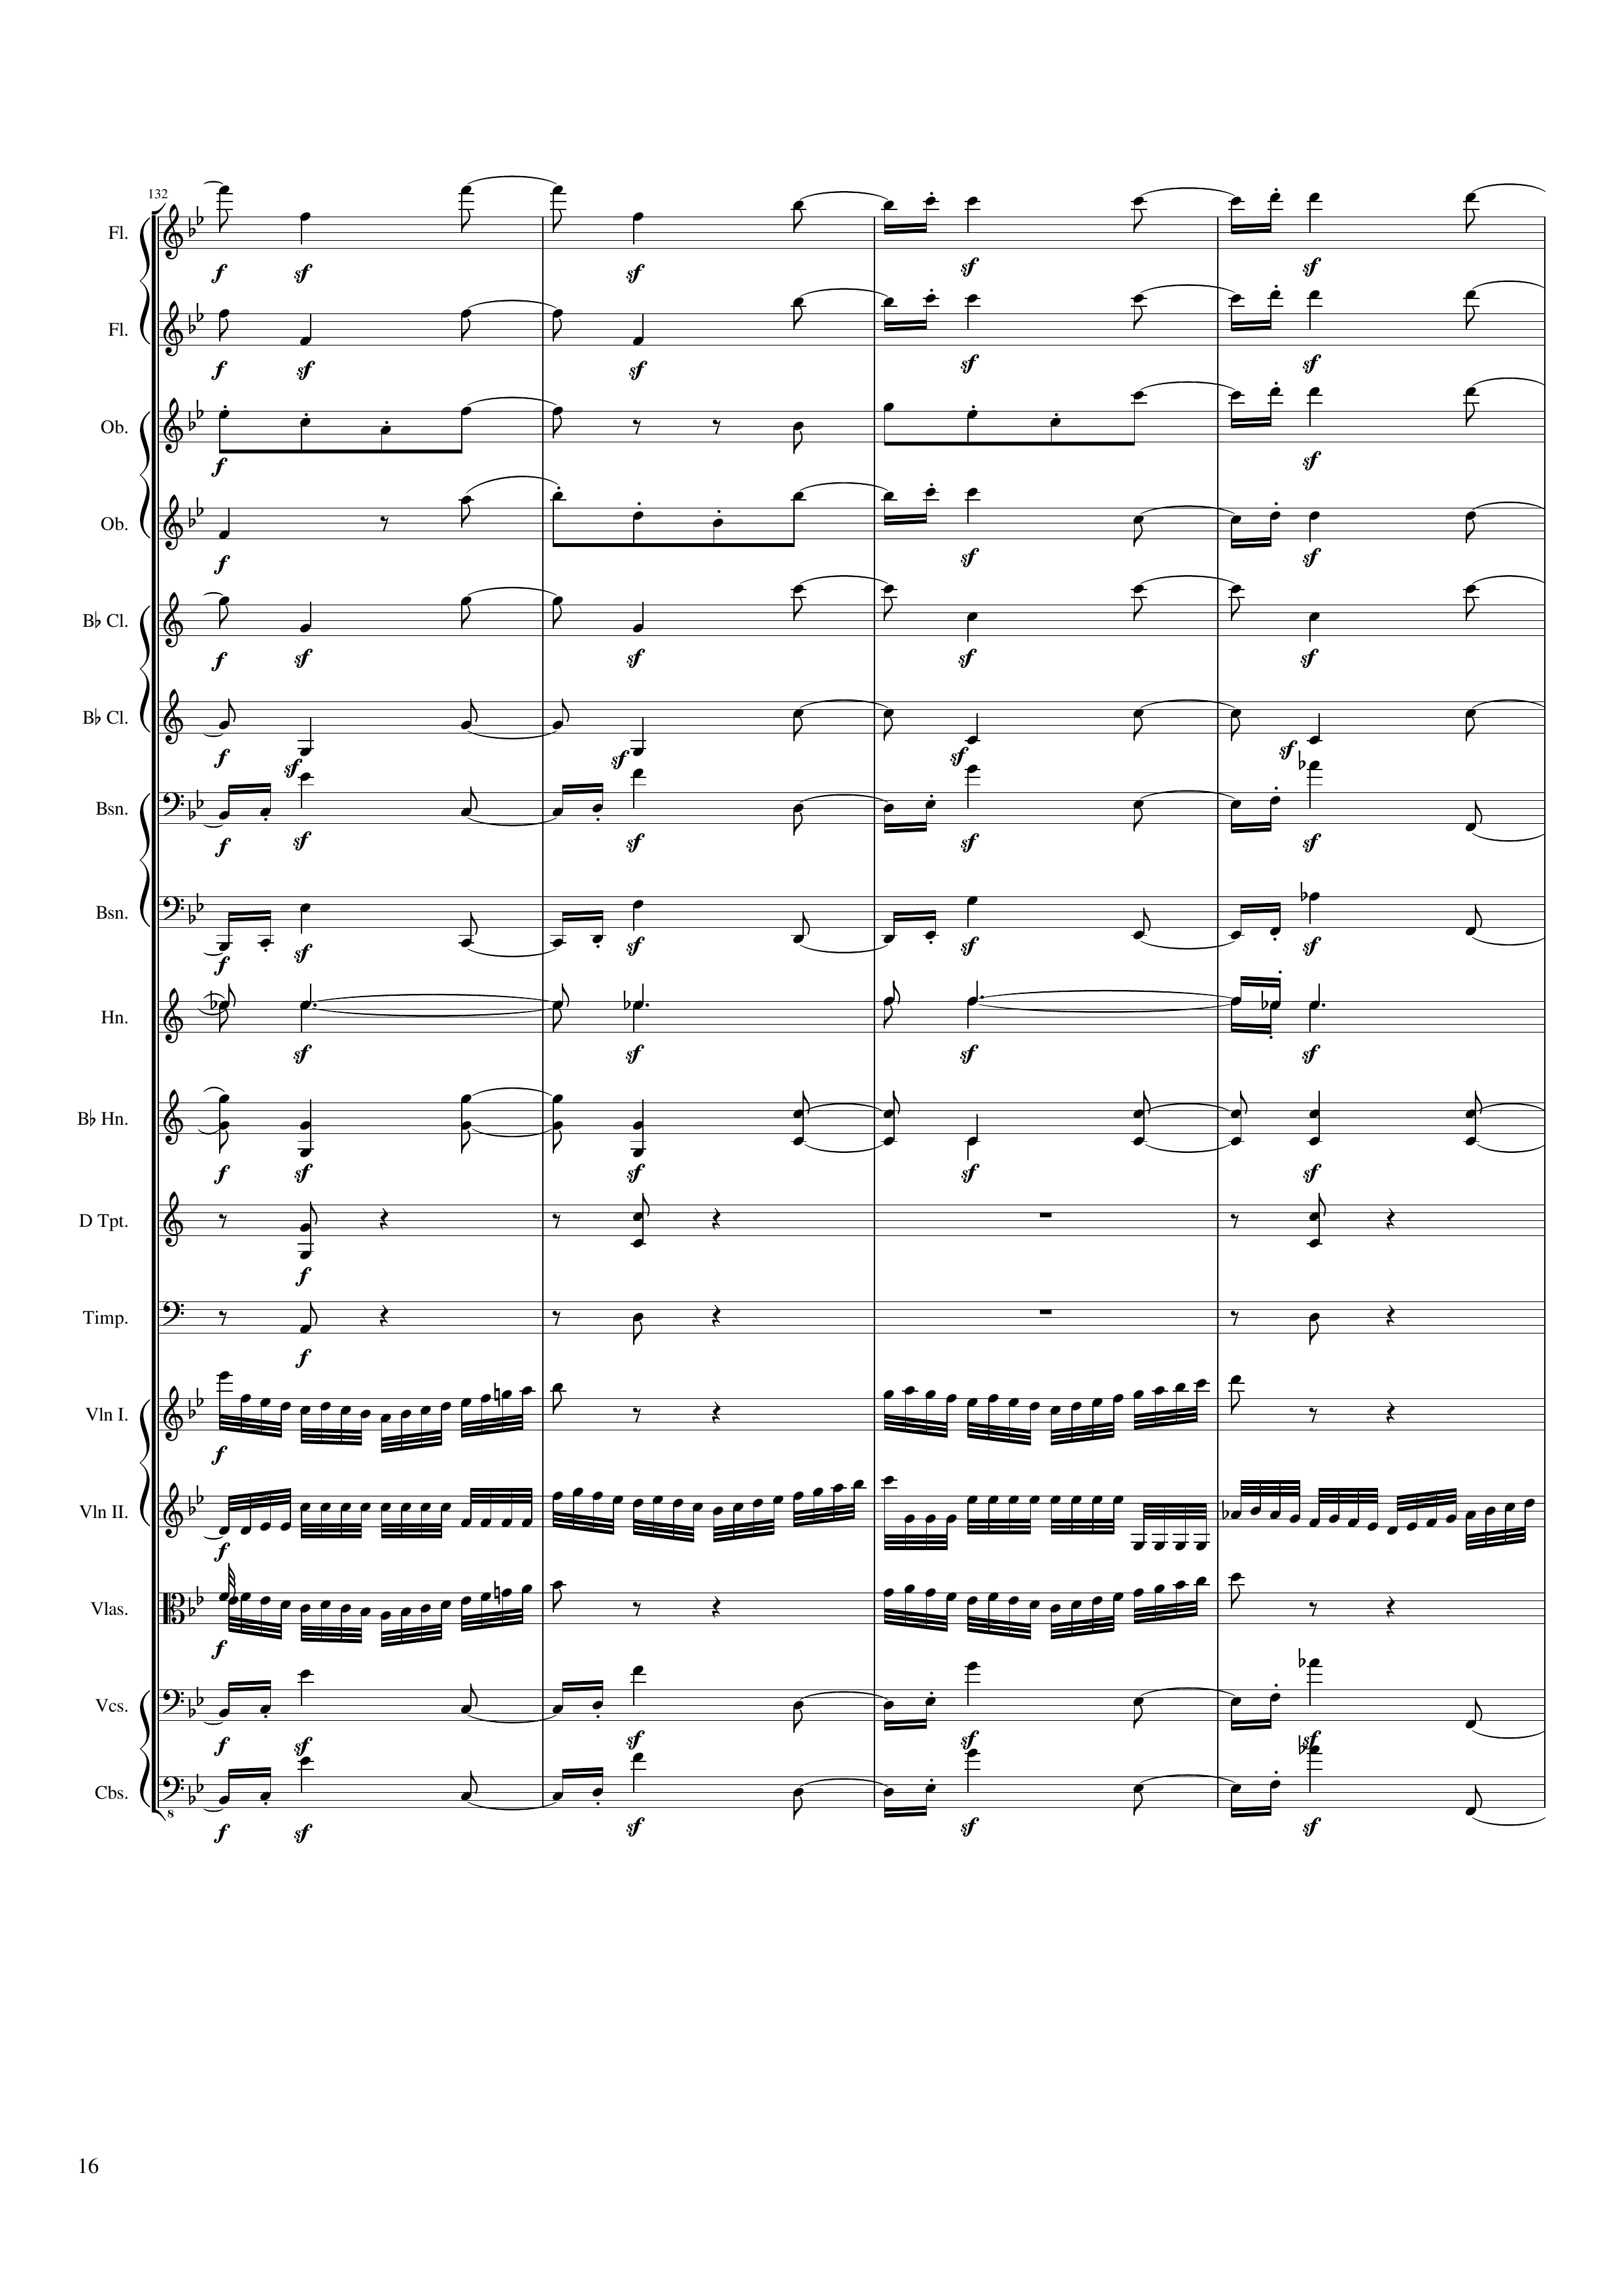
rhythm+harm
rhythm+harm
rhythm+harm
rhythm+harm
rhythm+harm
rhythm+harm
rhythm+harm
rhythm+harm
rhythm+harm
rhythm+harm
rhythm+harm
rhythm+harm
mel+rhythm
mel+rhythm
mel+rhythm
rhythm+harm
rhythm+harm
262 | 264 | 266 | 268
Notes:
6:03

Slide 17
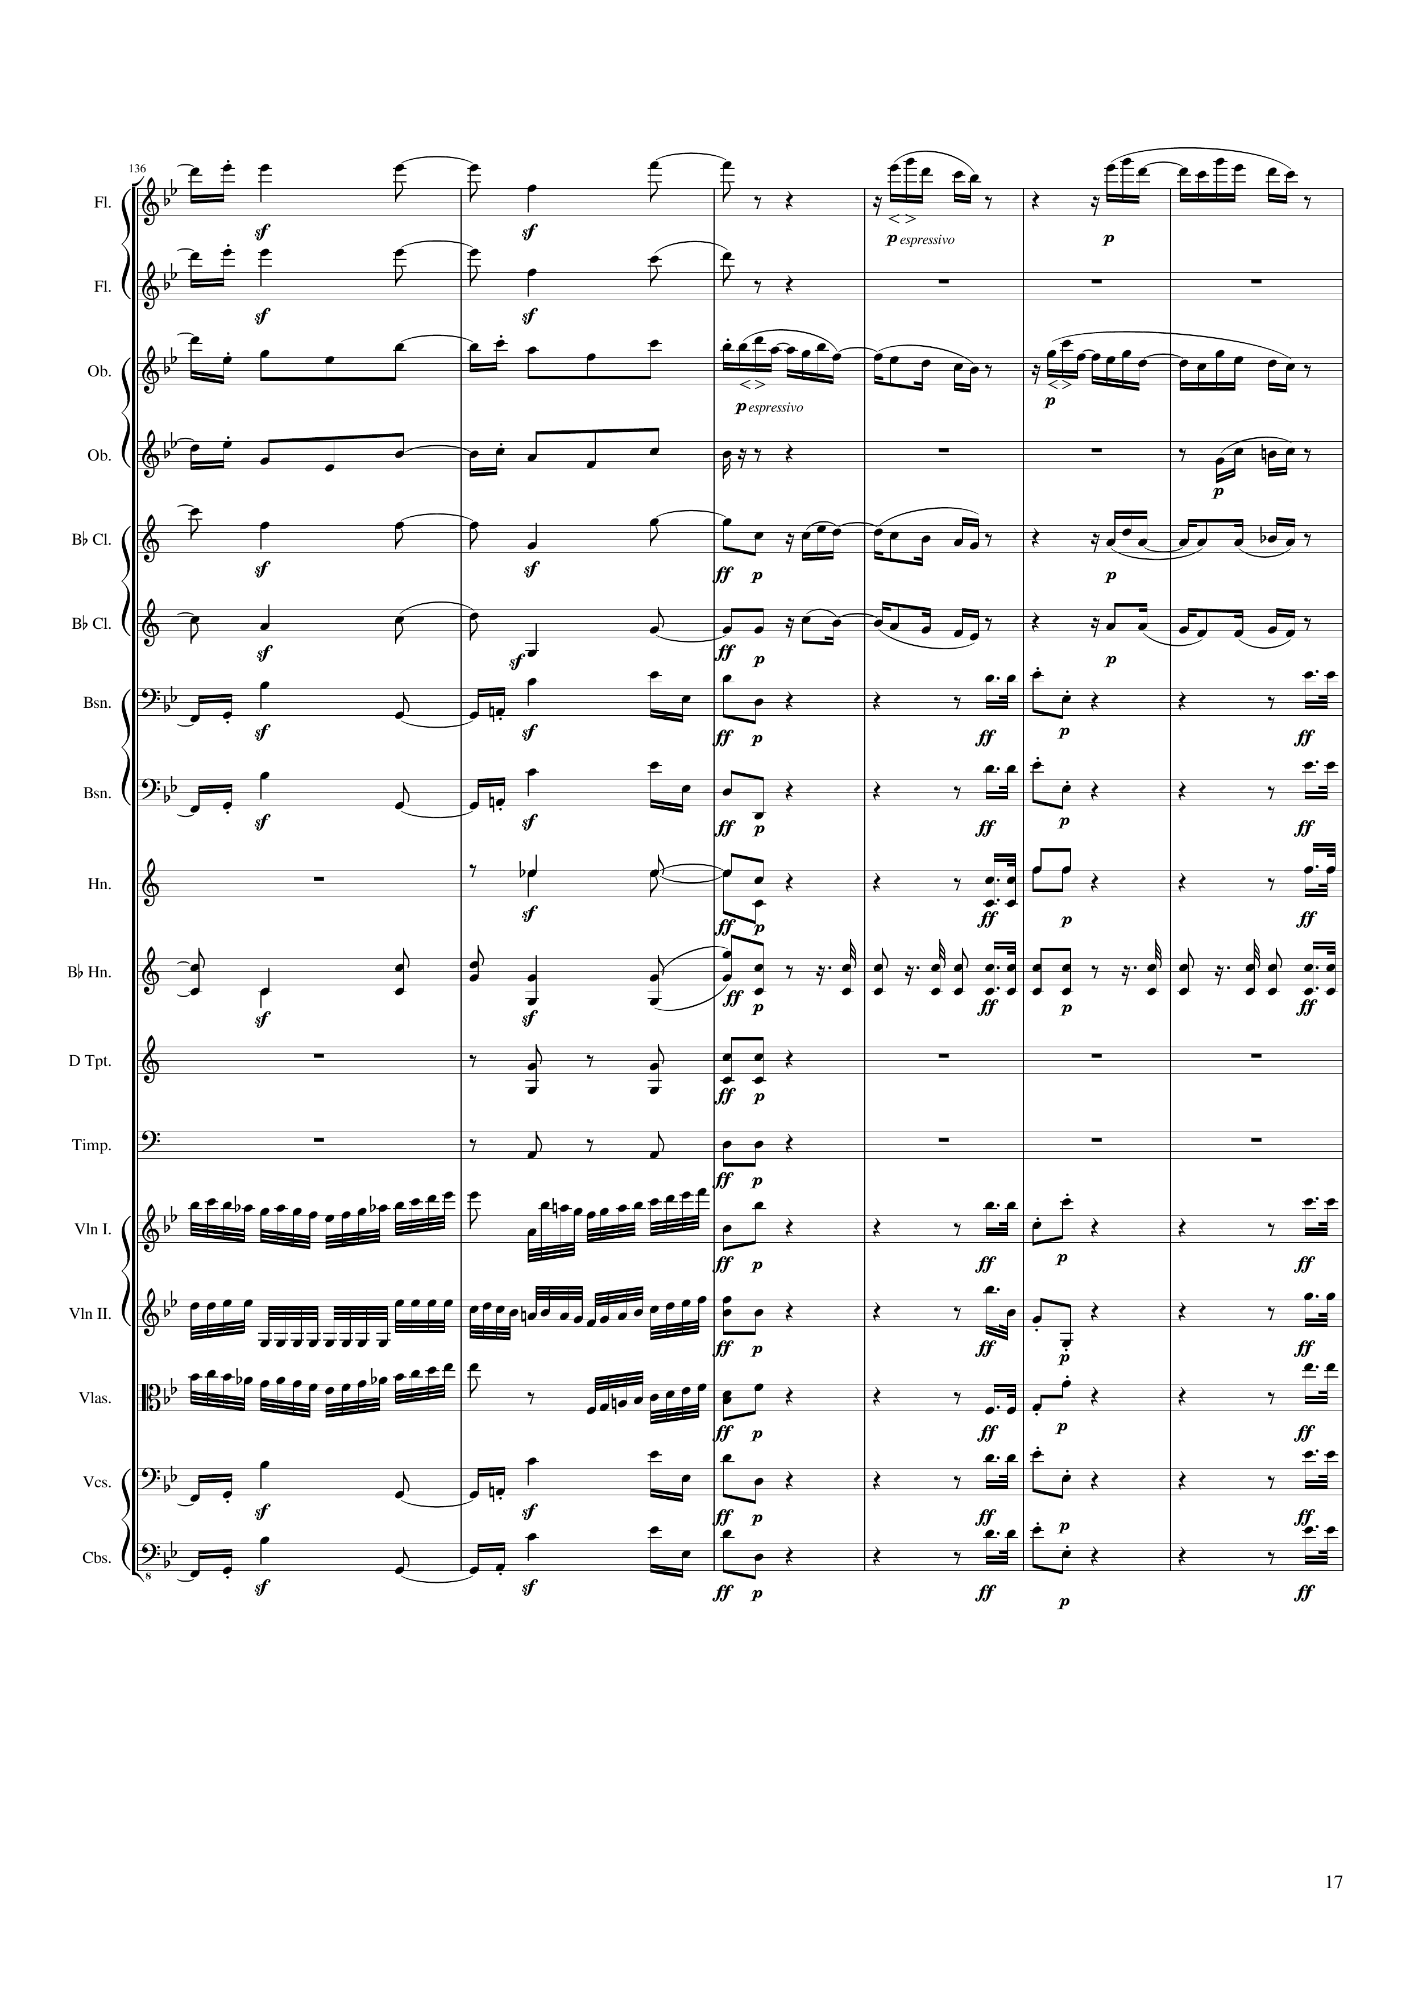
rhythm+harm
mel
rhythm+harm
rhythm+harm
mel
rhythm+harm
mel+harm
rhythm+harm
mel
rhythm+harm
mel
rhythm+harm
rhythm
rhythm+harm
rhythm
rhythm+harm
rhythm
rhythm+harm
rhythm
rhythm+harm
rhythm+harm
mel+rhythm
rhythm
mel+rhythm
rhythm
mel+rhythm
rhythm
rhythm+harm
rhythm
rhythm+harm
rhythm
270 | 272 | 274 | 276 | 278 | 280
262 | 264 | 266 | 268
Notes:
6:10

Slide 18
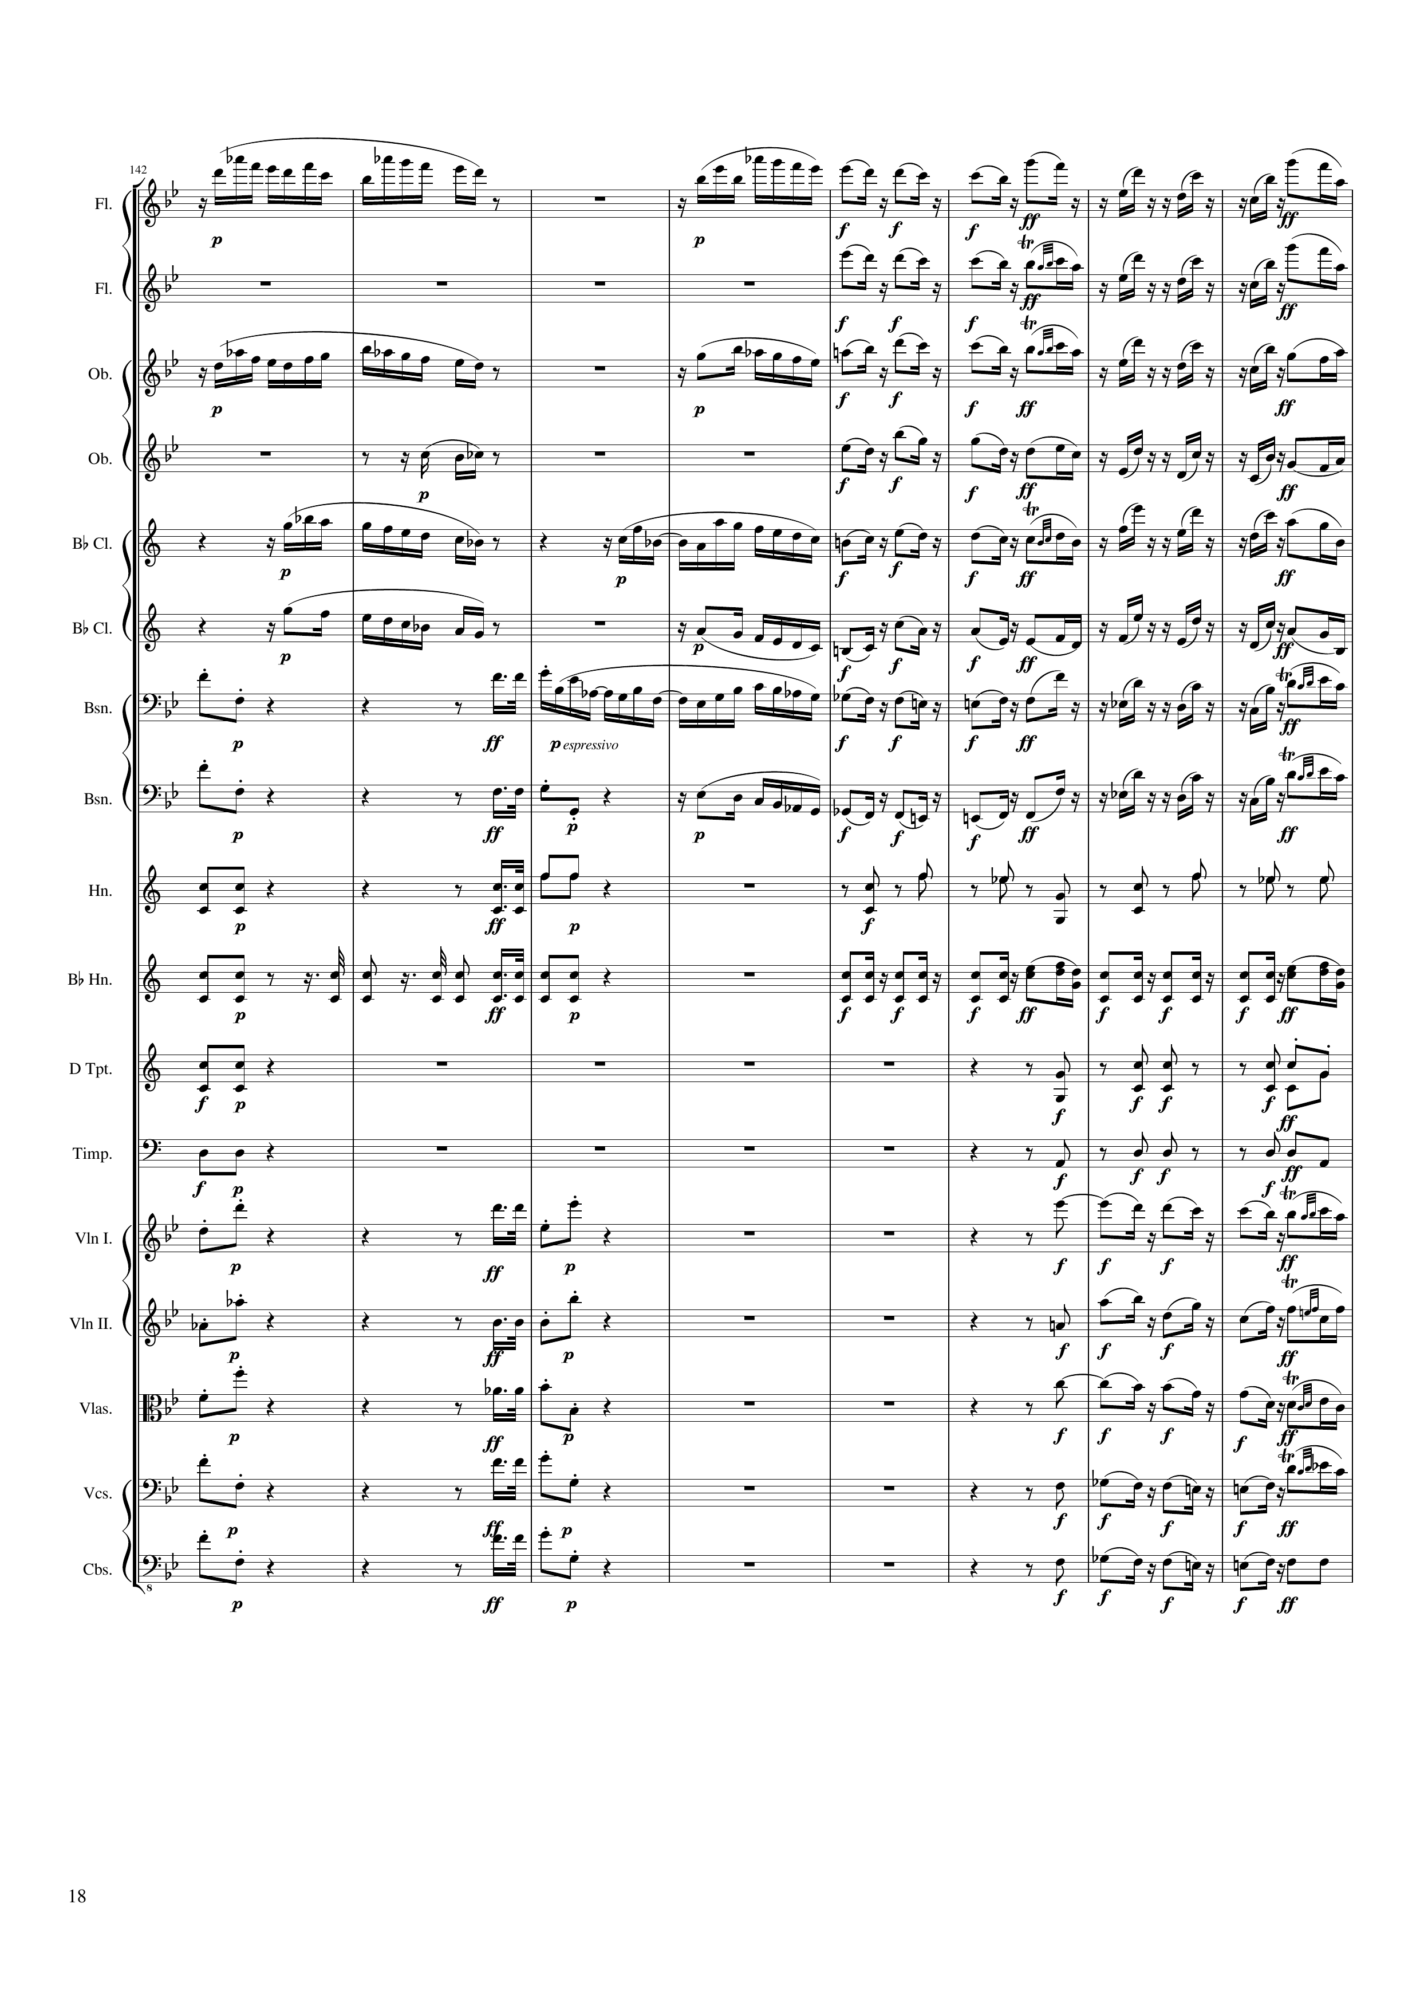
mel
mel+harm
rhythm+harm
mel
rhythm+harm
mel
mel+harm
rhythm+harm
mel+harm
mel+harm
rhythm+harm
mel
mel+harm
rhythm+harm
mel
mel+harm
rhythm+harm
rhythm
mel
mel+harm
rhythm+harm
rhythm
mel
mel+harm
rhythm+harm
rhythm
rhythm+harm
rhythm
rhythm
rhythm
rhythm
rhythm
rhythm
rhythm
mel
rhythm
mel+harm
rhythm
mel+harm
rhythm
mel+harm
rhythm
mel+harm
282 | 284 | 286 | 288 | 290 | 292 | 294 | 296
Notes:
6:22
又嘉check

Slide 19
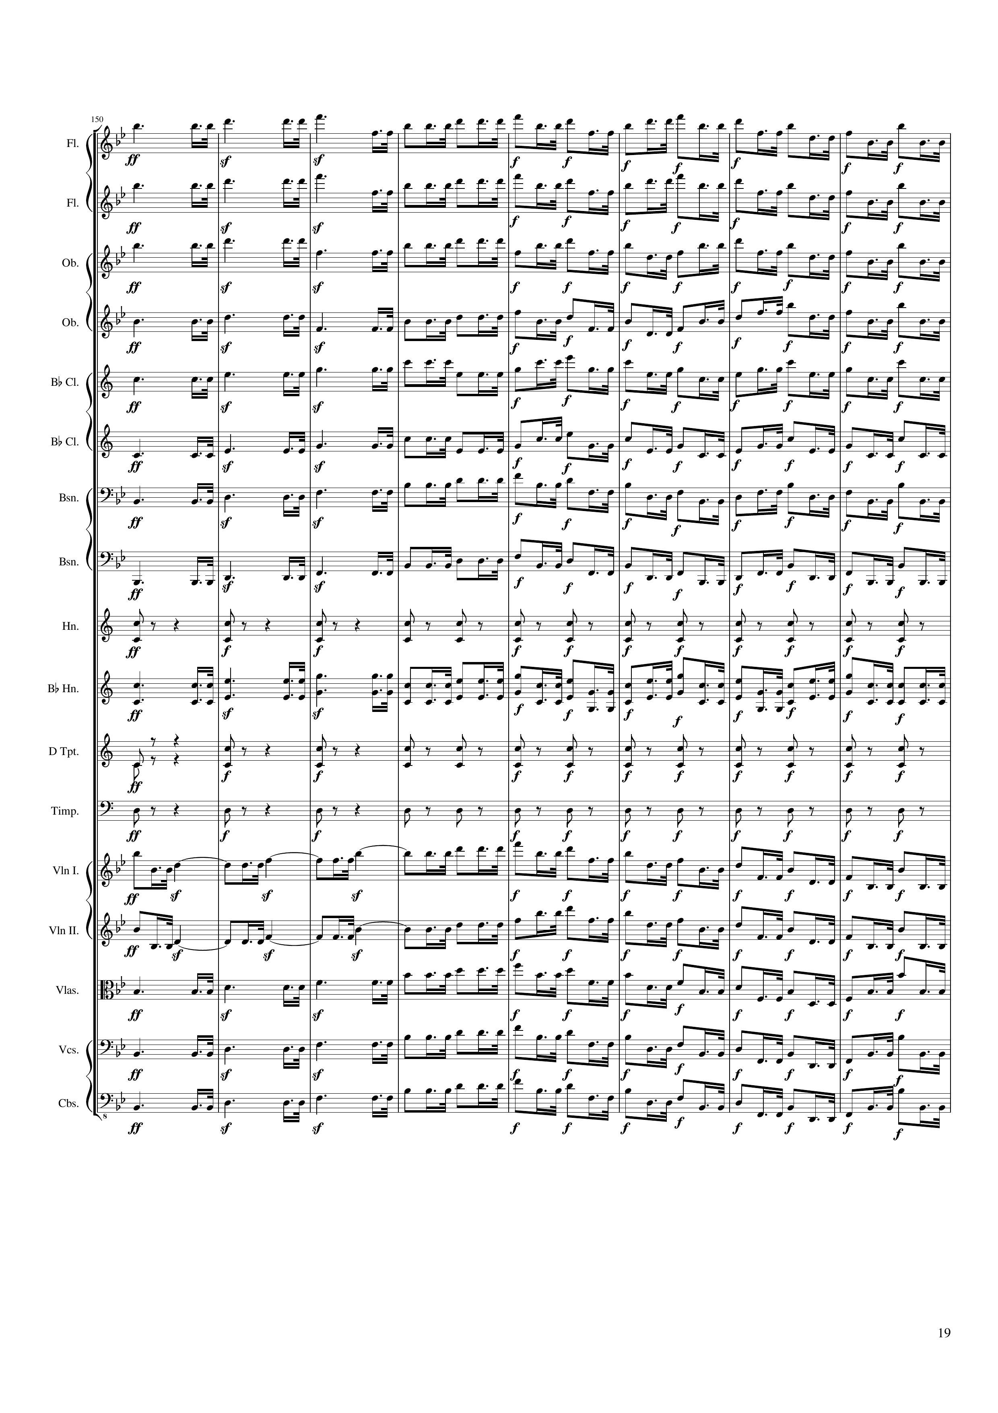
mel
mel
mel
mel
mel
mel
mel
mel
rhythm
mel
rhythm
rhythm
mel
mel
mel
mel
mel
298 | 300 | 302 | 304 | 306 | 308 | 310 | 312
Notes:
6:37

Slide 20
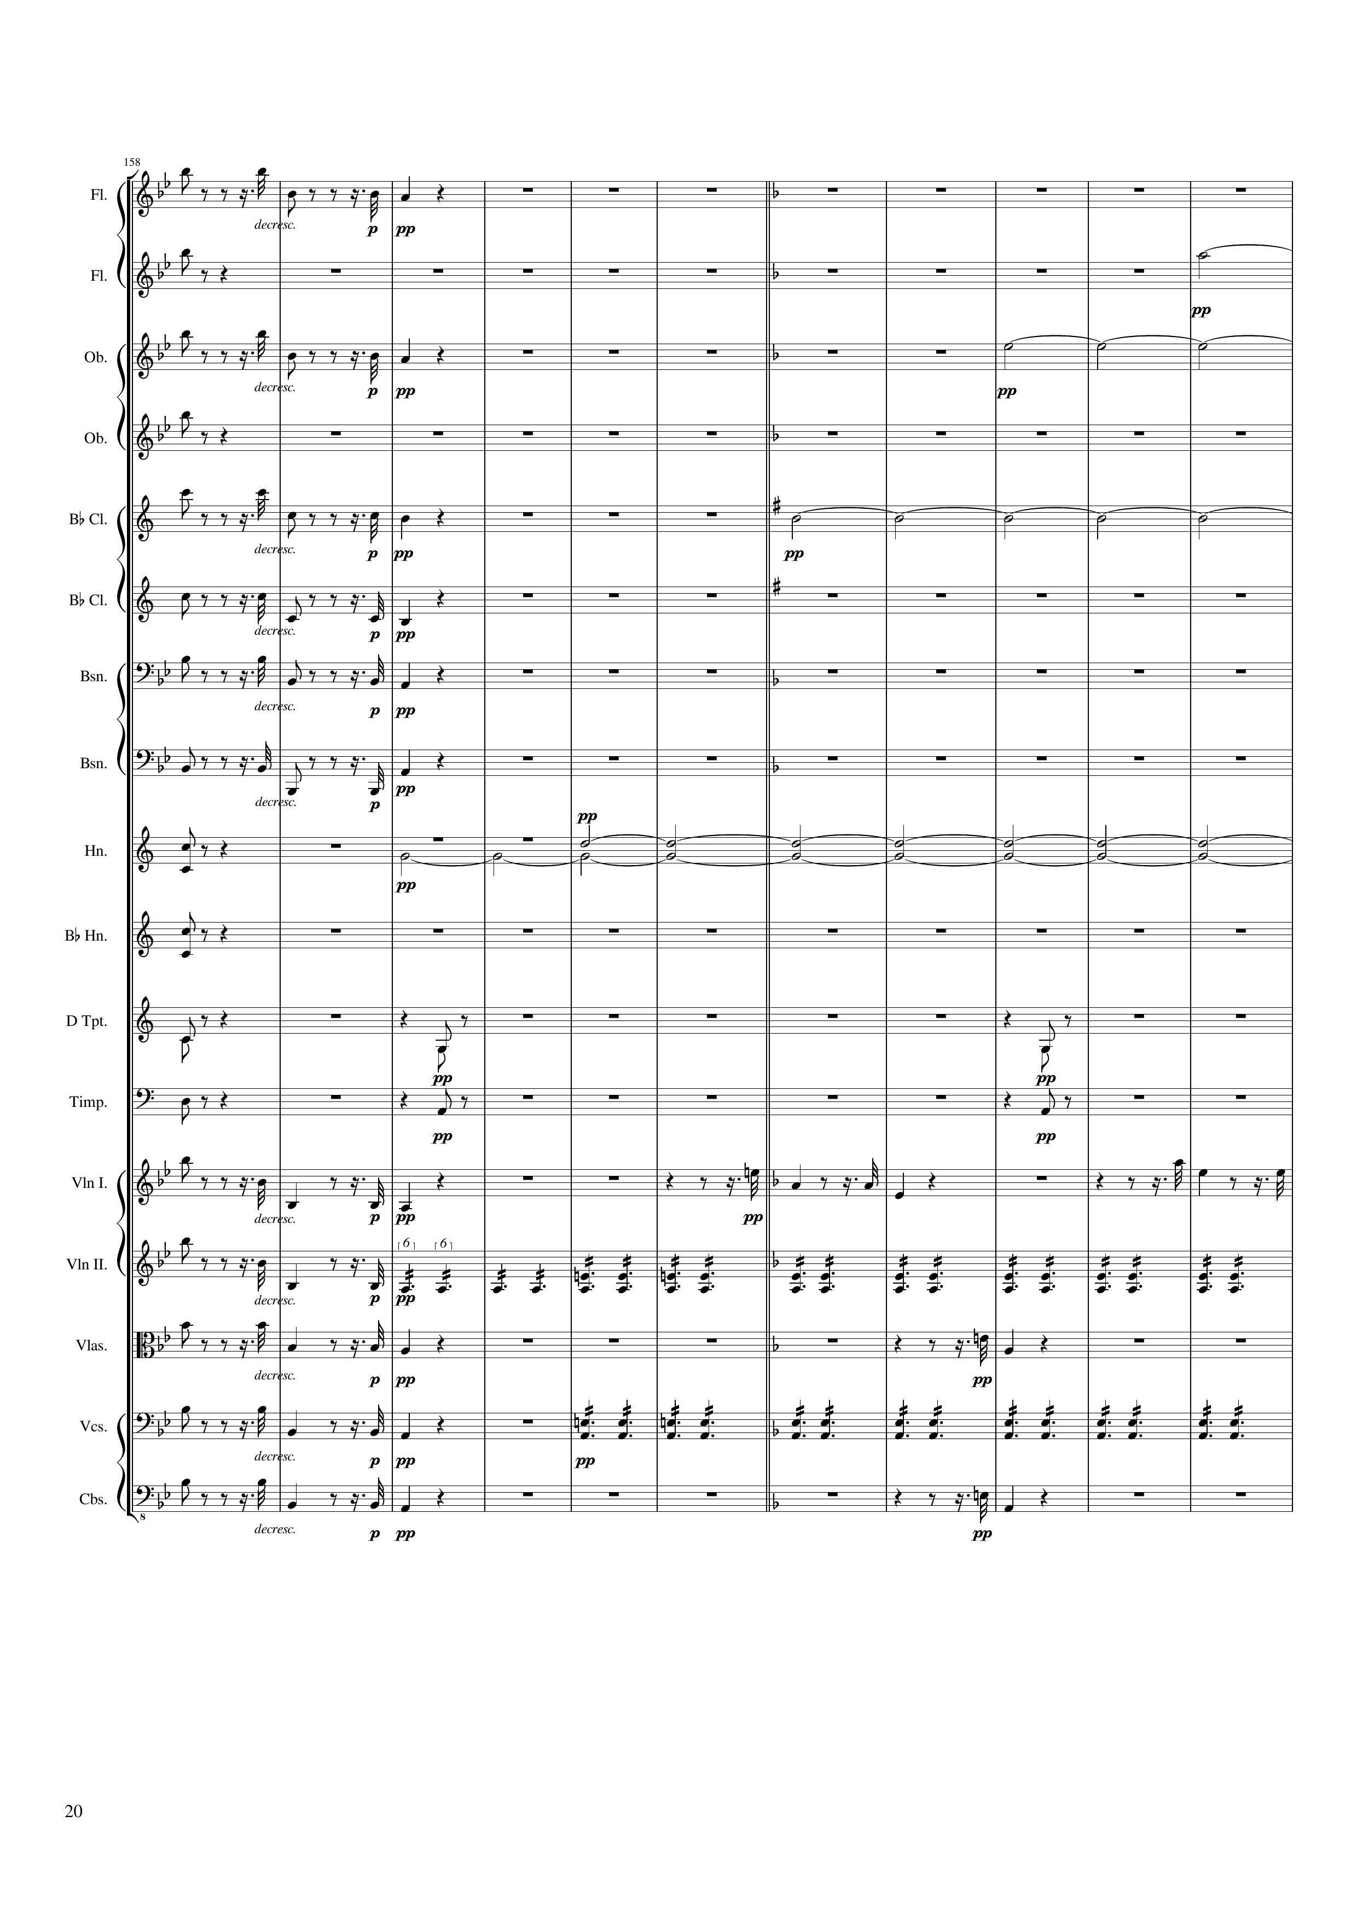
mel
mel
harm
mel
harm
mel
mel
harm
mel
mel
mel
rhythm
harm
mel
rhythm
rhythm
rhythm
rhythm
mel
mel
mel
mel
rhythm
mel
mel
mel
rhythm
mel
mel
314 | 316 | 318 | 320 | 322 | 324 | 326 | 328 | 330 | 332 | 334
Notes:
6:52

Slide 21
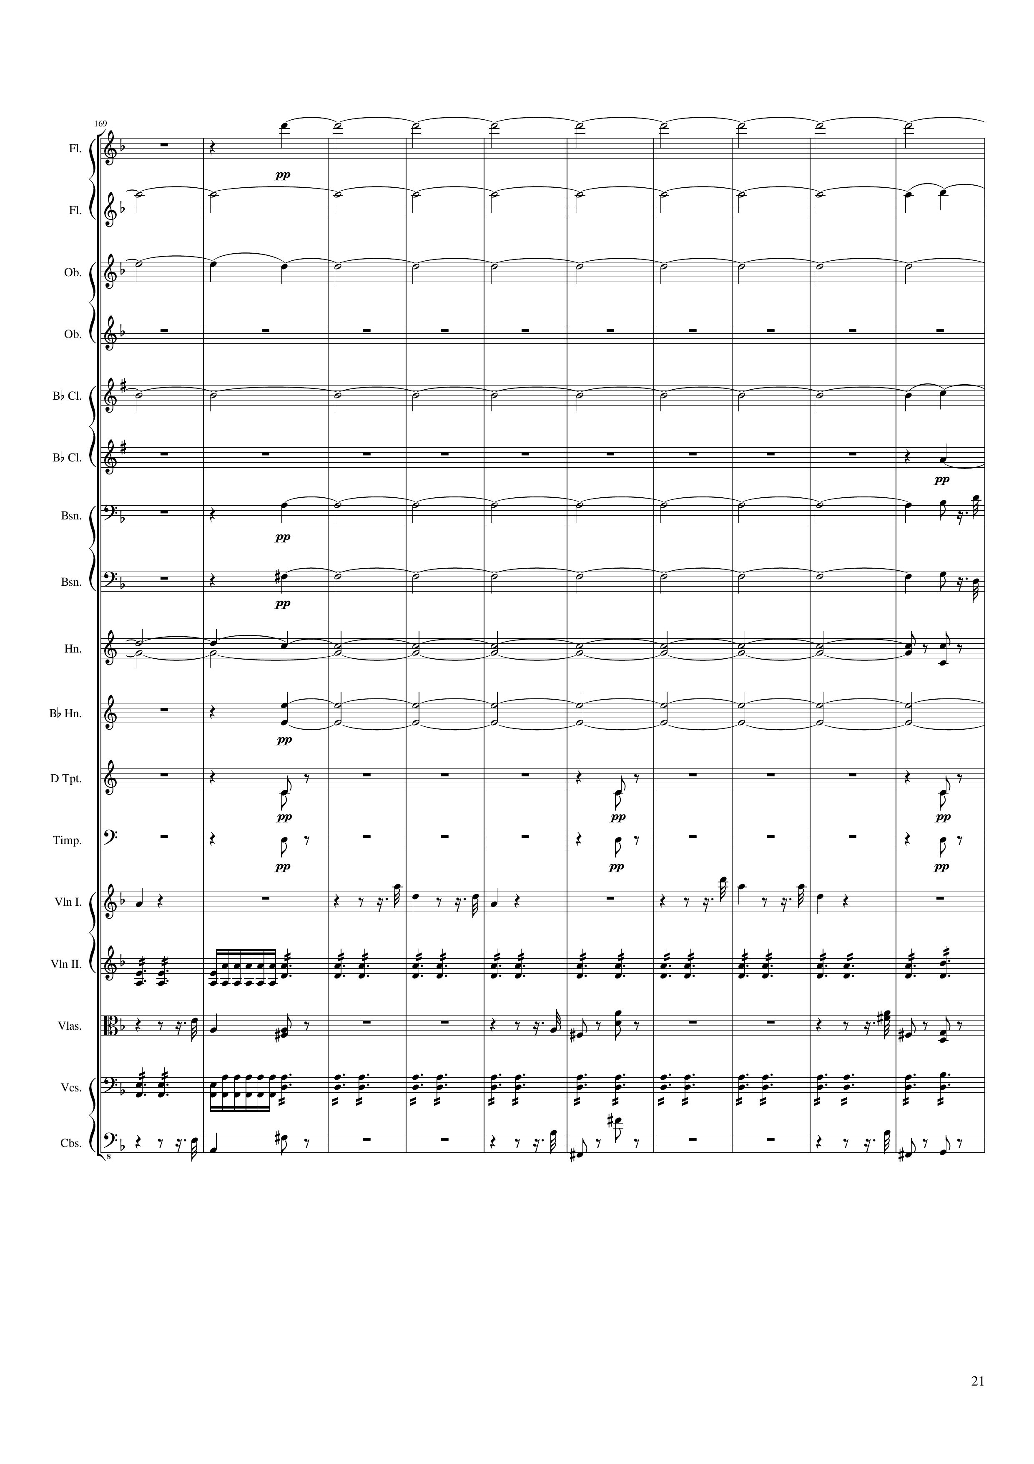
harm
harm
harm
harm
harm
harm
mel
harm
harm
rhythm
harm
rhythm
rhythm
rhythm
rhythm
rhythm
rhythm
mel
mel
mel
rhythm
mel
mel
mel
rhythm
mel
mel
mel
336 | 338 | 340 | 342 | 344 | 346 | 348 | 350 | 352 | 354
Notes:
7:14

Slide 22
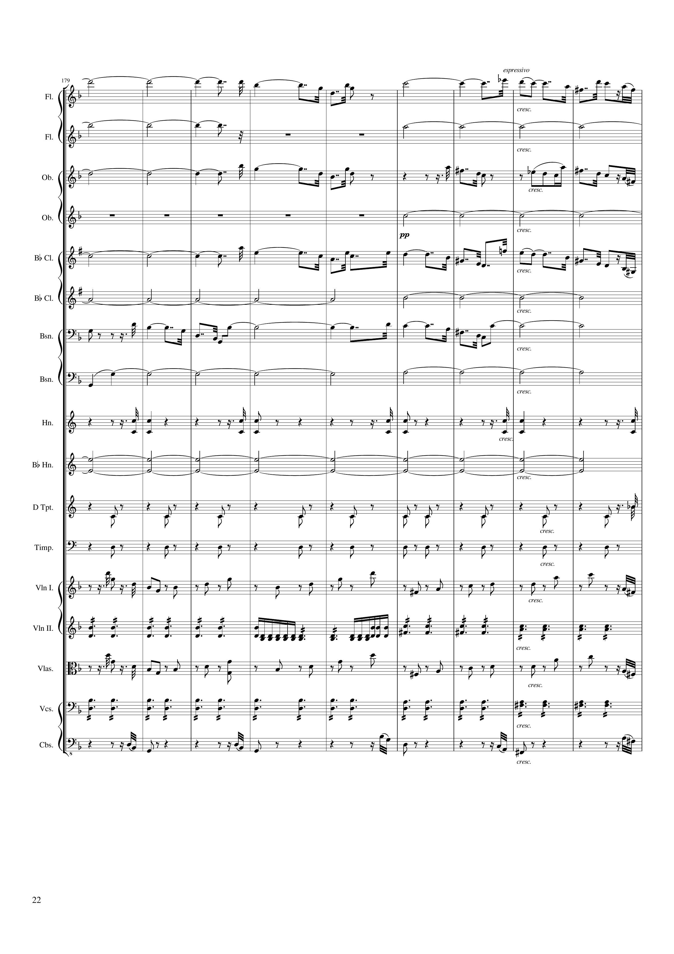
harm
mel
harm
harm
harm
mel
harm
harm
mel
harm
mel
mel+harm
harm
rhythm
harm
rhythm
rhythm
mel
rhythm
mel
rhythm
rhythm
356 | 358 | 360 | 362 | 364 | 366 | 368 | 370 | 372
Notes:
7:34

Slide 23
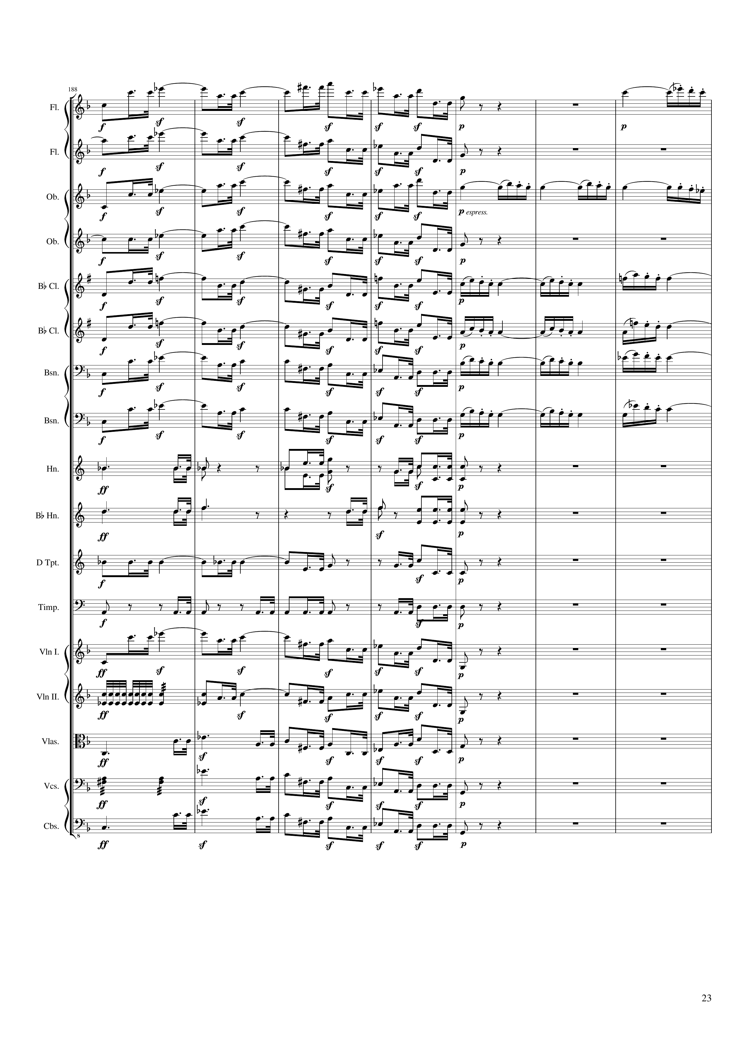
mel
mel
mel
mel
mel
mel
mel
mel+harm
mel
mel+harm
mel
mel+harm
mel
mel+harm
rhythm
rhythm
rhythm
rhythm
mel
rhythm
mel
mel
rhythm
mel
mel
374 | 376 | 378 | 380 | 382 | 384 | 386
Notes:
7:51

Slide 24
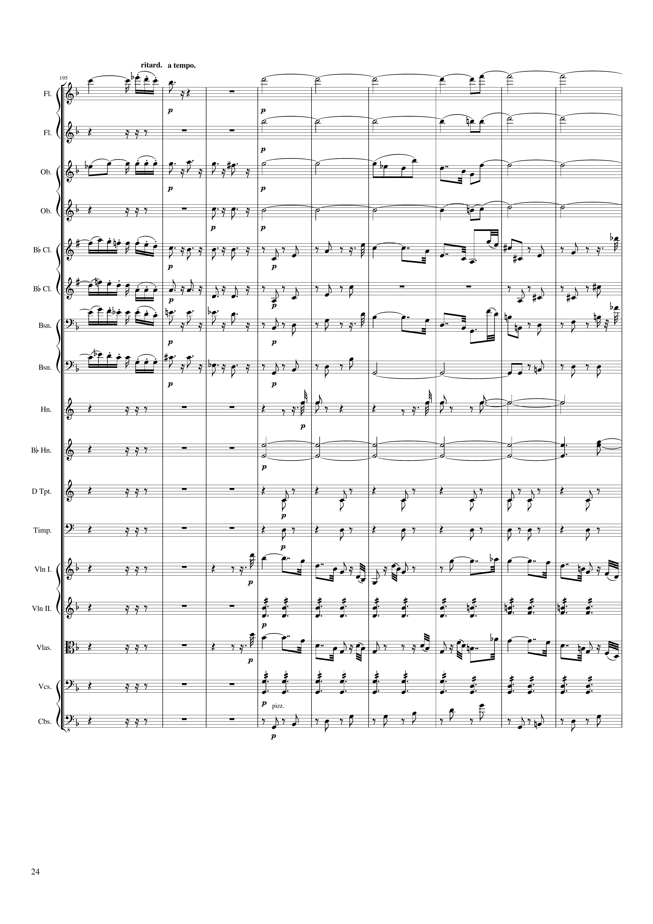
mel
harm
harm
mel
mel+harm
harm
mel+harm
rhythm
mel
rhythm
mel+harm
rhythm
rhythm
mel+harm
rhythm
mel
rhythm
mel+harm
rhythm
harm
rhythm
rhythm
harm
harm
rhythm
rhythm
mel
rhythm
mel
rhythm
rhythm
388 | 390 | 392 | 394 | 396 | 398 | 400 | 402 | 404
Notes:
8:04

Slide 25
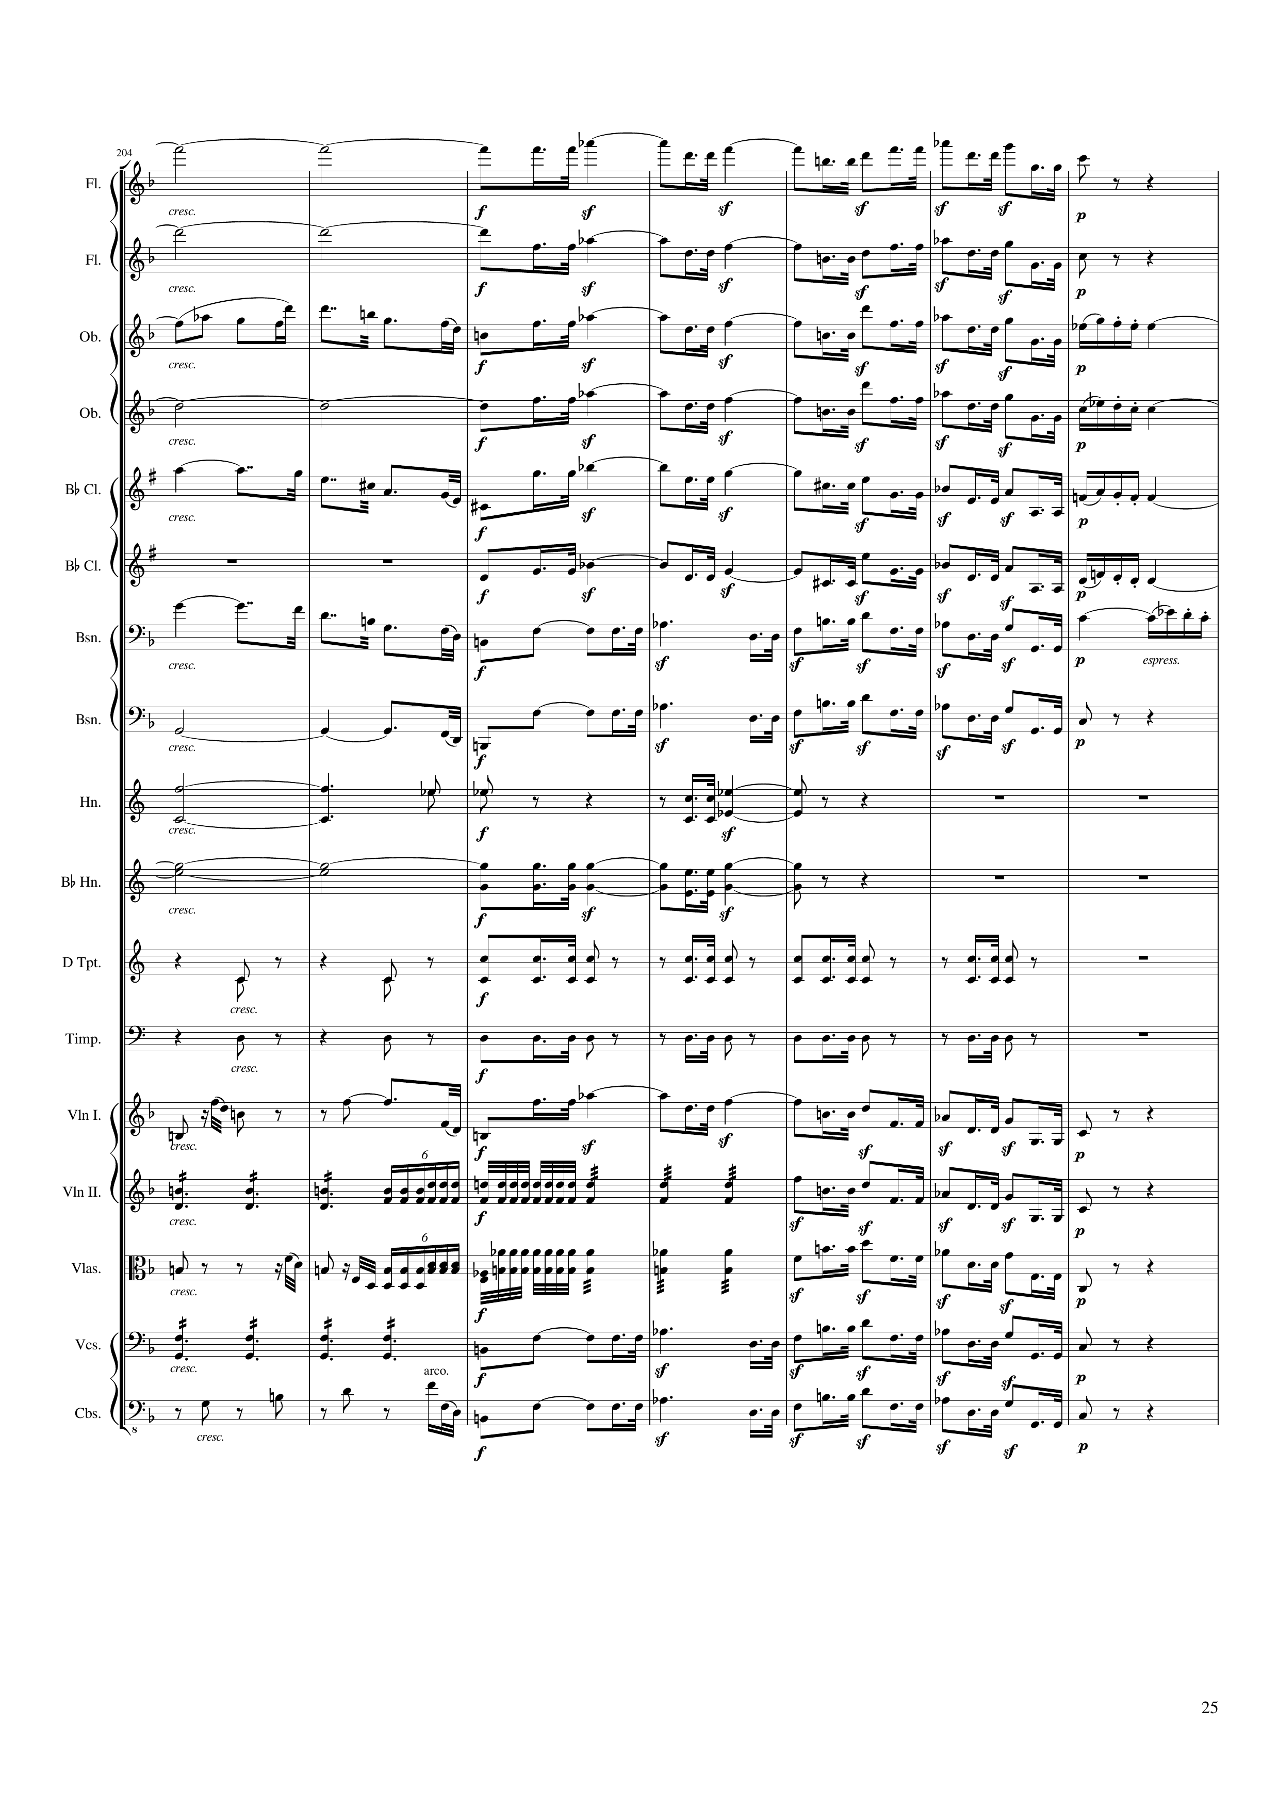
harm
mel
harm
mel
mel+harm
mel
mel
harm
mel
mel
mel
mel
mel
mel
mel
mel
mel
mel+harm
harm
mel
harm
rhythm
harm
rhythm
rhythm
rhythm
mel
rhythm
mel
mel
rhythm
mel
rhythm
mel
rhythm
mel
406 | 408 | 410 | 412 | 414 | 416 | 418
Notes:
8:22

Slide 26
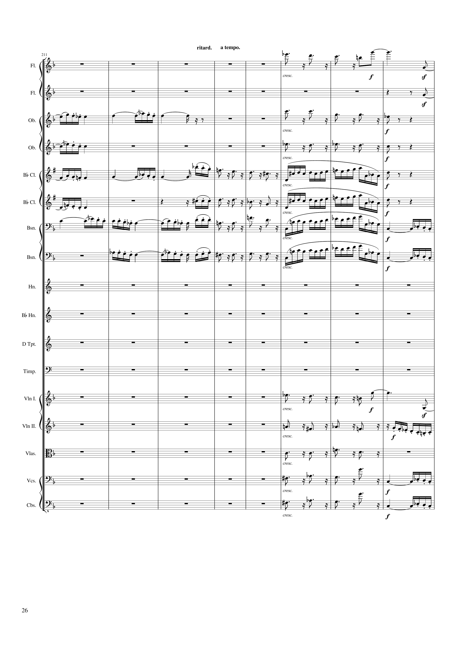
rhythm+harm
rhythm
rhythm
mel
rhythm+harm
mel
rhythm+harm
mel
mel
mel
mel+harm
mel
mel+harm
mel
mel
mel+harm
mel
mel
rhythm+harm
rhythm
rhythm+harm
mel+rhythm
rhythm+harm
rhythm+harm
mel
rhythm+harm
mel
420 | 422 | 424 | 426 | 428 | 430 | 432 | 434
Notes:
8:35

Slide 27
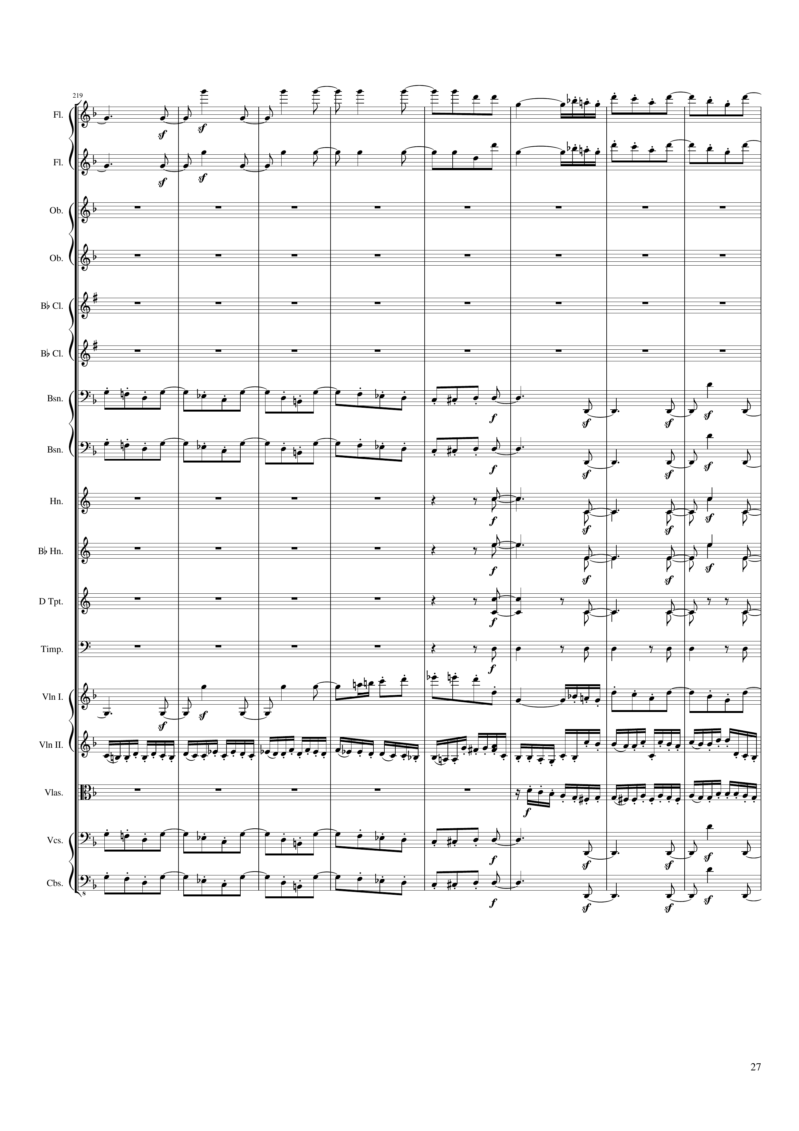
rhythm
mel
rhythm
mel
mel
rhythm
mel
rhythm
rhythm
rhythm
rhythm
rhythm
rhythm
mel
mel+rhythm
mel+rhythm
mel
rhythm
mel
rhythm
436 | 438 | 440 | 442 | 444 | 446 | 448 | 450
Notes:
8:50

Slide 28
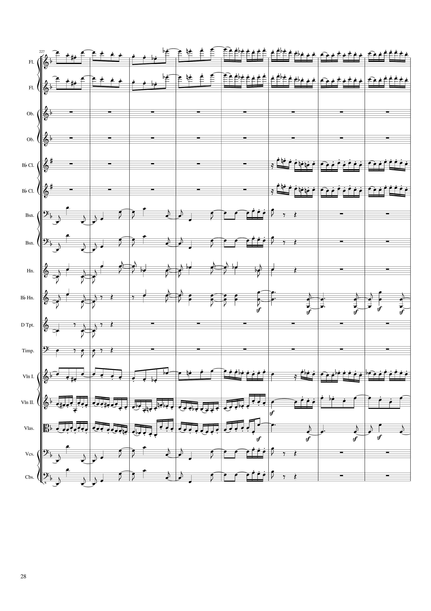
mel
mel+rhythm
mel
mel+rhythm
mel+rhythm
mel+rhythm
rhythm
rhythm+harm
rhythm
rhythm+harm
rhythm
rhythm+harm
rhythm
rhythm+harm
rhythm
rhythm
rhythm
mel
mel+rhythm
mel+rhythm
mel
mel+rhythm
rhythm
rhythm
rhythm+harm
rhythm
rhythm+harm
452 | 454 | 456 | 458 | 460 | 462 | 464 | 466
Notes:
9:05

Slide 29
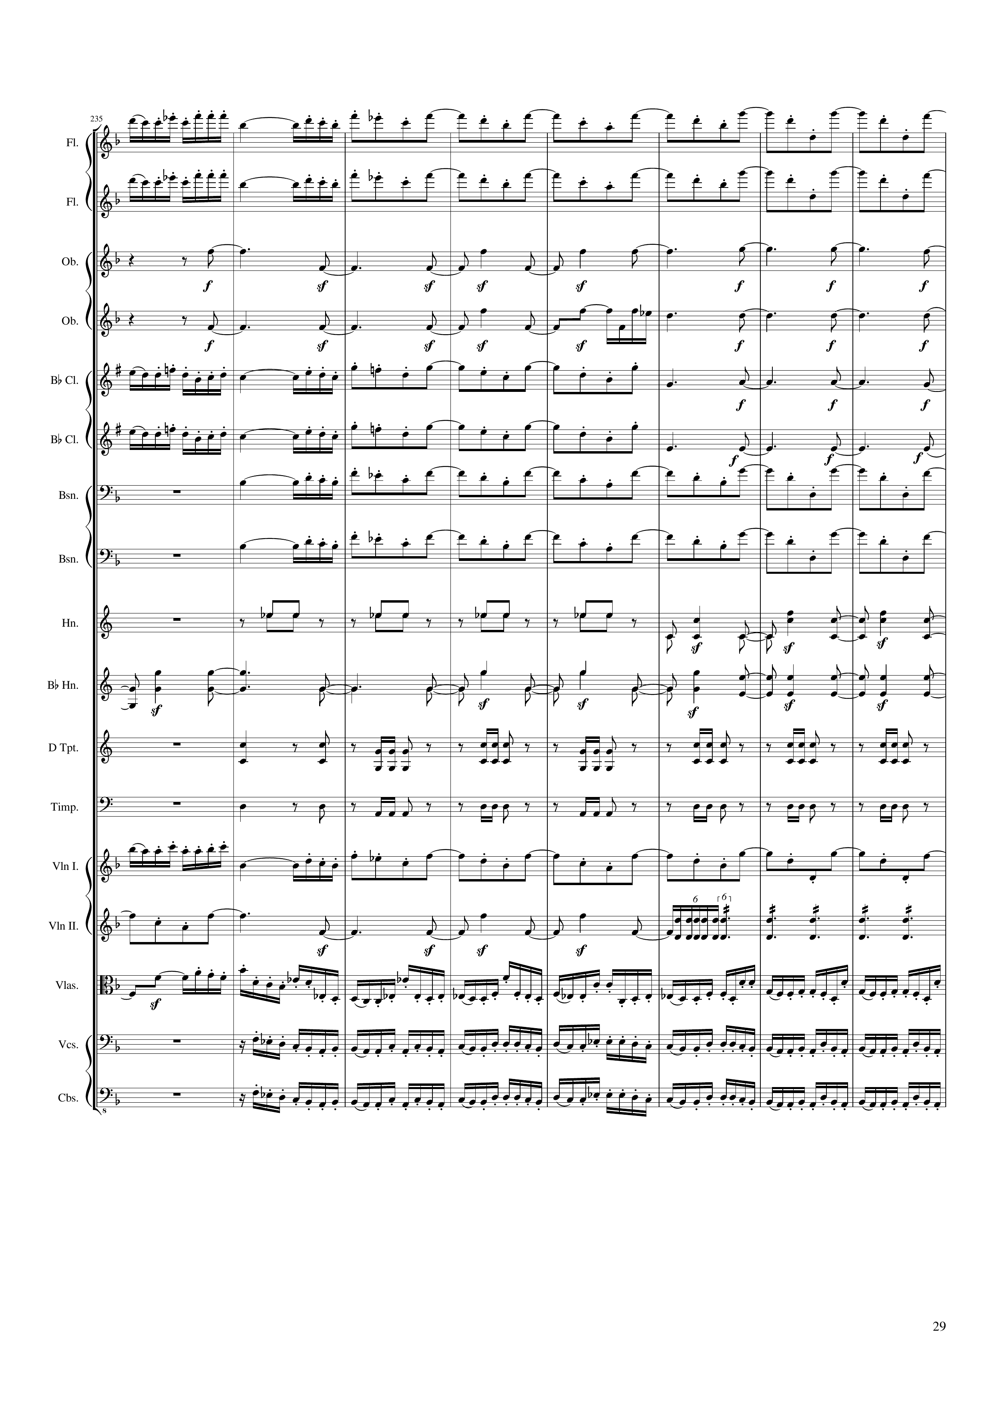
mel+rhythm
mel
mel+rhythm
mel
rhythm
rhythm
mel+rhythm
mel
rhythm
mel+rhythm
mel
rhythm
mel
mel
rhythm
rhythm
rhythm
rhythm
mel+rhythm
mel
mel
rhythm
rhythm
rhythm
rhythm
rhythm
468 | 470 | 472 | 474 | 476 | 478 | 480 | 482
Notes:
9:19

Slide 30
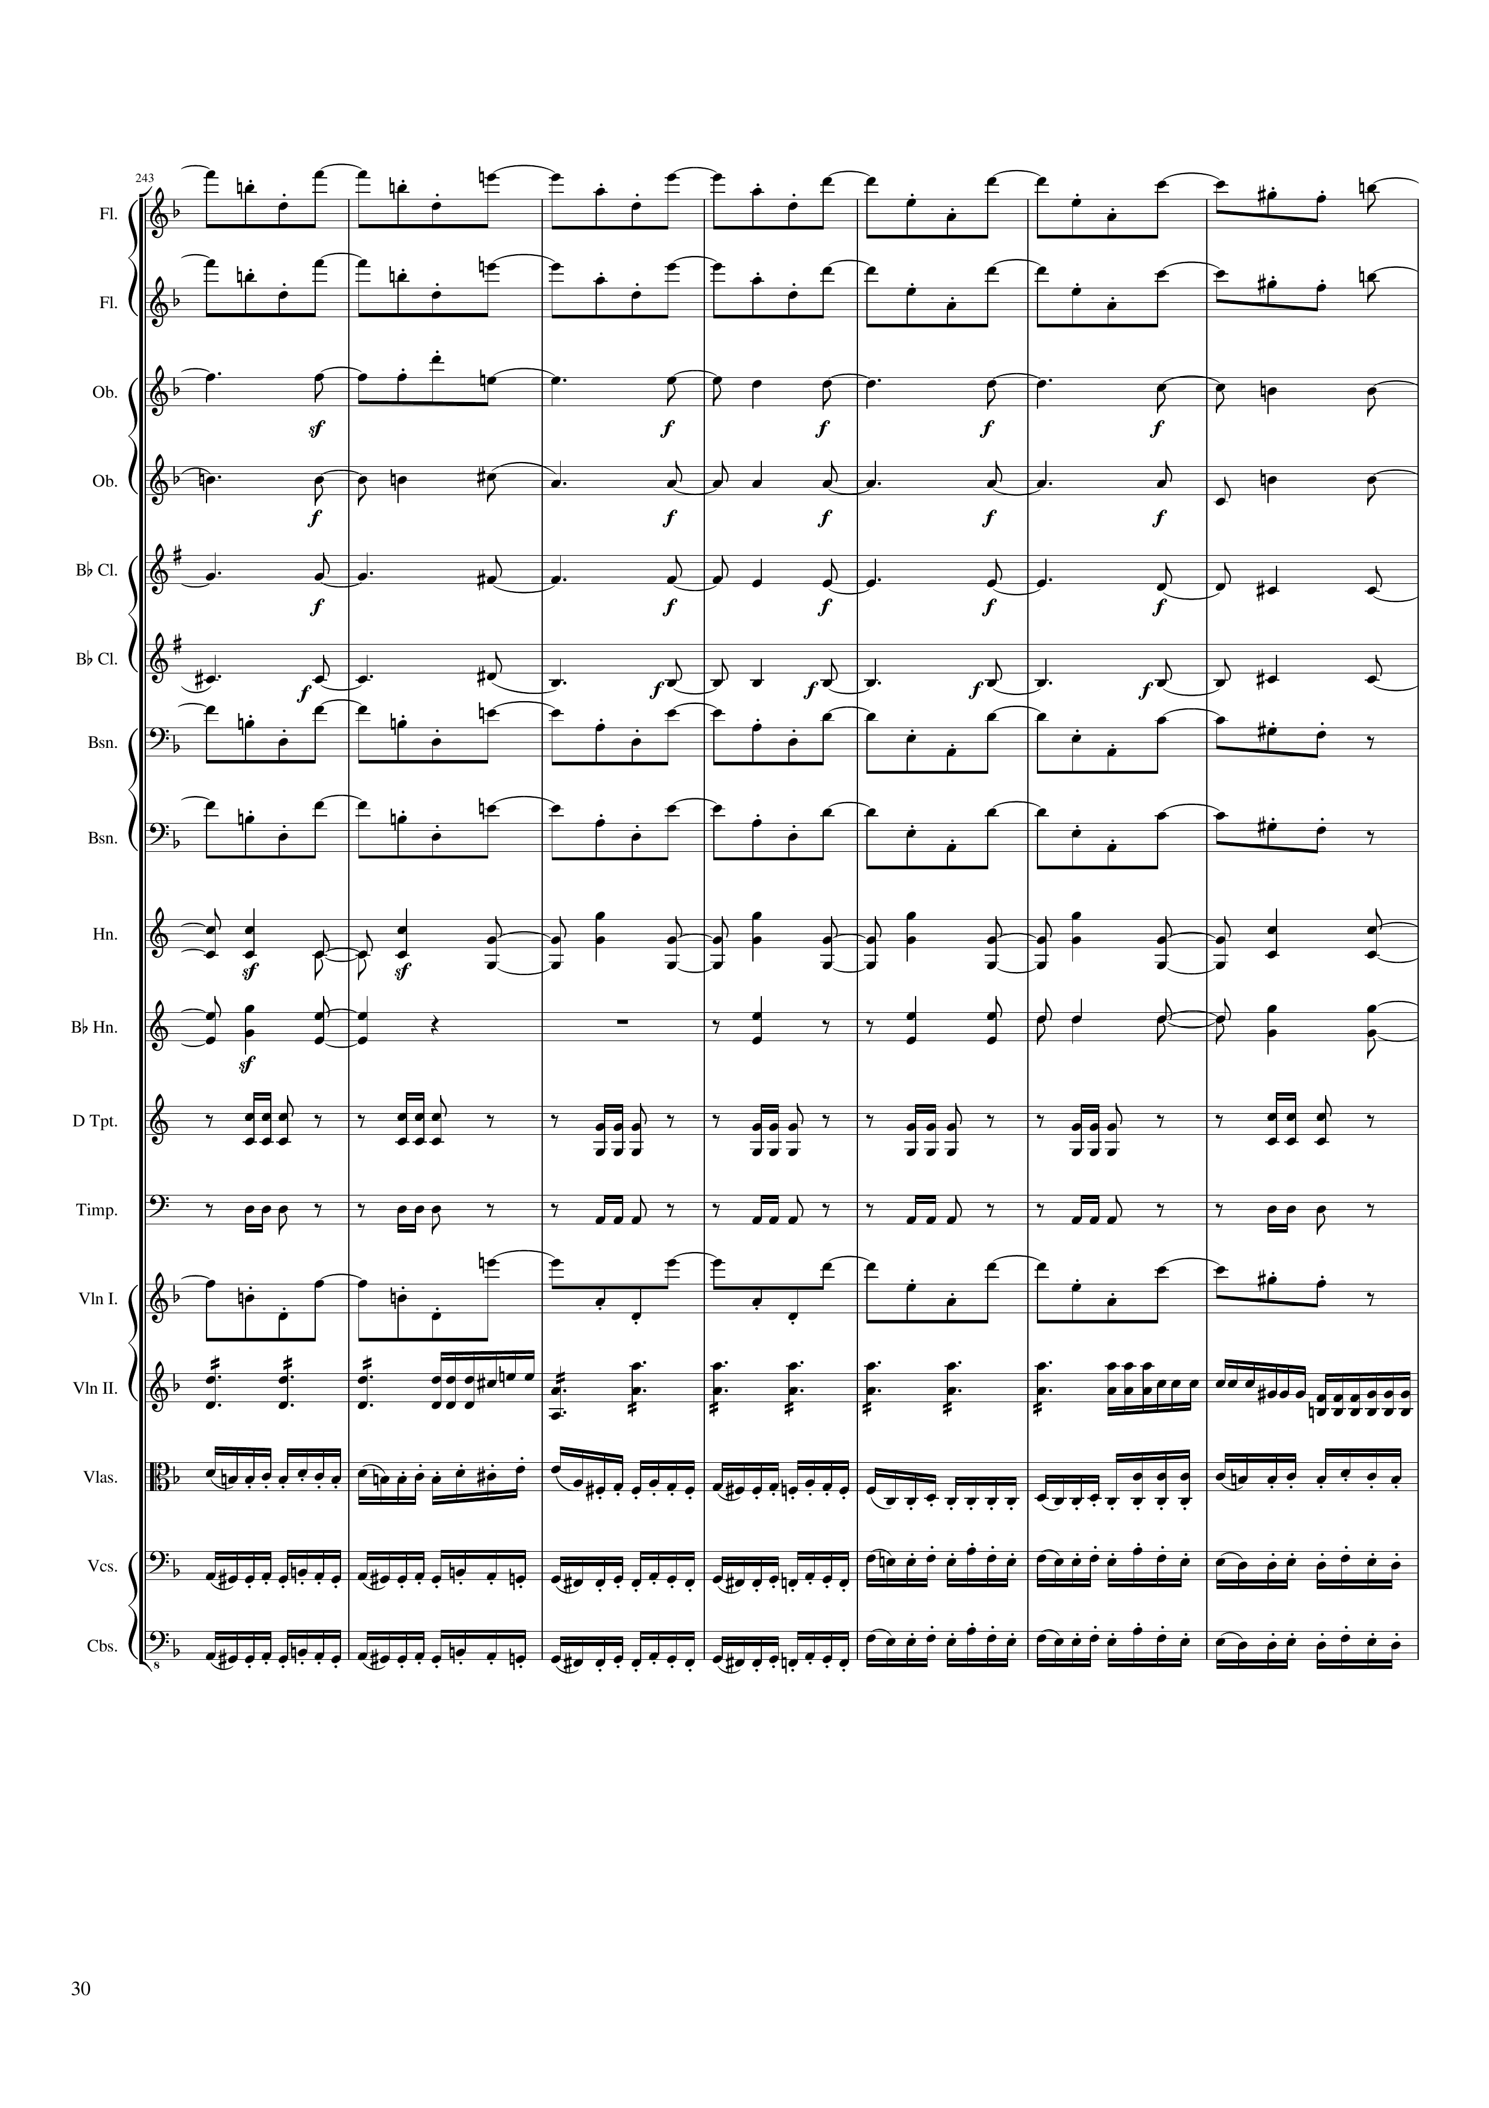
mel
mel
rhythm
mel
rhythm
mel
rhythm
mel
rhythm
mel
mel
mel
rhythm
rhythm
rhythm
rhythm
mel
rhythm
rhythm
rhythm
rhythm
484 | 486 | 488 | 490 | 492 | 494 | 496
Notes:
9:34

Slide 31
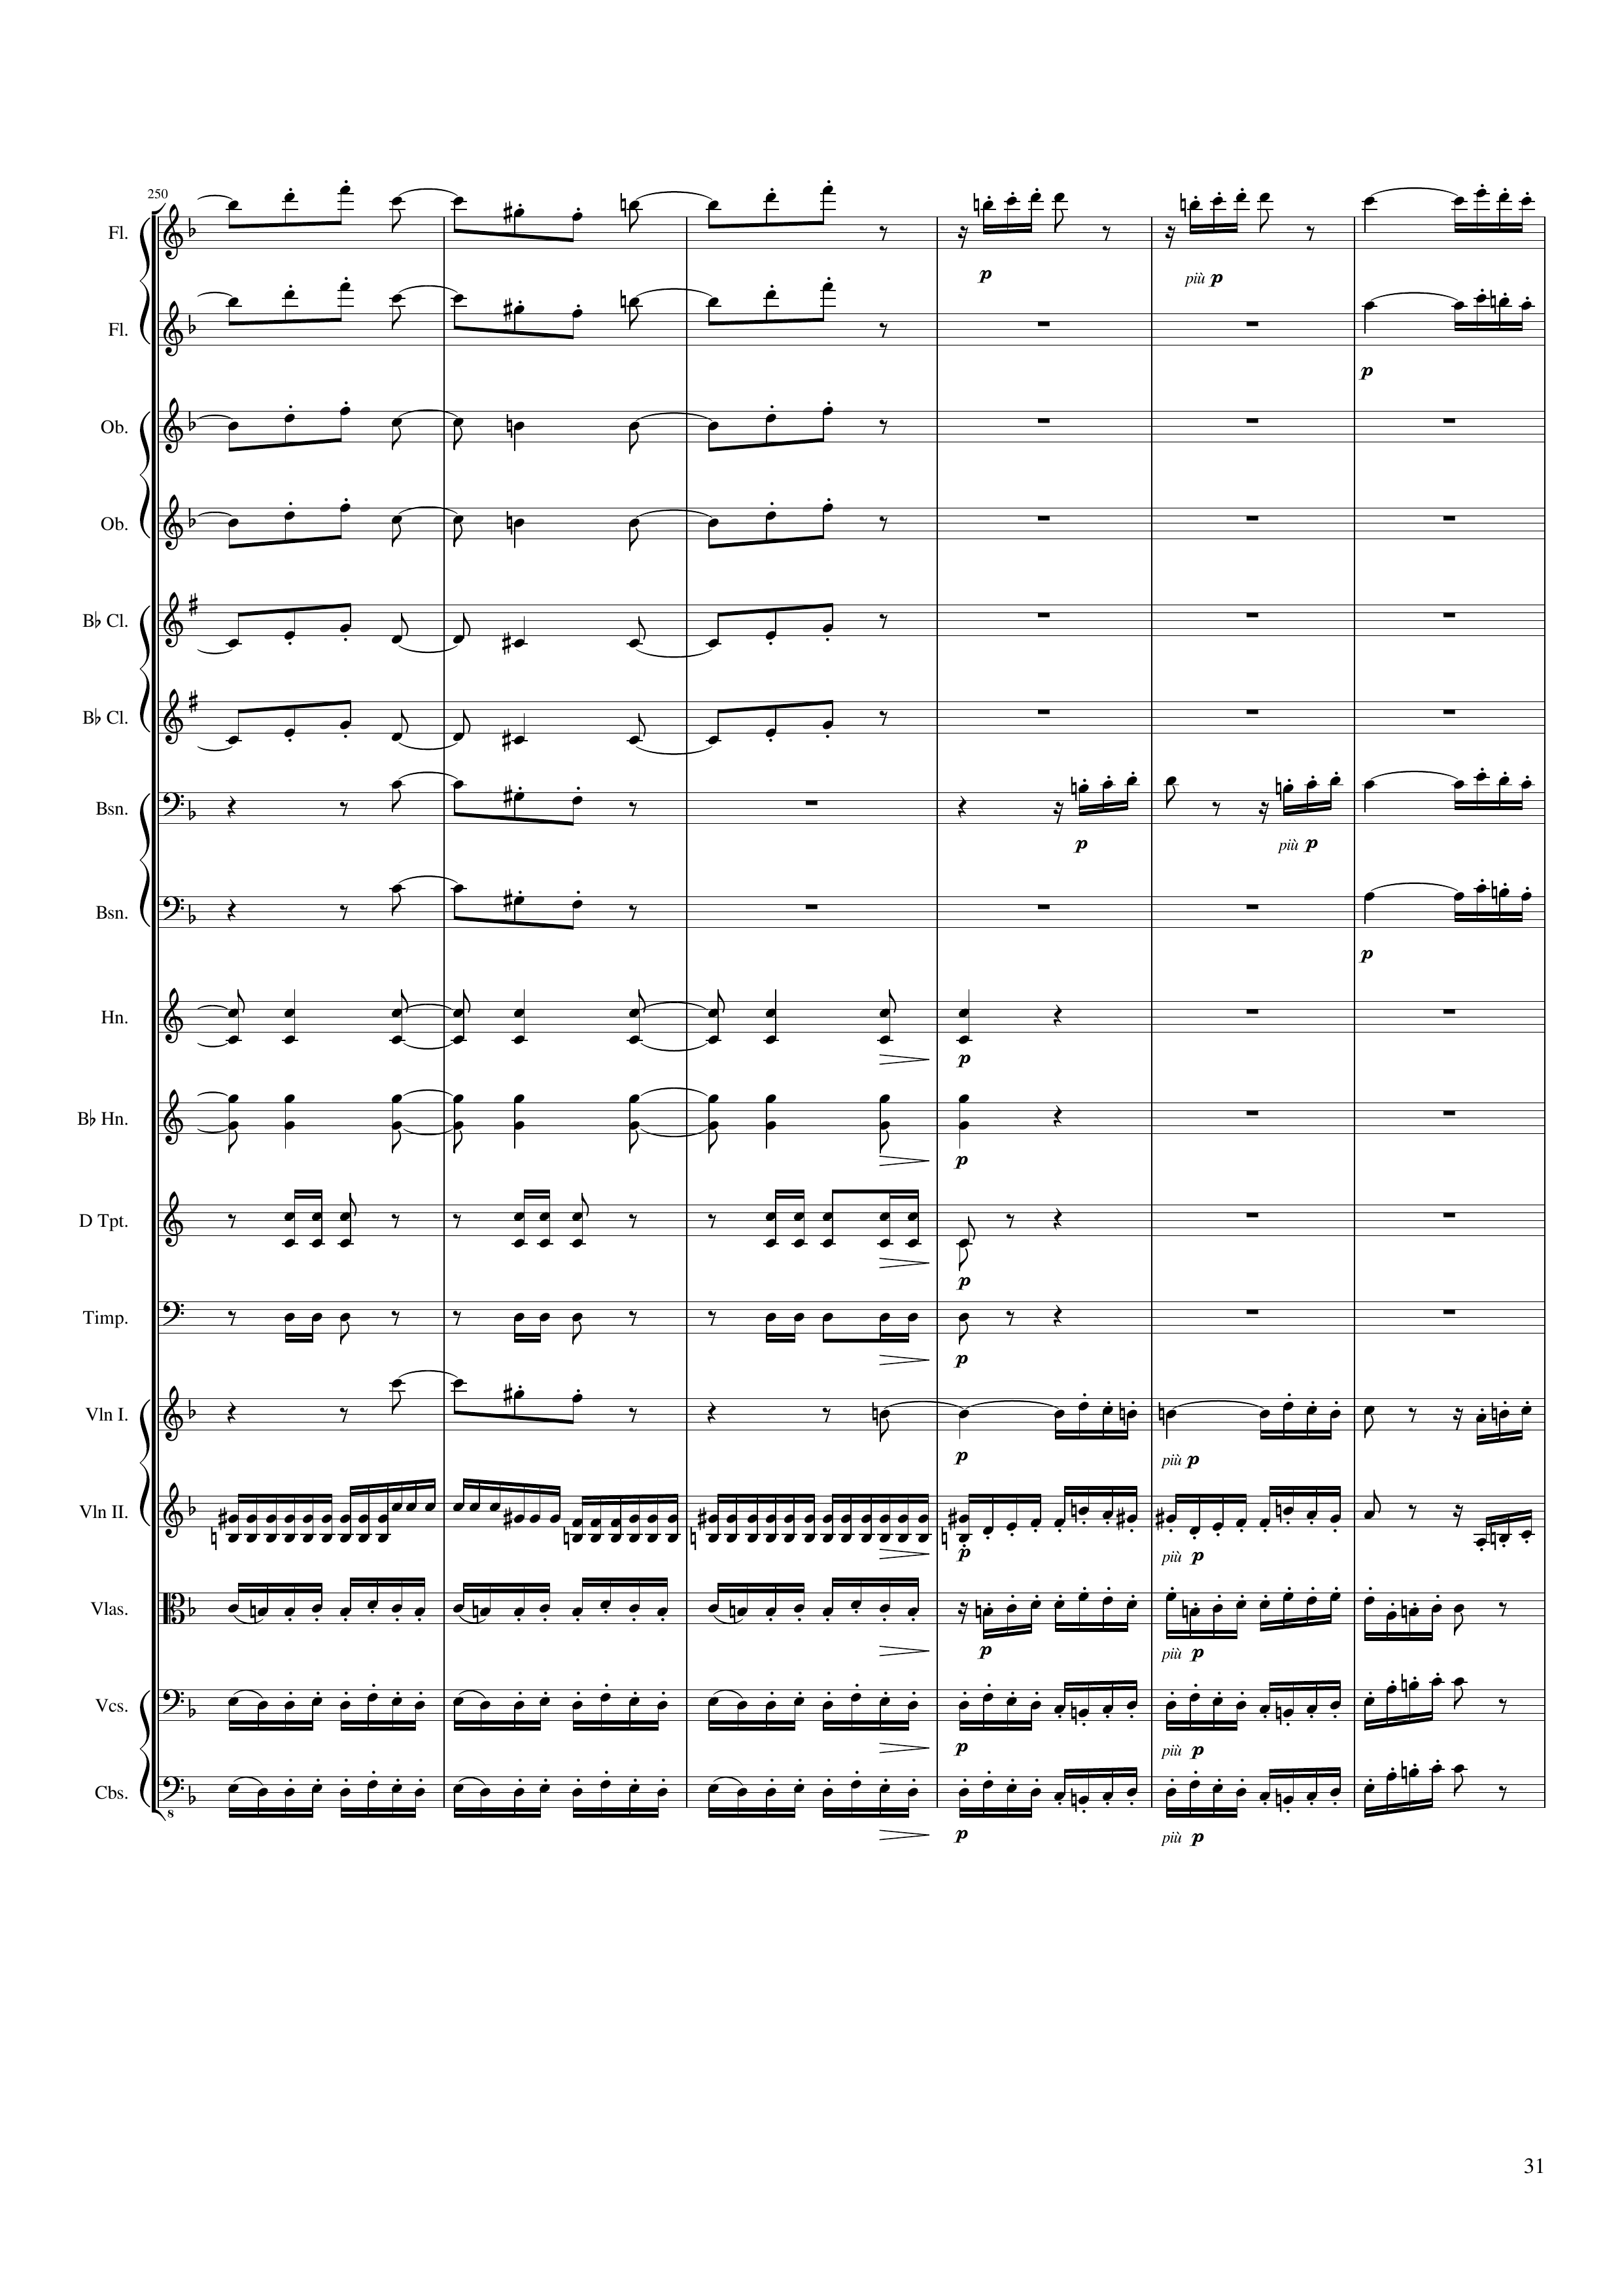
mel
mel
mel
mel
mel
mel
mel
mel
mel
mel
mel
mel
rhythm
rhythm
rhythm
rhythm
mel
mel
rhythm
mel+rhythm
rhythm
mel+rhythm
rhythm
mel+rhythm
rhythm
mel+rhythm
498 | 500 | 502 | 504 | 506 | 508
Notes:
9:46

Slide 32
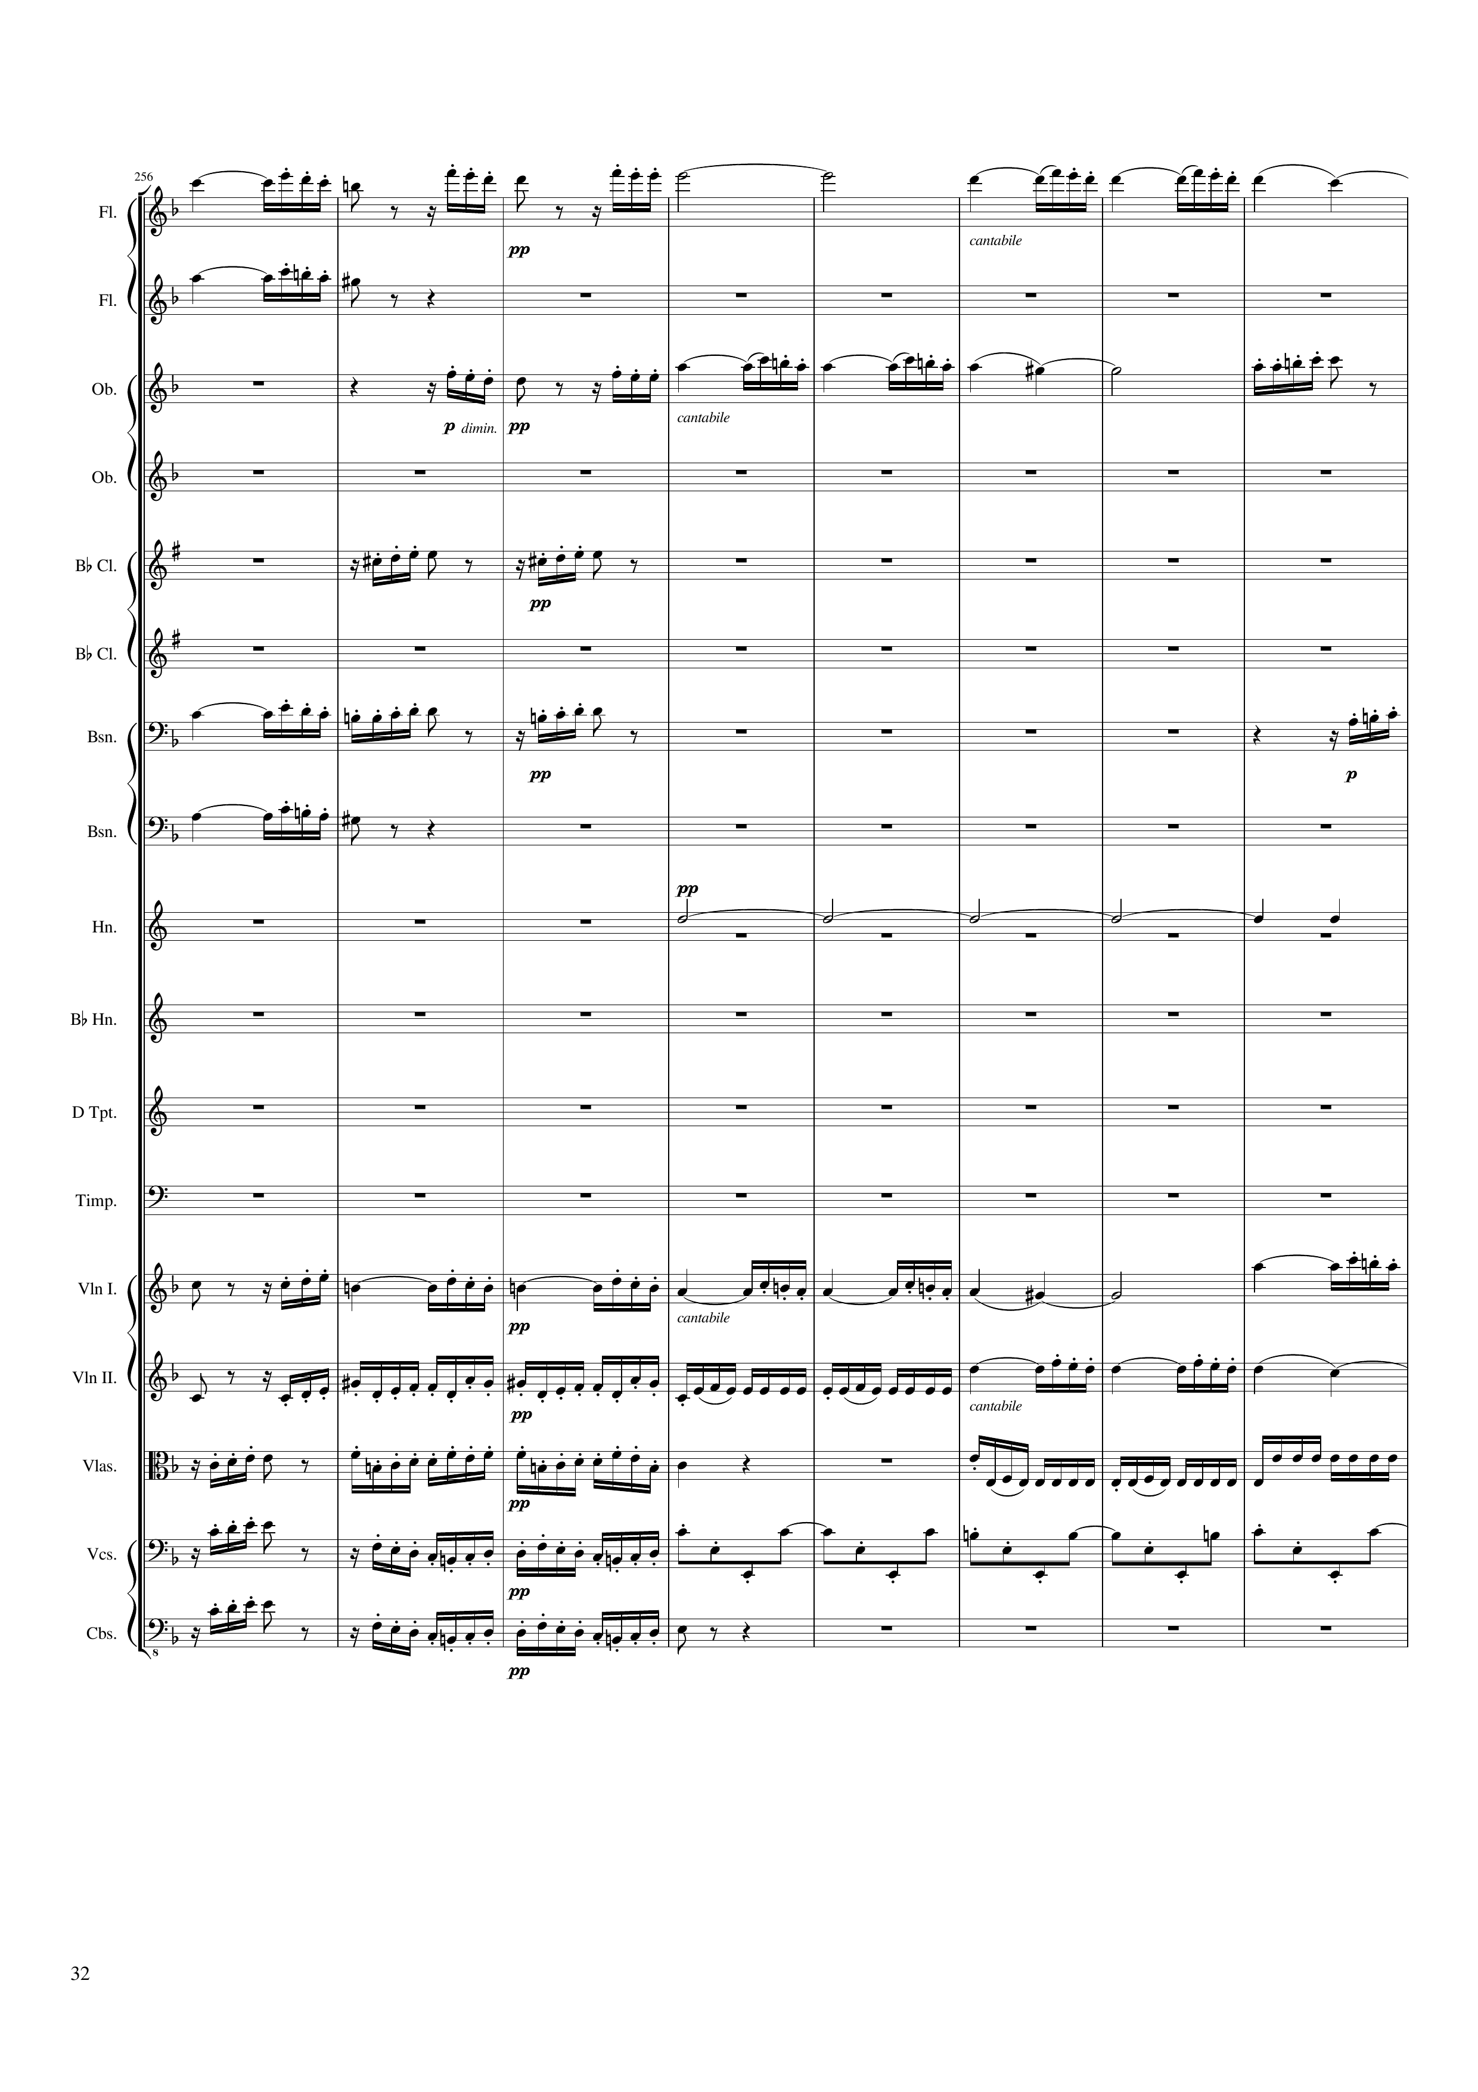
mel
mel
mel
mel
mel
mel
mel
harm
rhythm
mel
mel+rhythm
rhythm
mel
mel+rhythm
rhythm
mel+rhythm
rhythm
mel+rhythm
510 | 512 | 514 | 516 | 518 | 520 | 522 | 524
Notes:
9:57

Slide 33
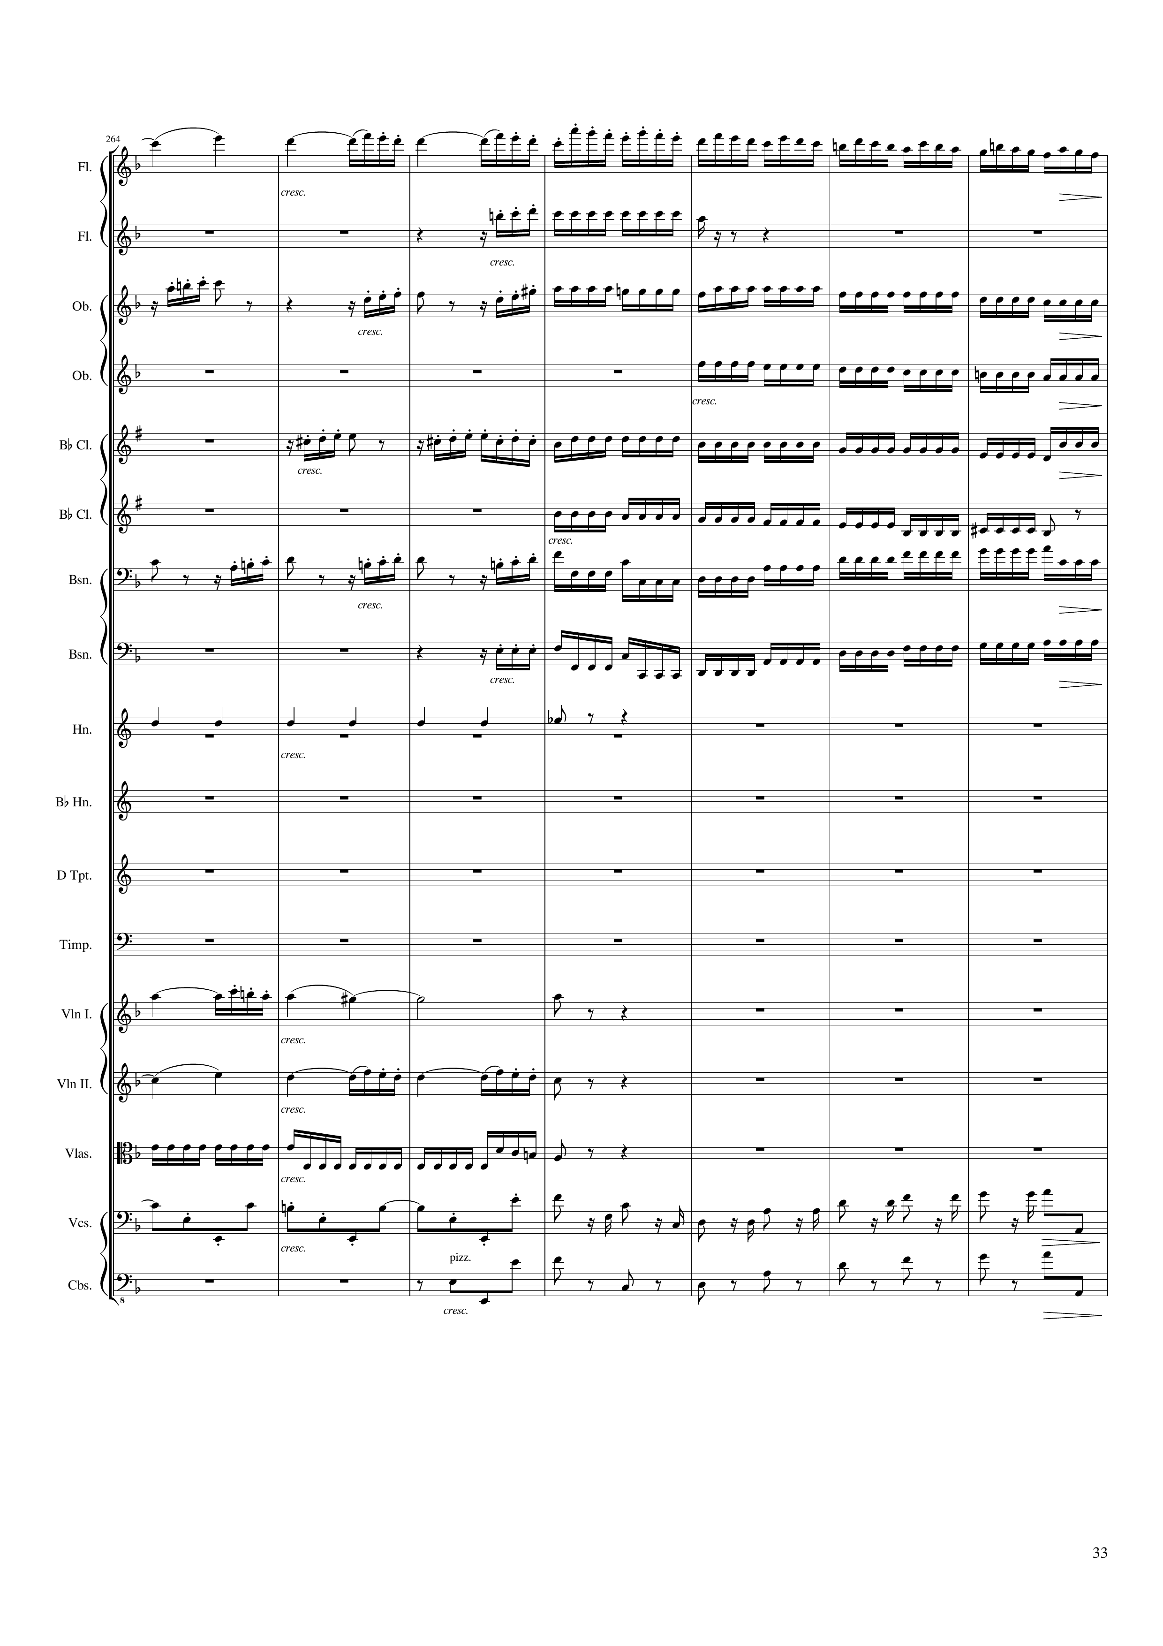
mel
mel+rhythm
rhythm
mel
rhythm
rhythm
mel
rhythm
rhythm
mel
rhythm
rhythm
rhythm
mel
mel
rhythm
rhythm
rhythm+harm
rhythm+harm
526 | 528 | 530 | 532 | 534 | 536 | 538
Notes:
10:12

Slide 34
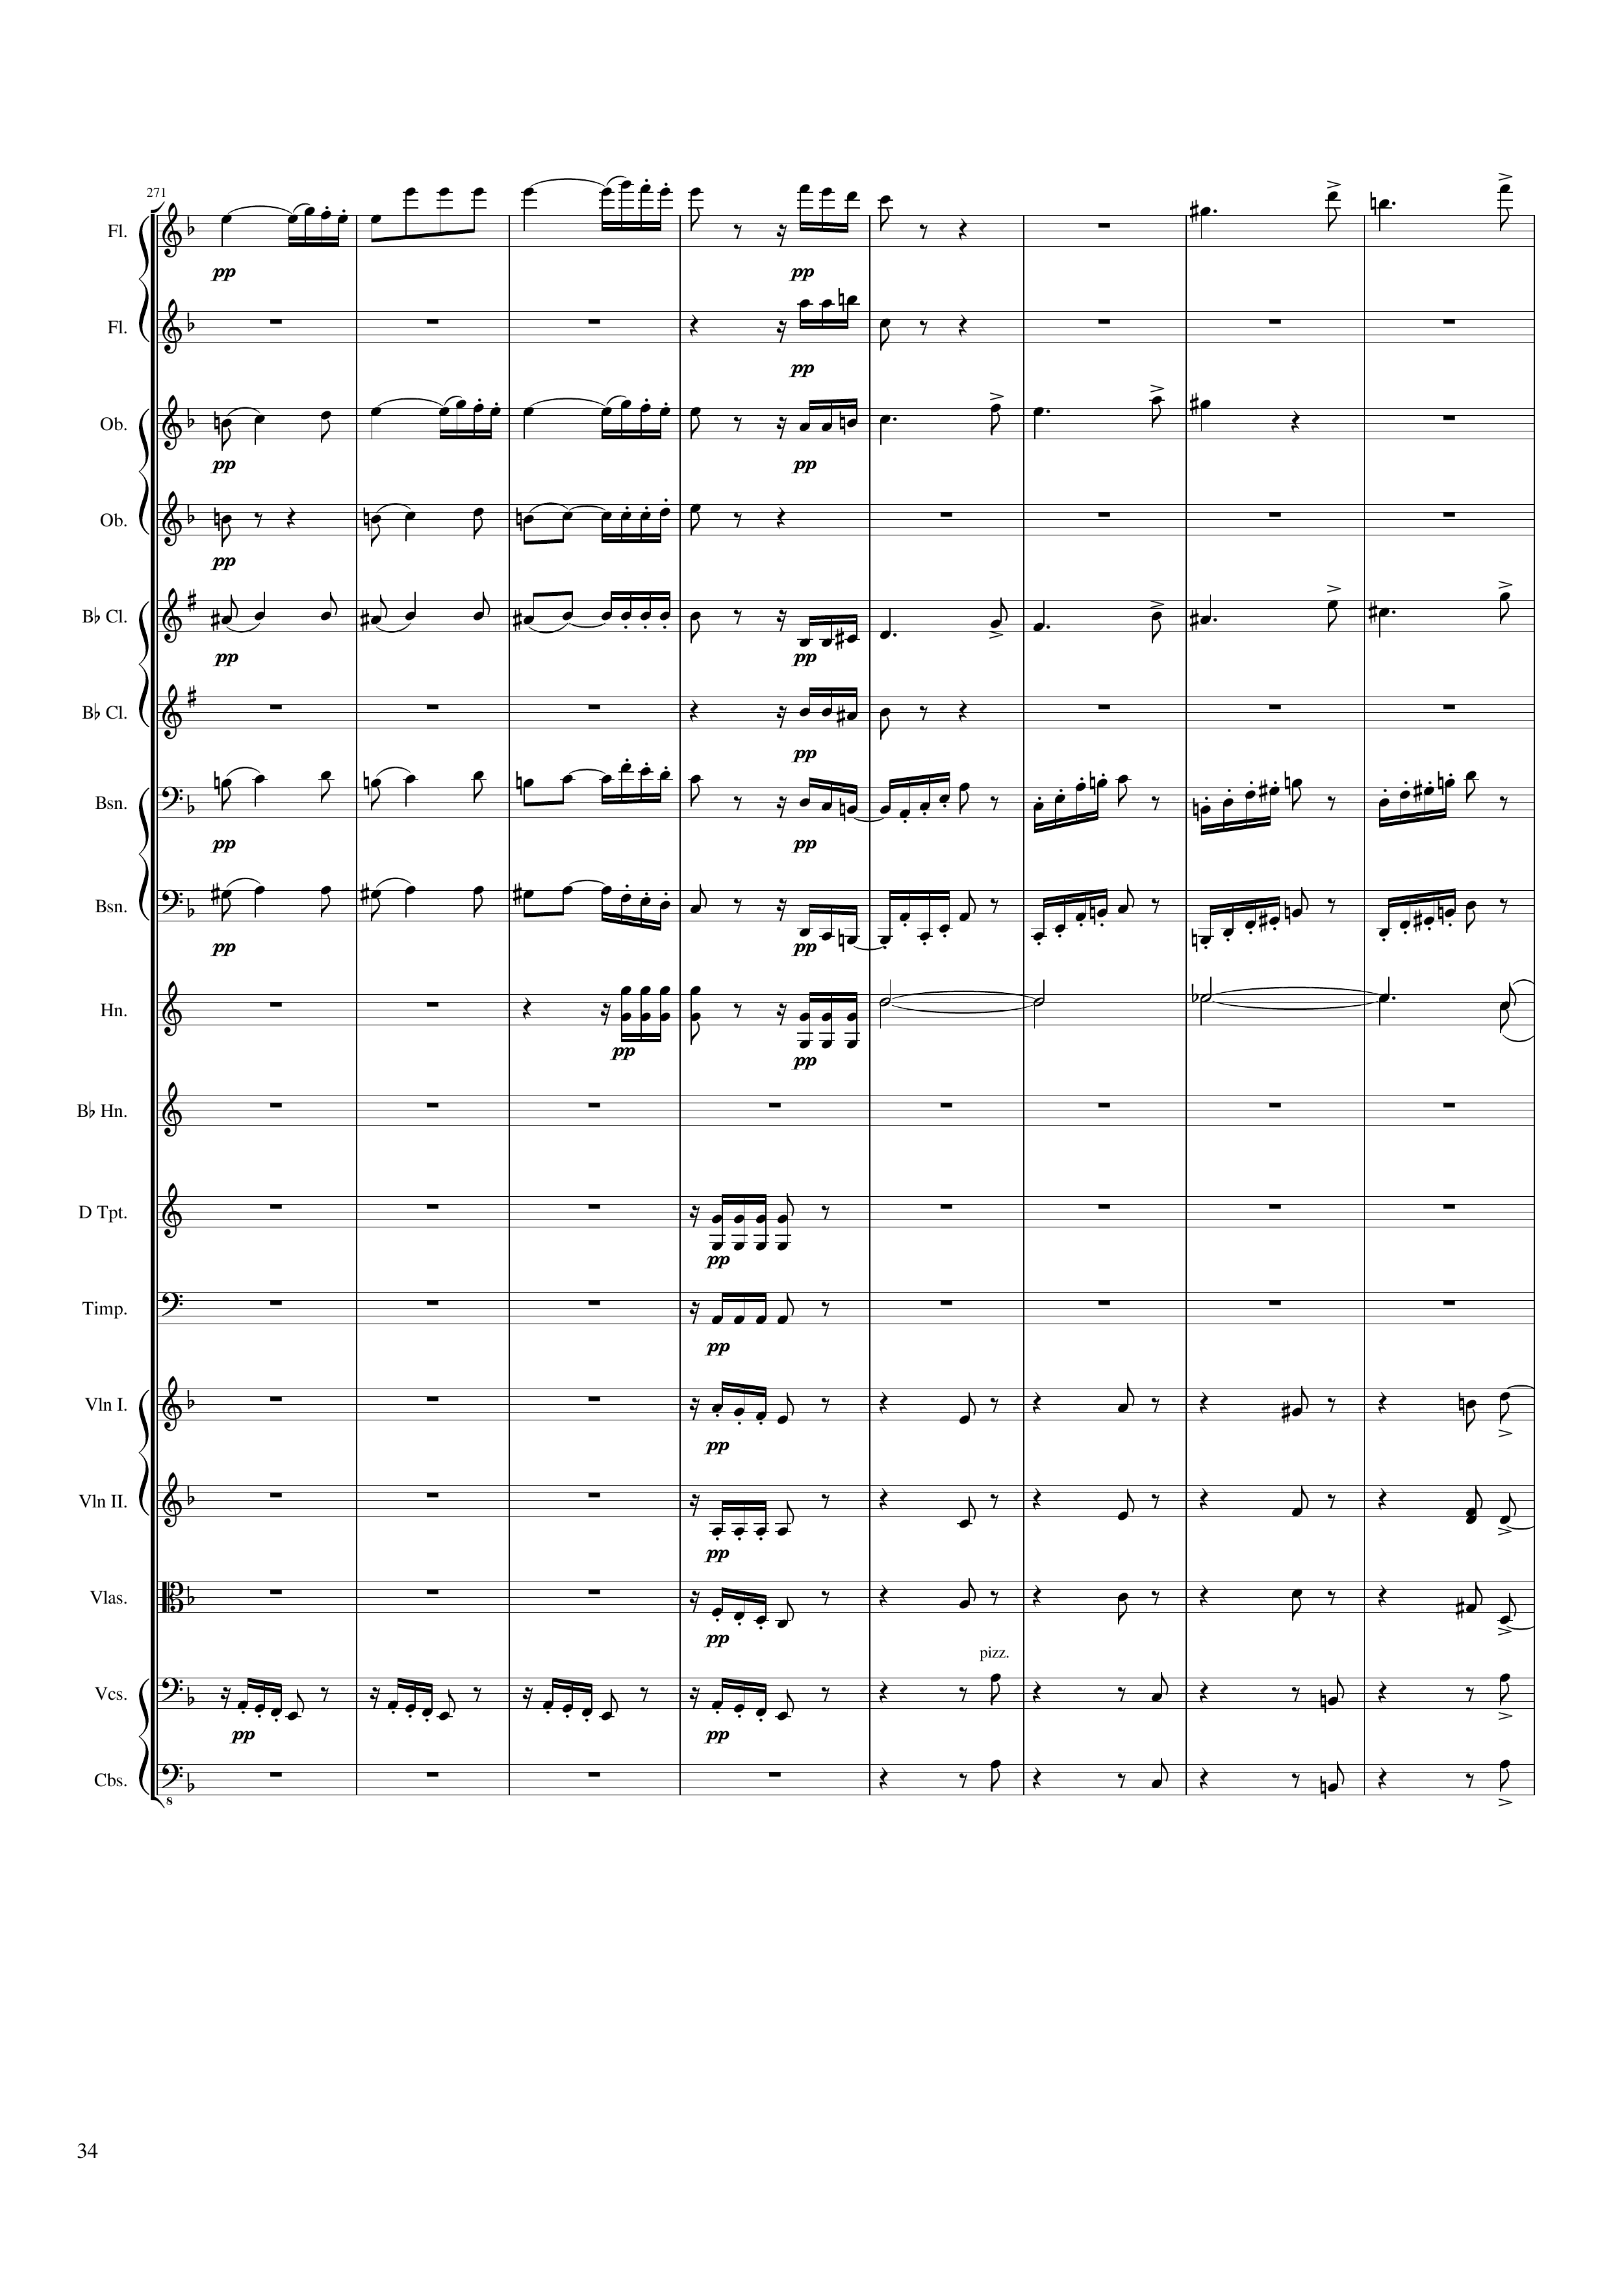
mel
mel
mel+harm
mel
mel+harm
mel+harm
mel
mel+harm
mel+harm
rhythm
mel+harm
rhythm
rhythm
harm
rhythm
v
rhythm
mel
rhythm+harm
rhythm
rhythm+harm
mel
rhythm+harm
mel
rhythm+harm
rhythm+harm
540 | 542 | 544 | 546 | 548 | 550 | 552 | 554
Notes:
10:25

Slide 35
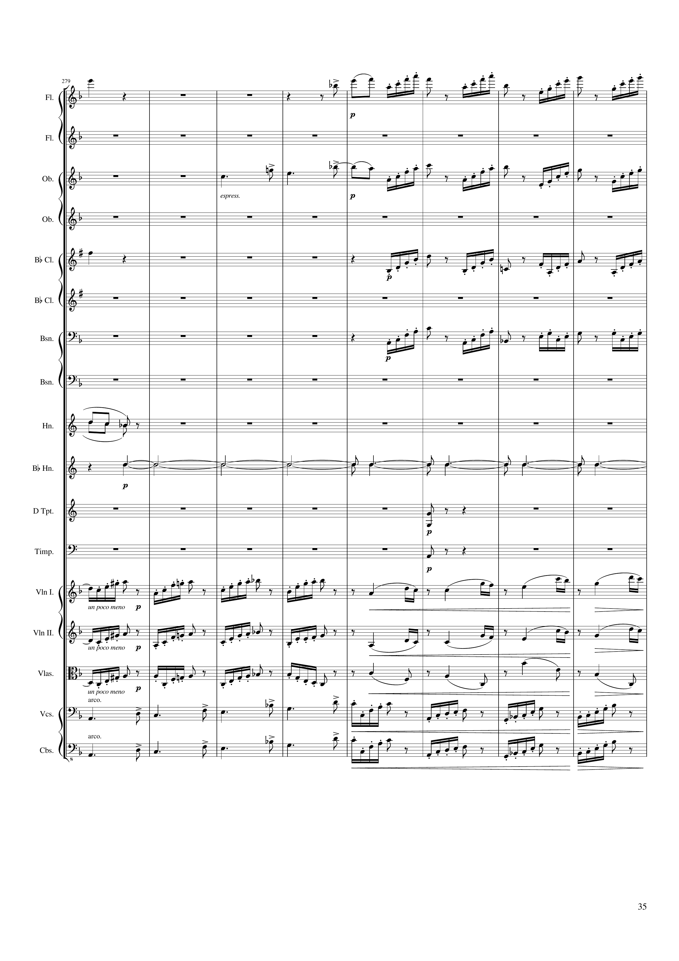
mel
mel+harm
rhythm
mel
rhythm
mel
rhythm
rhythm
harm
harm
rhythm
rhythm
rhythm
mel
rhythm
mel
rhythm
mel
mel
rhythm
mel
rhythm
556 | 558 | 560 | 562 | 564 | 566 | 568 | 570
Notes:
10:40

Slide 36
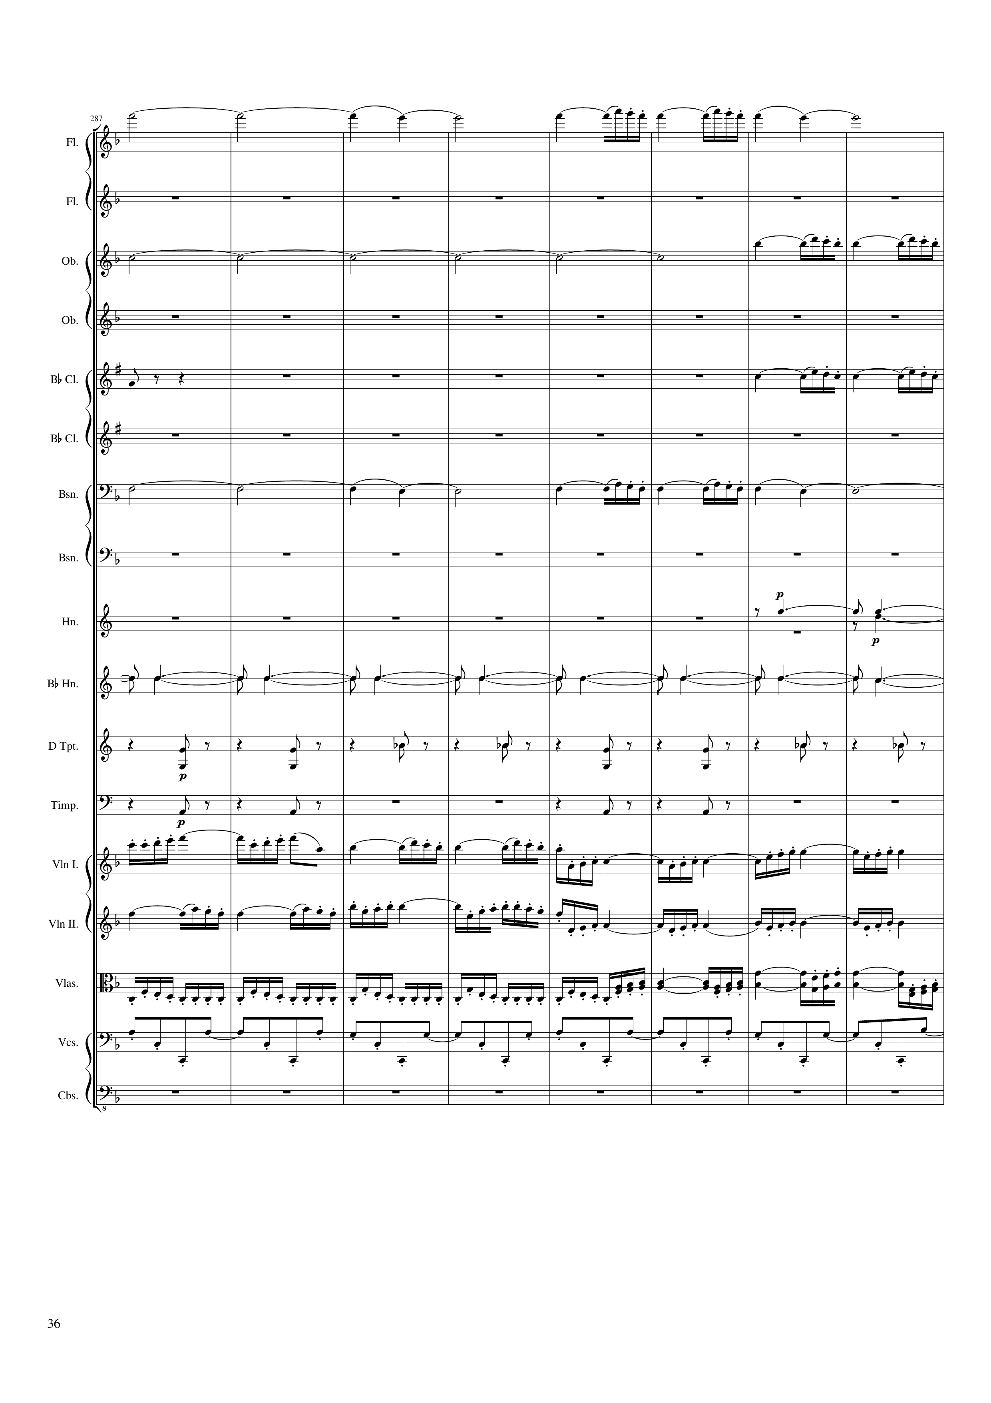
harm
mel
harm
harm
mel
rhythm
mel
harm
mel
harm
harm
harm
rhythm
rhythm
mel
mel
mel
mel
rhythm
mel
rhythm
572 | 574 | 576 | 578 | 580 | 582 | 584 | 586
Notes:
10:55

Slide 37
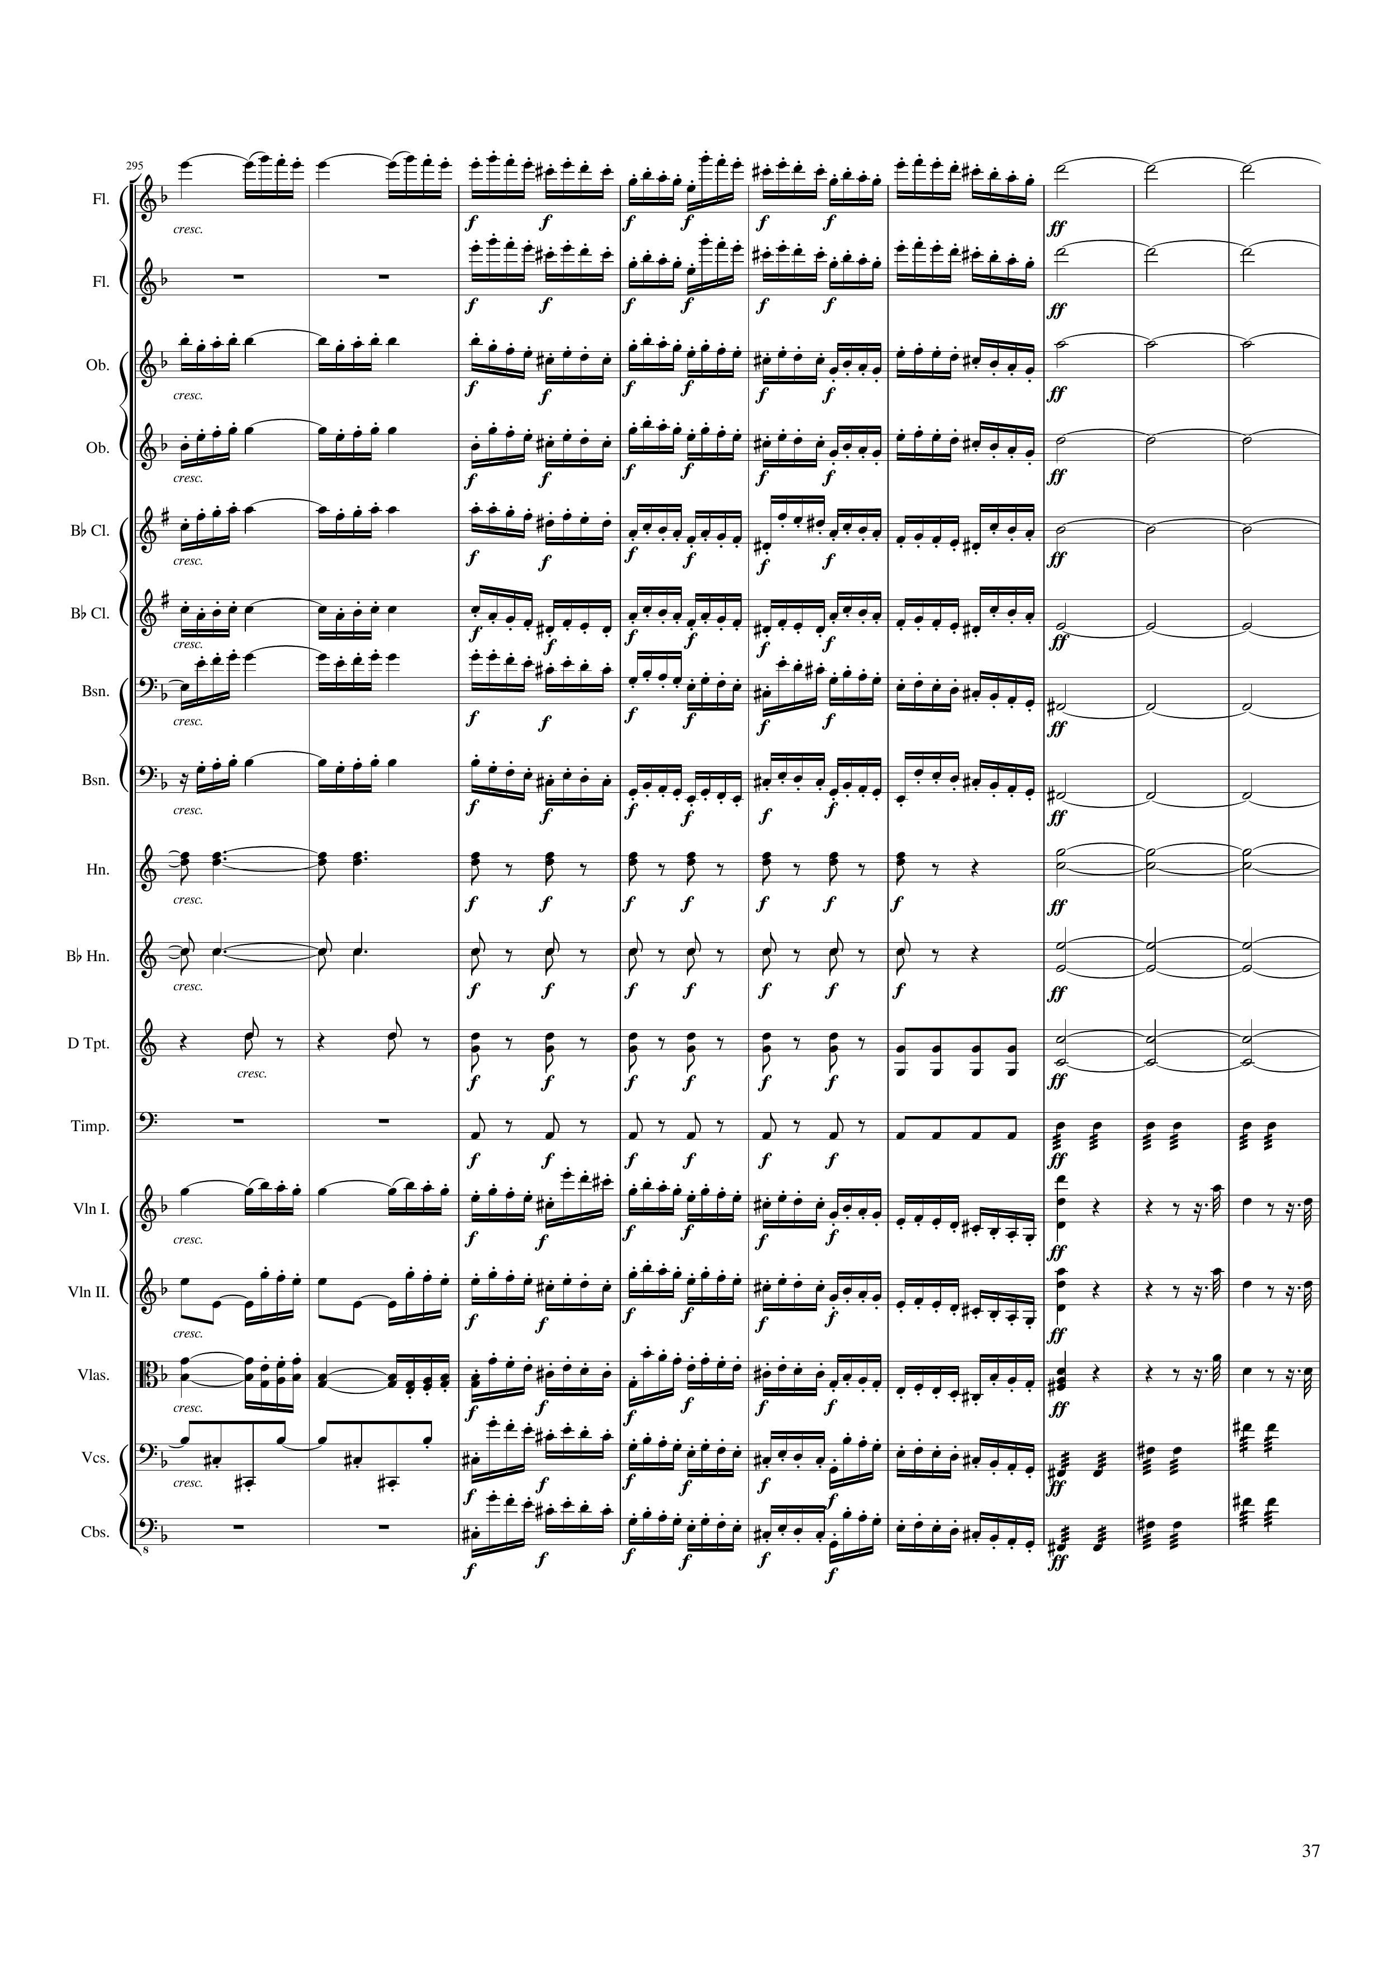
mel
mel
harm
mel
harm
mel
mel
harm
mel
mel
harm
mel
mel
harm
mel
mel
harm
mel
mel
harm
mel
mel
harm
harm
rhythm
harm
harm
rhythm
harm
rhythm
harm
rhythm
rhythm
mel
mel
rhythm+harm
mel
mel
mel
rhythm+harm
mel
mel
mel
rhythm+harm
mel
rhythm
mel
rhythm
mel
rhythm
588 | 590 | 592 | 594 | 596 | 598 | 600 | 602 | 604
Notes:
11:09

Slide 38
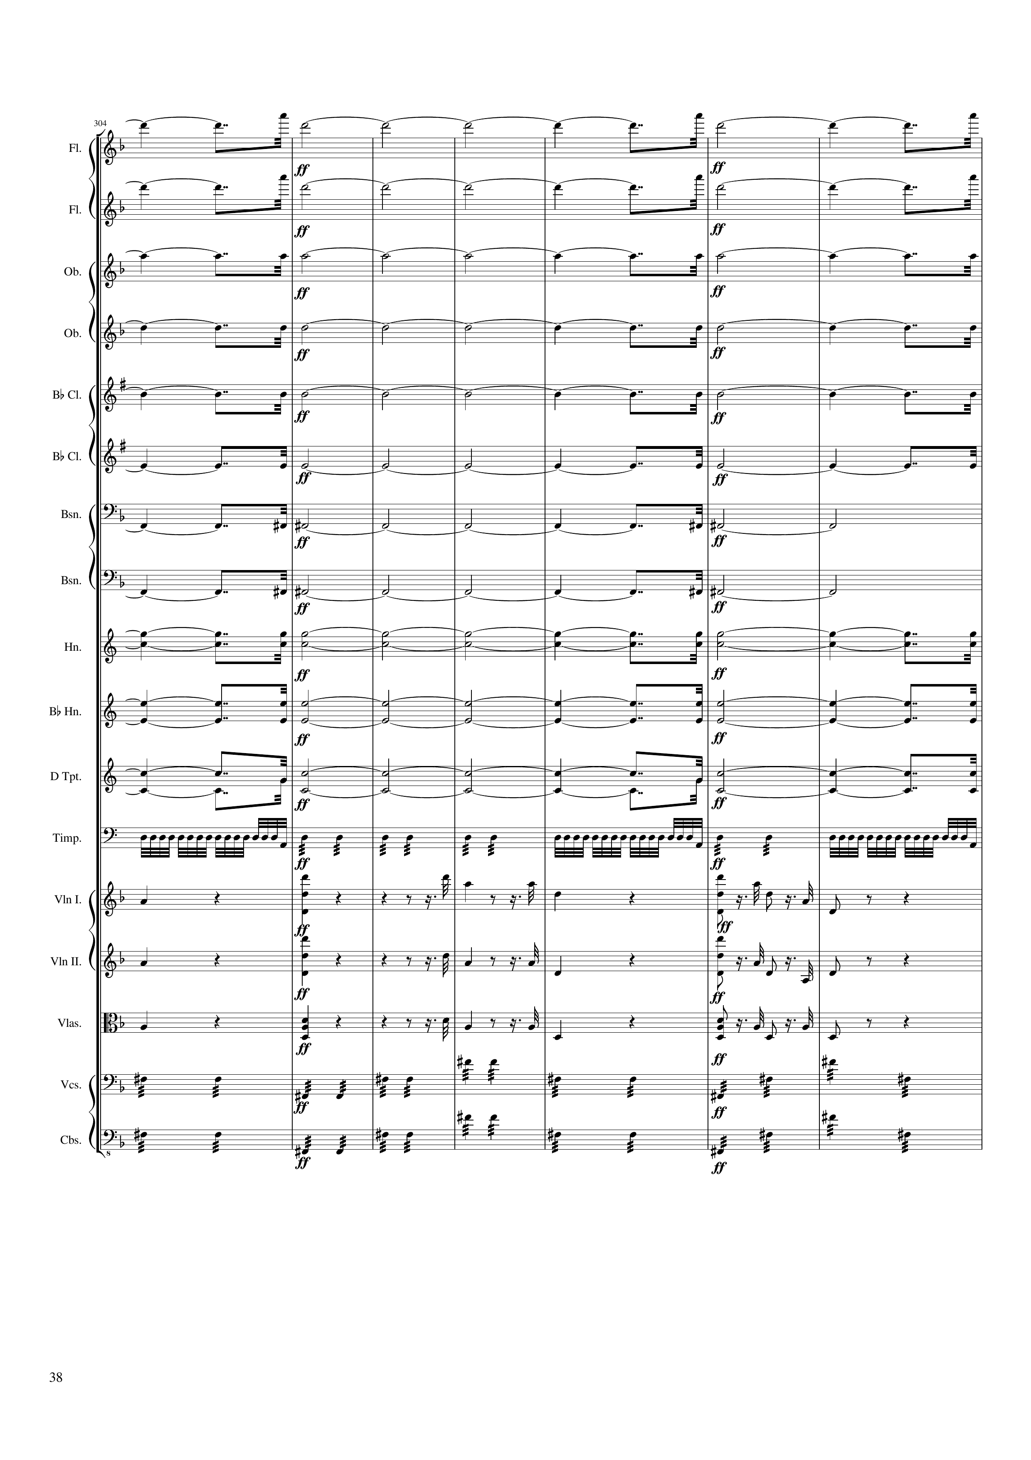
harm
harm
harm
harm
harm
harm
harm
harm
harm
harm
harm
rhythm
mel
rhythm+harm
mel
mel
rhythm+harm
mel
mel
rhythm+harm
mel
rhythm
rhythm
606 | 608 | 610 | 612 | 614 | 616 | 618
Notes:
11:27

Slide 39
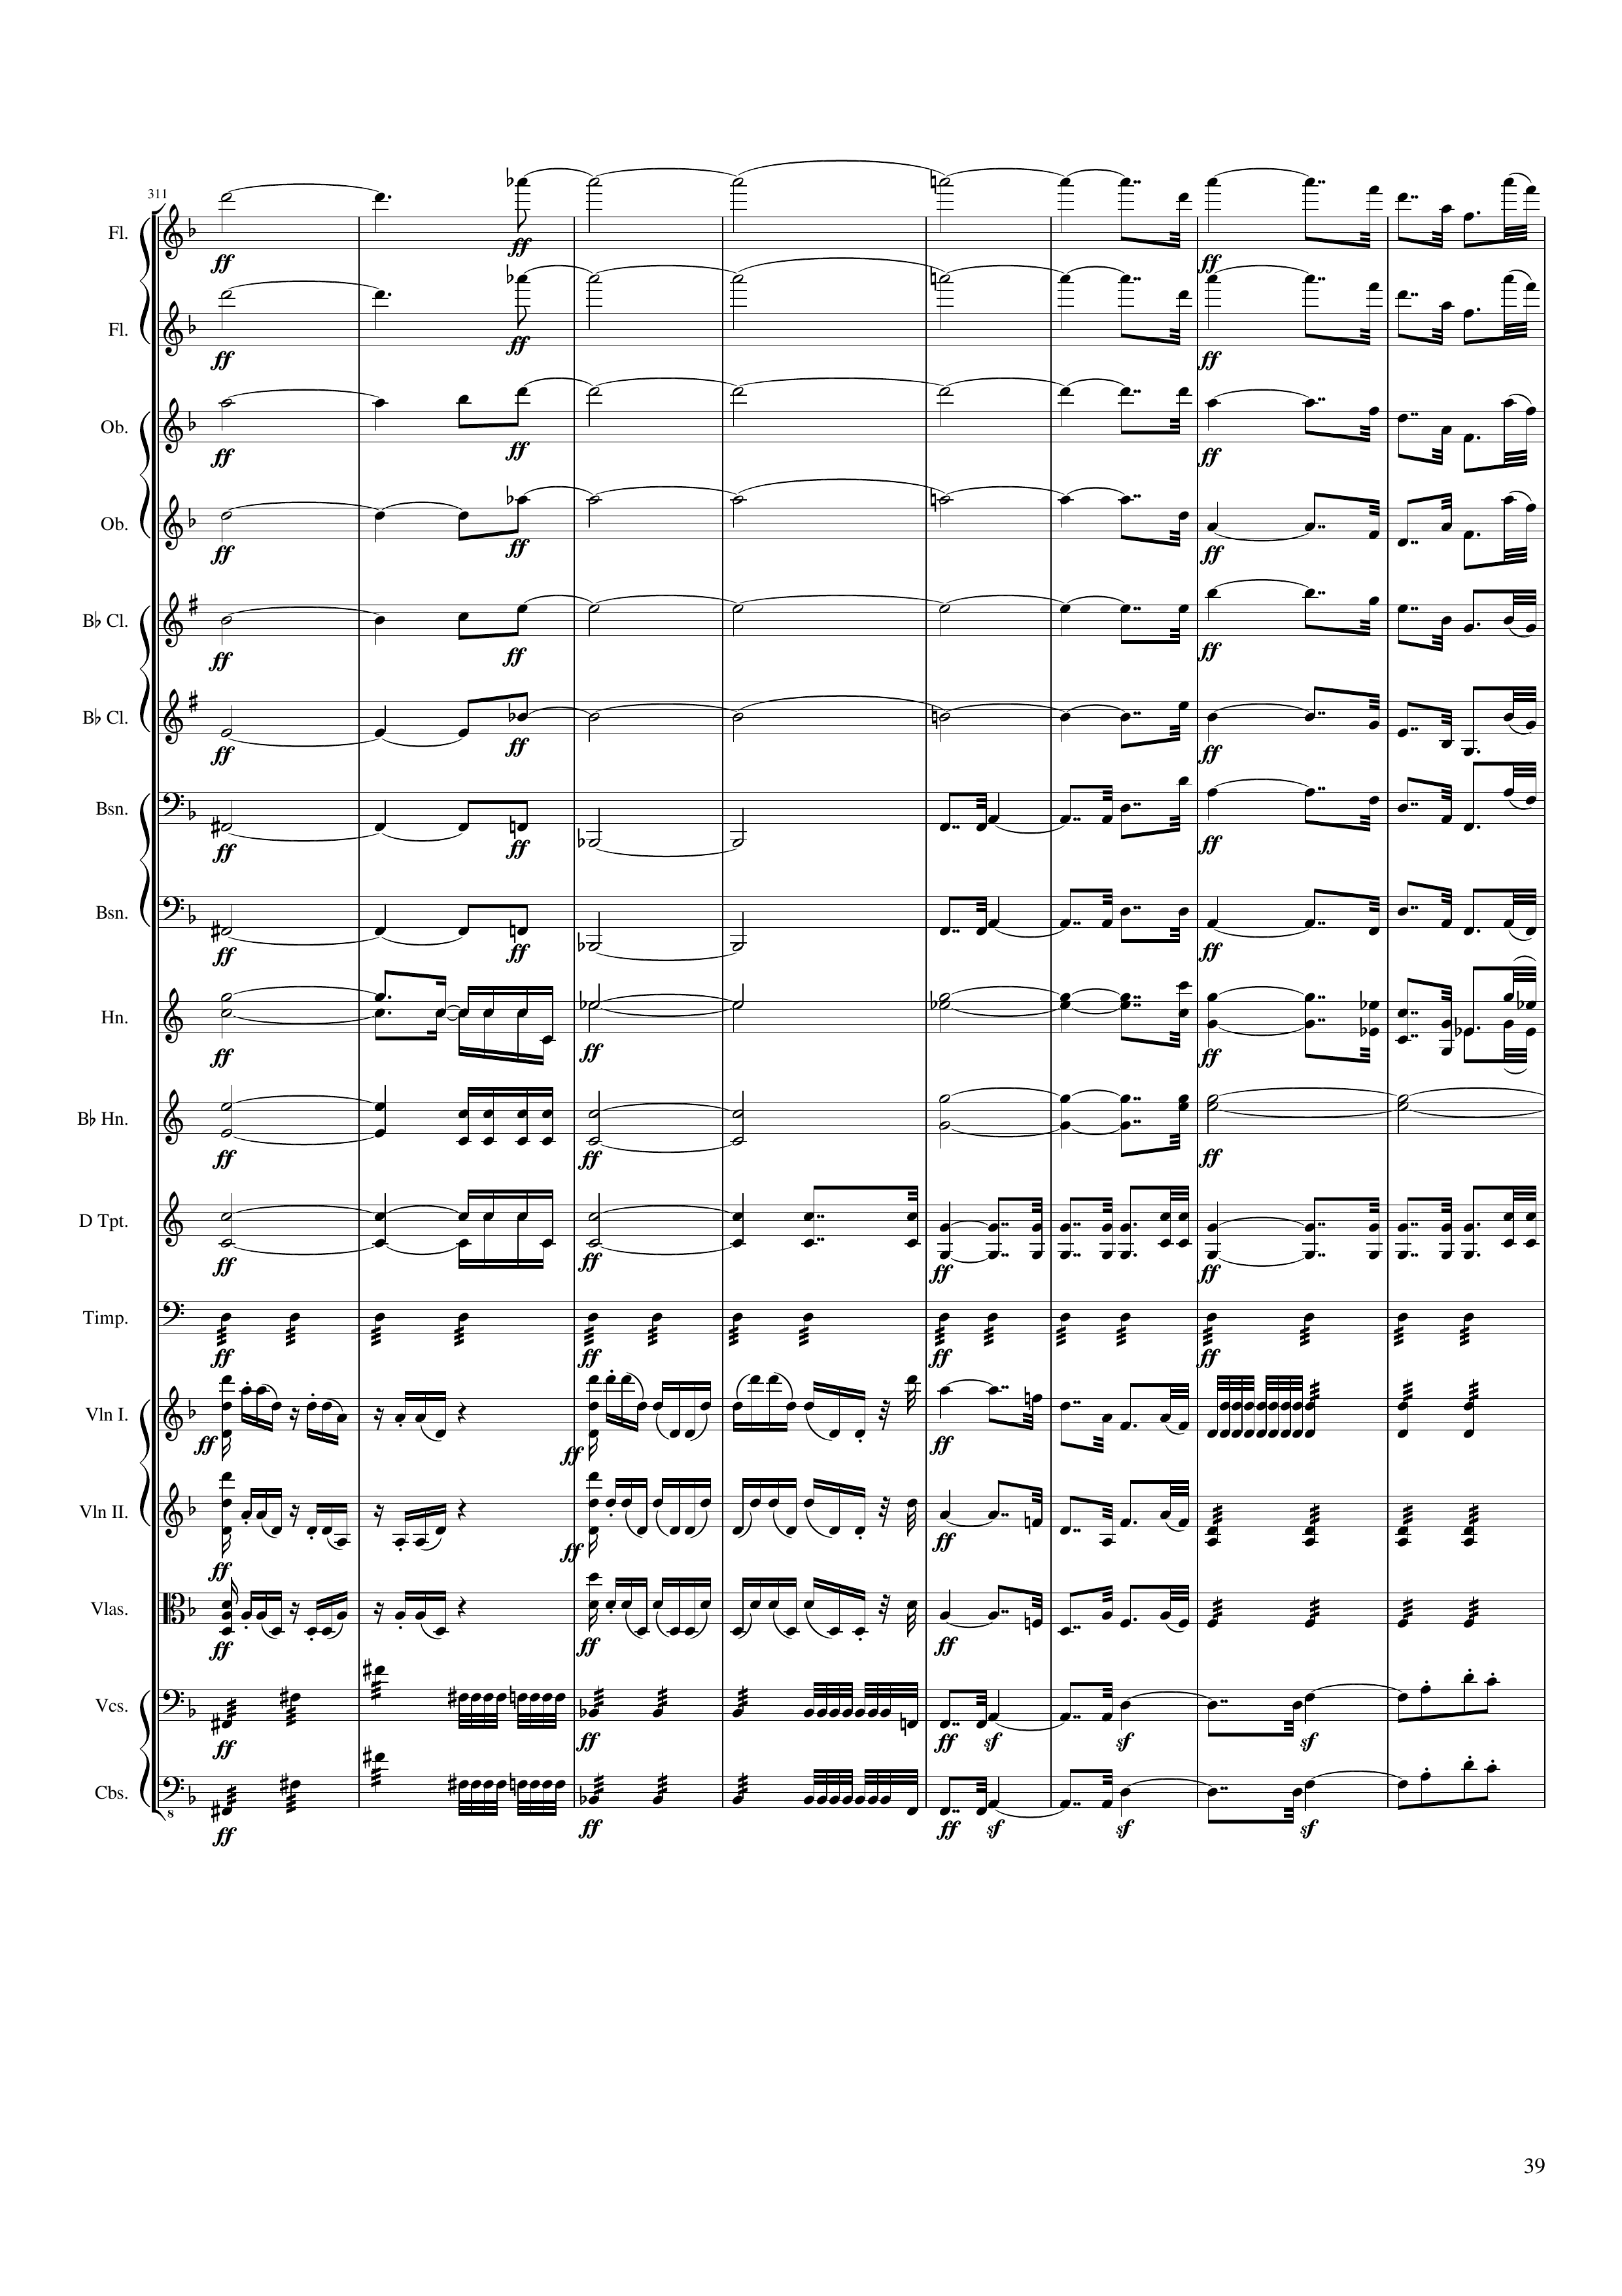
harm
mel
harm
mel
harm
mel
harm
mel
harm
mel
harm
mel
harm
mel
harm
mel
harm
rhythm
harm
mel
harm
rhythm
harm
harm
rhythm
harm
rhythm
rhythm
mel
rhythm
mel
rhythm
mel
rhythm
rhythm
rhythm
620 | 622 | 624 | 626 | 628 | 630 | 632 | 634
Notes:
11:42

Slide 40
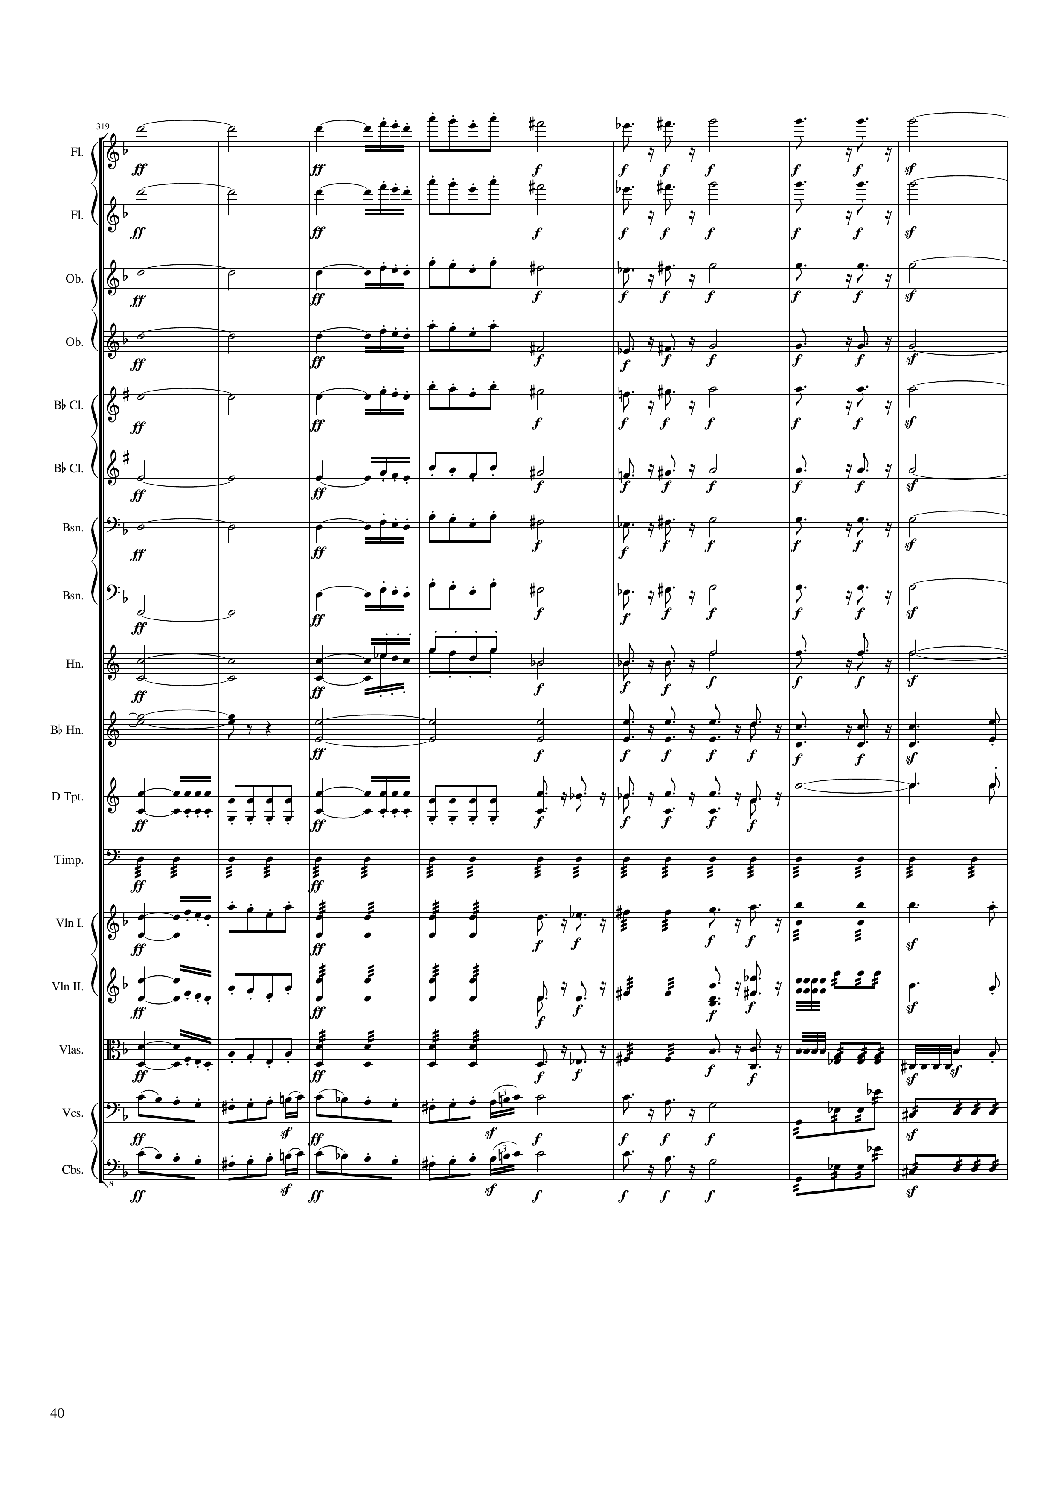
harm
mel
rhythm+harm
harm
mel
rhythm+harm
harm
mel
rhythm+harm
harm
mel
rhythm+harm
harm
mel
rhythm+harm
harm
mel
rhythm+harm
harm
mel
rhythm+harm
harm
mel
rhythm+harm
harm
mel
rhythm+harm
harm
rhythm+harm
rhythm
rhythm+harm
rhythm
mel
rhythm
mel+rhythm+harm
mel
mel
rhythm
mel+rhythm+harm
mel
mel
rhythm
mel+rhythm+harm
mel+rhythm
rhythm
rhythm+harm
rhythm
rhythm
rhythm+harm
rhythm
636 | 638 | 640 | 642 | 644 | 646 | 648 | 650 | 652
Notes:
11:58

Slide 41
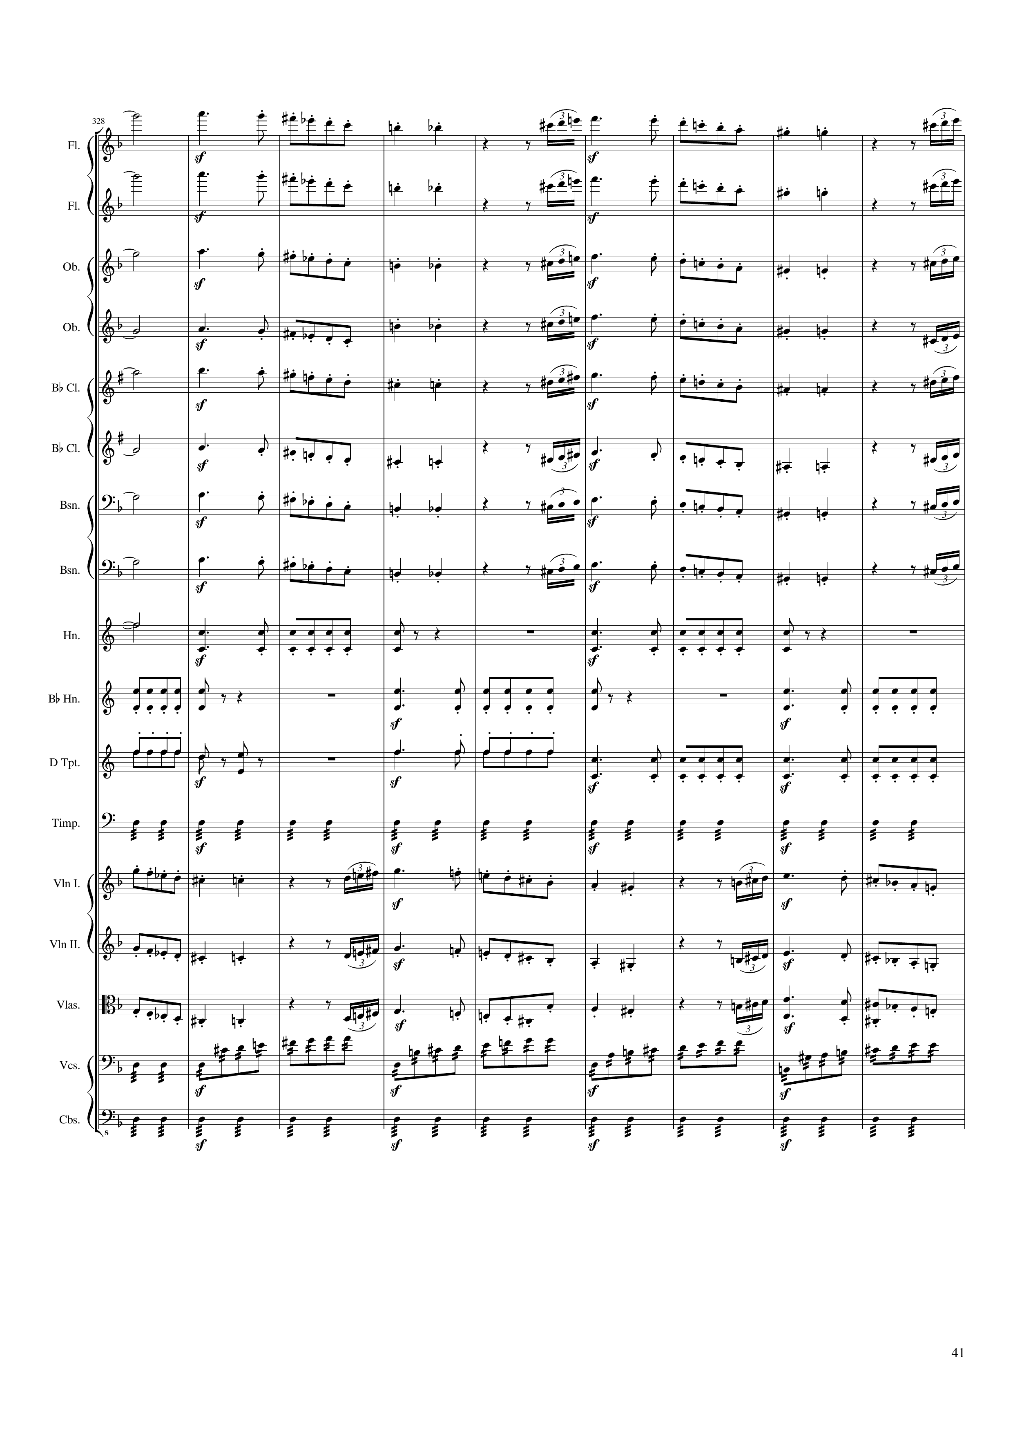
rhythm+harm
mel
rhythm+harm
mel
rhythm+harm
mel
rhythm+harm
mel
rhythm+harm
mel
rhythm+harm
mel
rhythm+harm
mel
rhythm+harm
mel
rhythm+harm
rhythm
rhythm
rhythm
rhythm
mel
mel
mel+rhythm
mel
rhythm
mel+rhythm
rhythm
654 | 656 | 658 | 660 | 662 | 664 | 666 | 668 | 670
Notes:
12:17

Slide 42
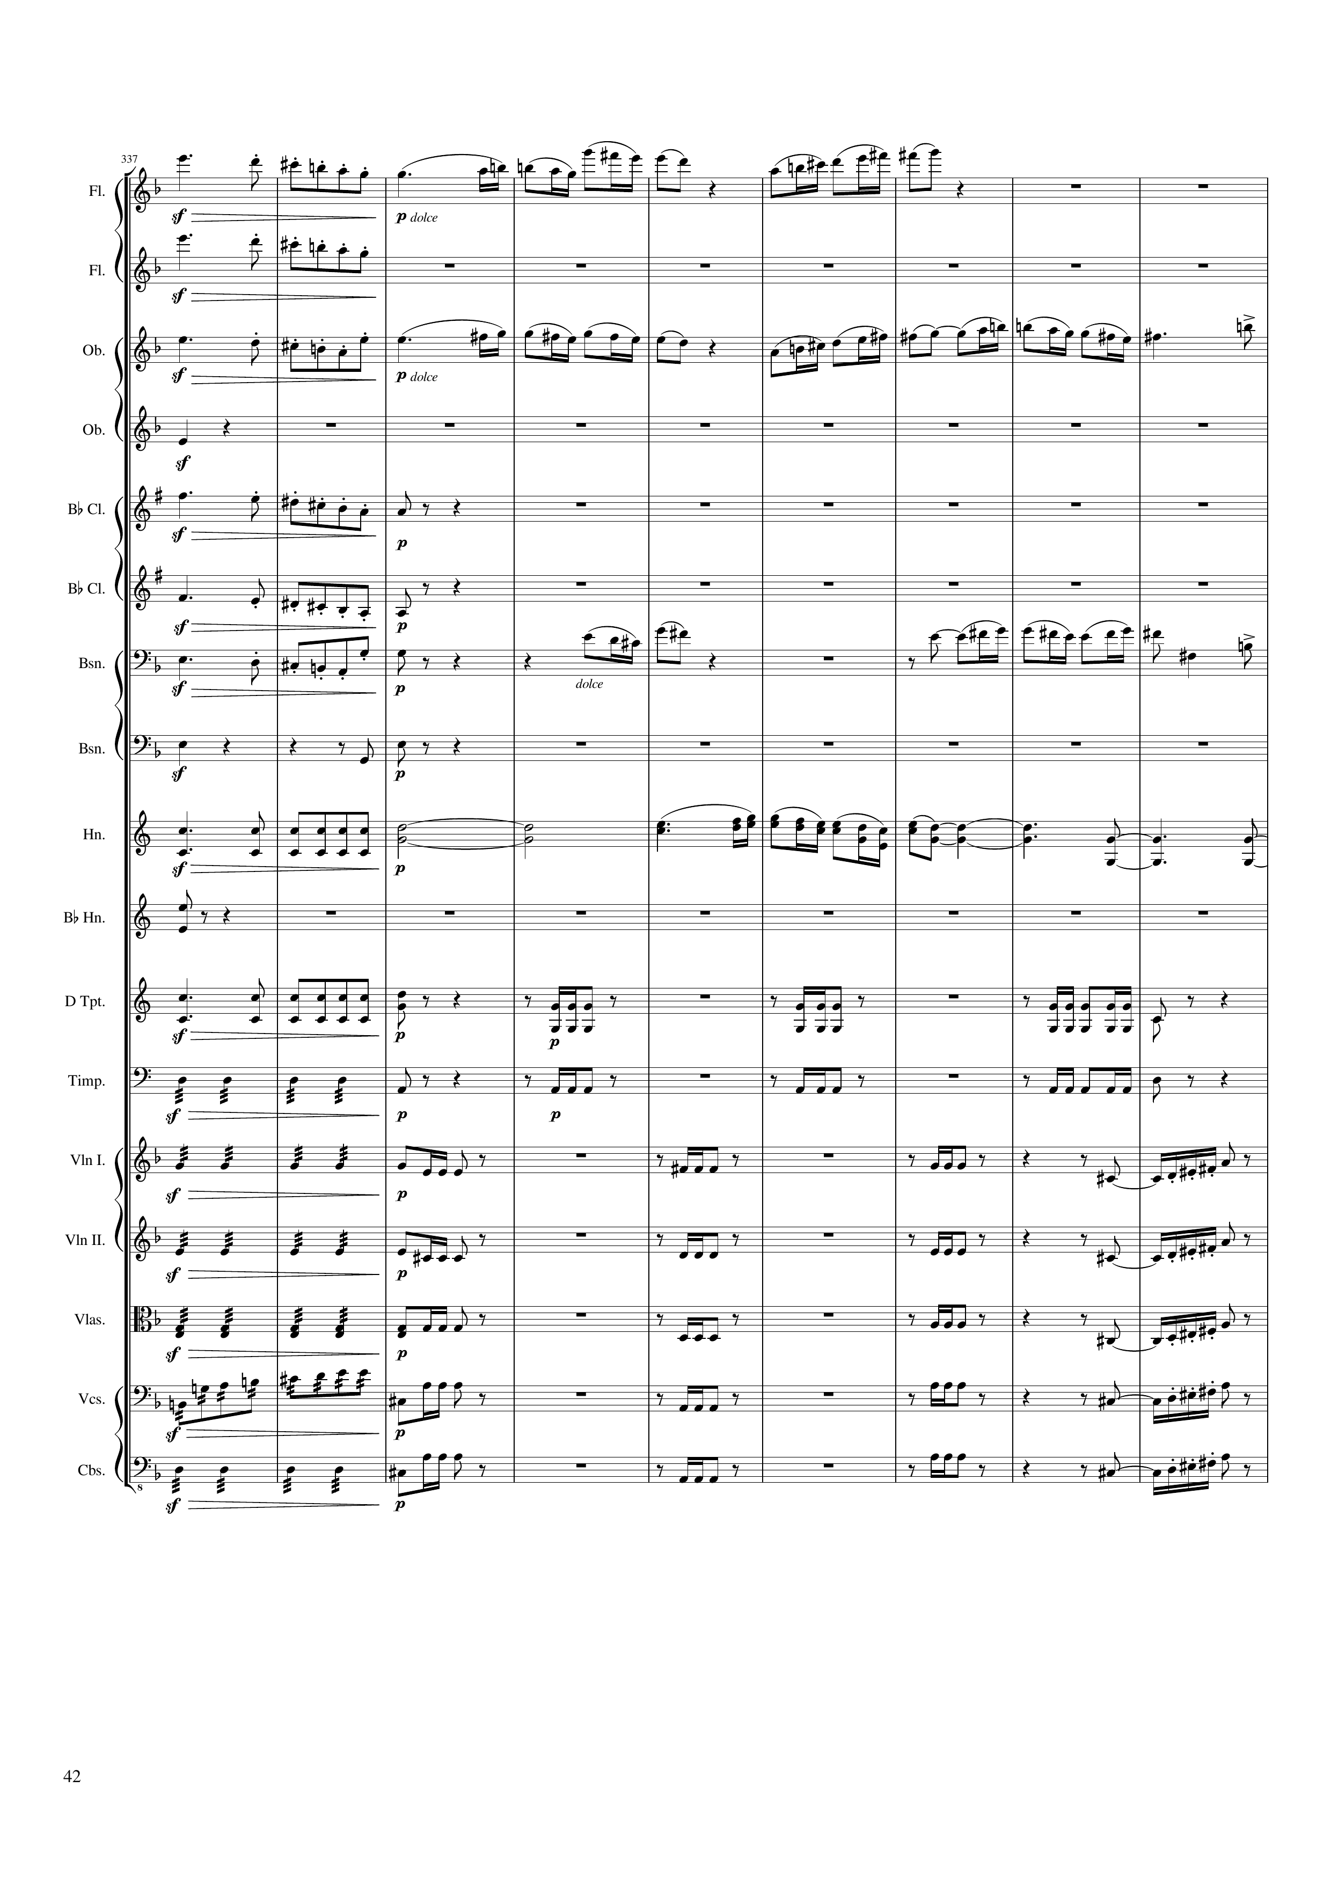
mel
mel
mel
mel
mel
mel
mel
mel+harm
mel
mel
rhythm
harm
mel
harm
rhythm
rhythm
rhythm
rhythm
rhythm
rhythm
rhythm
rhythm
mel+rhythm
rhythm
rhythm
672 | 674 | 676 | 678 | 680 | 682 | 684 | 686 | 688
Notes:
12:35

Slide 43
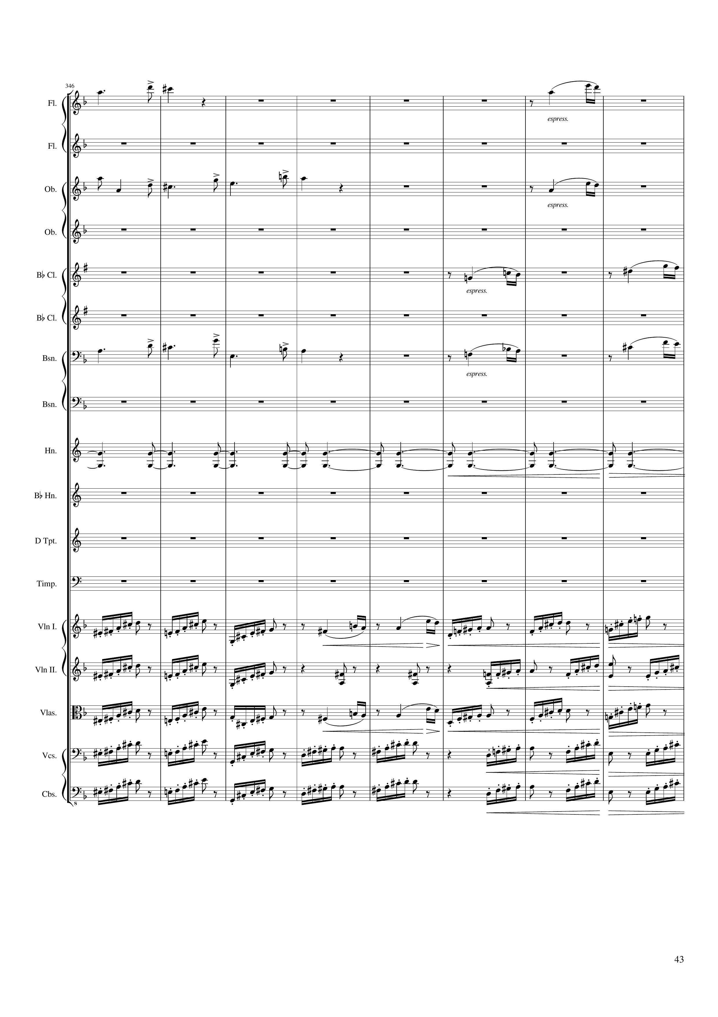
mel
mel
mel
mel
mel
mel
mel
harm
rhythm
mel
rhythm
rhythm
rhythm
mel
rhythm
rhythm
rhythm
690 | 692 | 694 | 696 | 698 | 700 | 702 | 704
Notes:
12:52

Slide 44
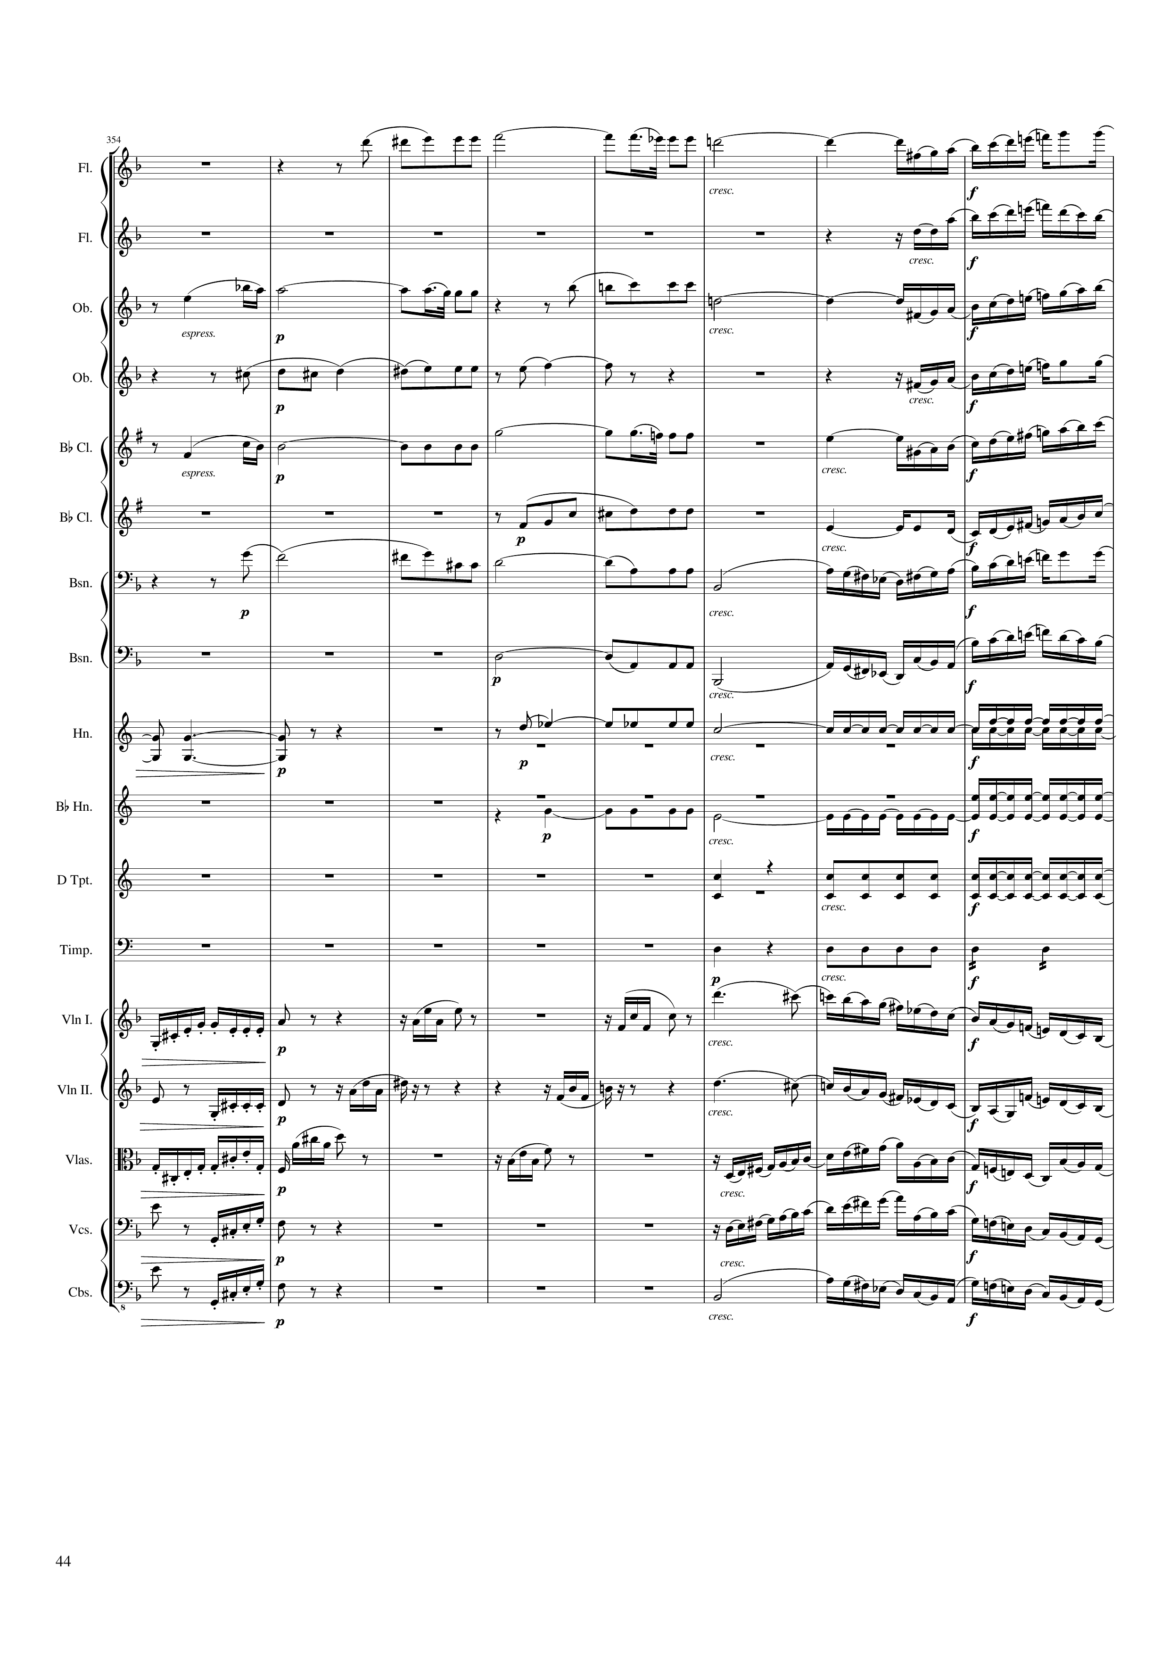
mel
mel
mel
mel+harm
mel
mel+harm
mel
mel
mel
mel+harm
mel
mel+harm
mel
mel+harm
mel
harm
mel+harm
rhythm
rhythm
rhythm
rhythm
rhythm
mel
rhythm
mel
rhythm
mel
rhythm
mel
rhythm
mel
706 | 708 | 710 | 712 | 714 | 716 | 718 | 720
Notes:
13:08

Slide 45
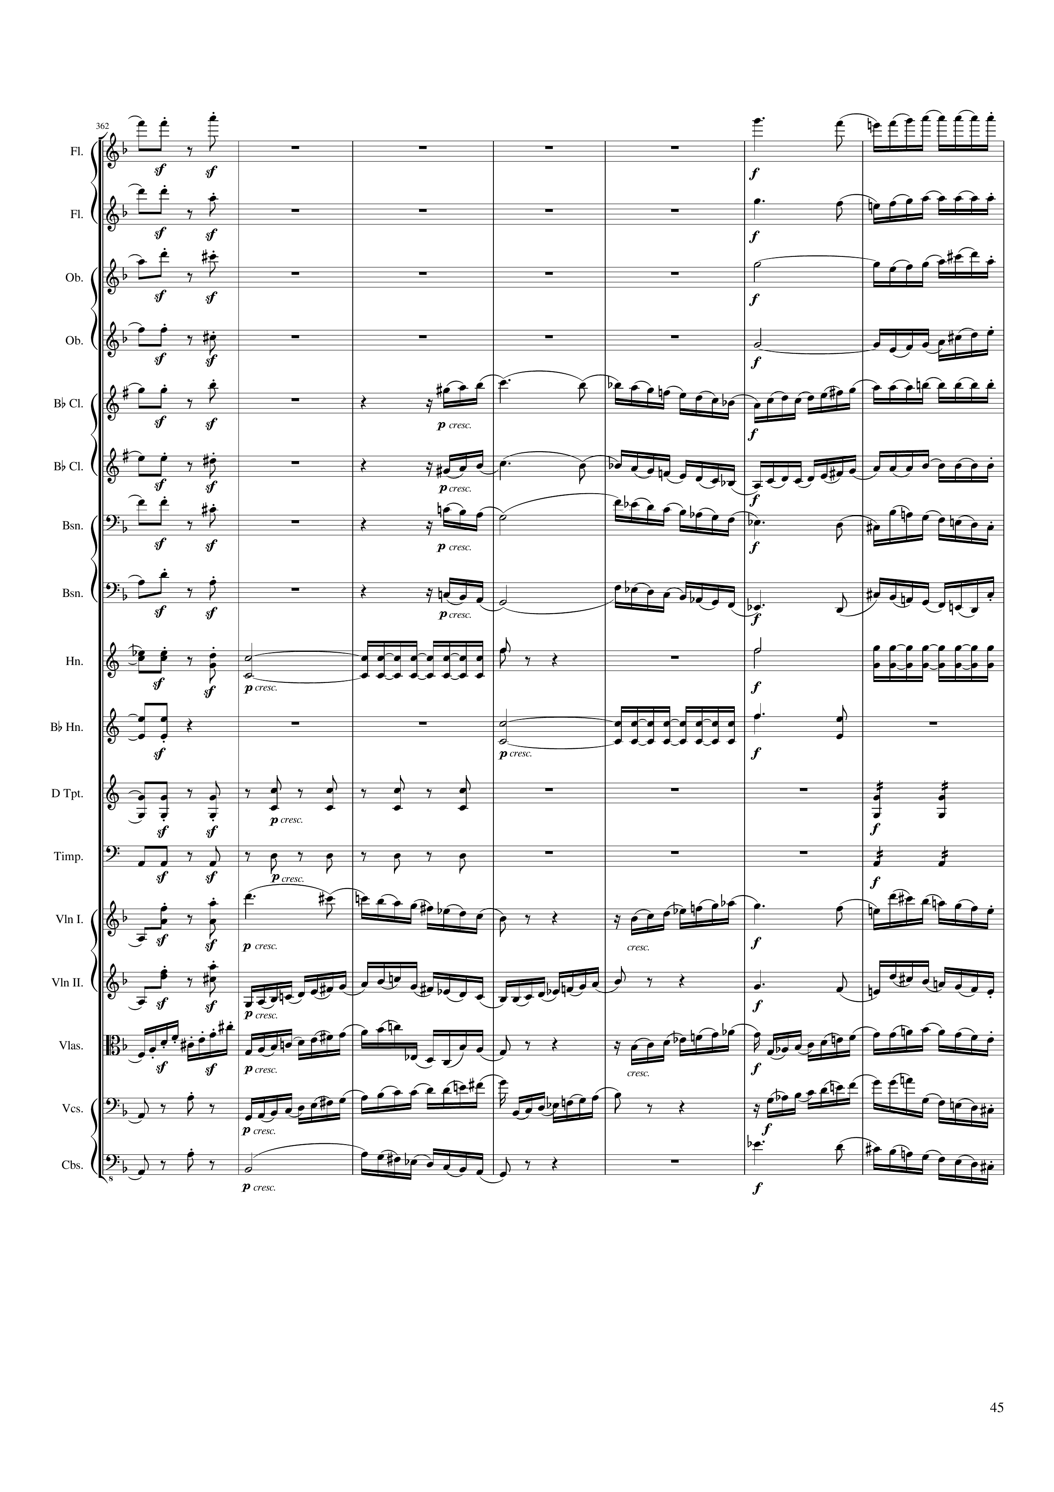
rhythm+harm
mel
rhythm+harm
mel
rhythm+harm
mel
rhythm+harm
mel
rhythm+harm
mel
rhythm+harm
mel
rhythm+harm
mel
rhythm+harm
mel
rhythm+harm
rhythm
rhythm
rhythm
rhythm
rhythm
rhythm
rhythm
rhythm+harm
mel
rhythm+harm
mel
mel
rhythm+harm
mel
rhythm+harm
mel
722 | 724 | 726 | 728 | 730 | 732 | 734
Notes:
13:23

Slide 46
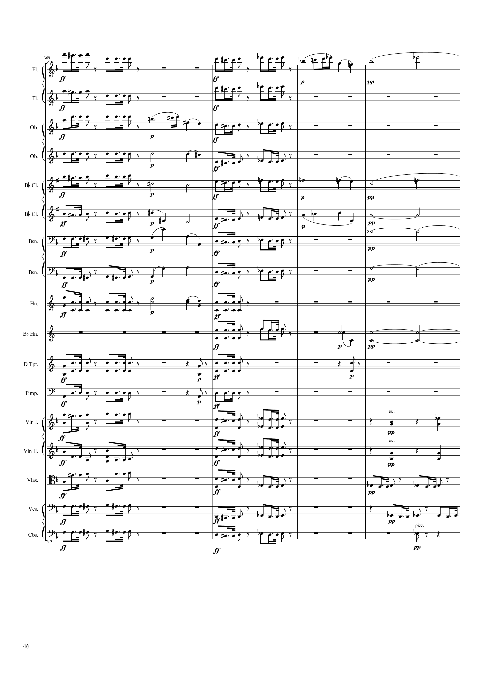
mel
rhythm+harm
mel
mel
rhythm+harm
mel
rhythm+harm
mel
mel
rhythm+harm
harm
mel
mel
harm
mel
harm
mel
mel
harm
mel
harm
rhythm+harm
harm
mel
harm
rhythm+harm
harm
mel
harm
rhythm+harm
harm
rhythm+harm
rhythm+harm
harm
rhythm+harm
rhythm+harm
rhythm+harm
rhythm+harm
rhythm+harm
mel
mel
rhythm+harm
rhythm+harm
mel
rhythm+harm
mel
mel
rhythm
rhythm+harm
mel
rhythm
rhythm+harm
mel
rhythm+harm
736 | 738 | 740 | 742 | 744 | 746 | 748 | 750 | 752 | 754
Notes:
13:36

Slide 47
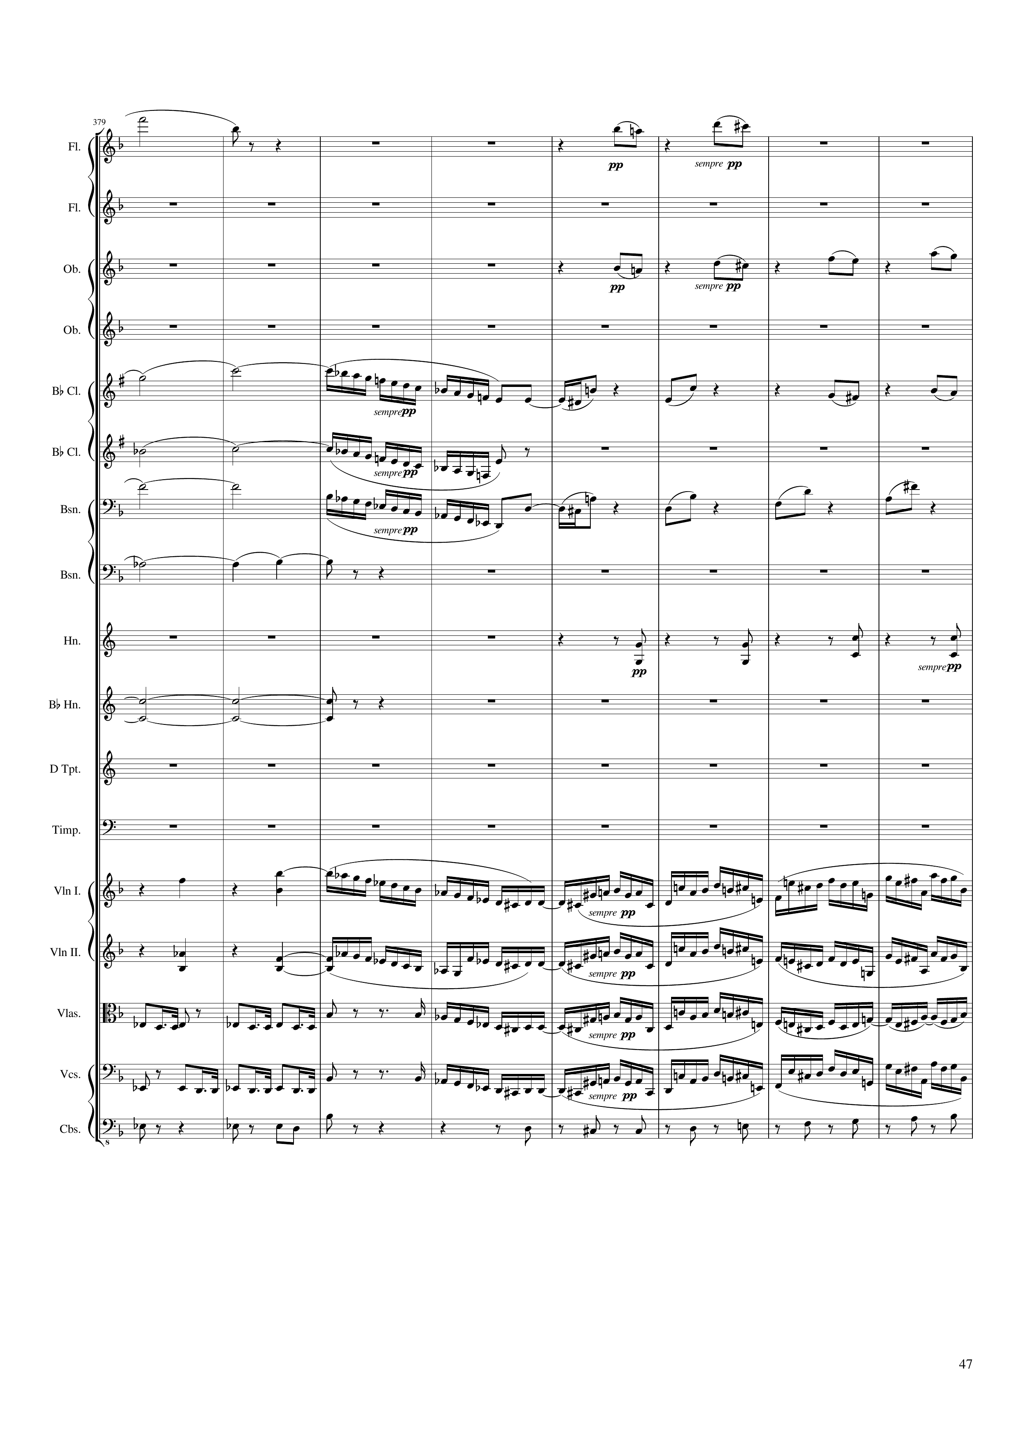
mel
mel
mel
mel
harm
mel
harm
mel
harm
rhythm+harm
harm
rhythm+harm
mel
mel+rhythm
rhythm+harm
mel
mel+rhythm
rhythm
mel
mel+rhythm
rhythm
mel
mel+rhythm
rhythm+harm
756 | 758 | 760 | 762 | 764 | 766 | 768 | 770
Notes:
13:57

Slide 48
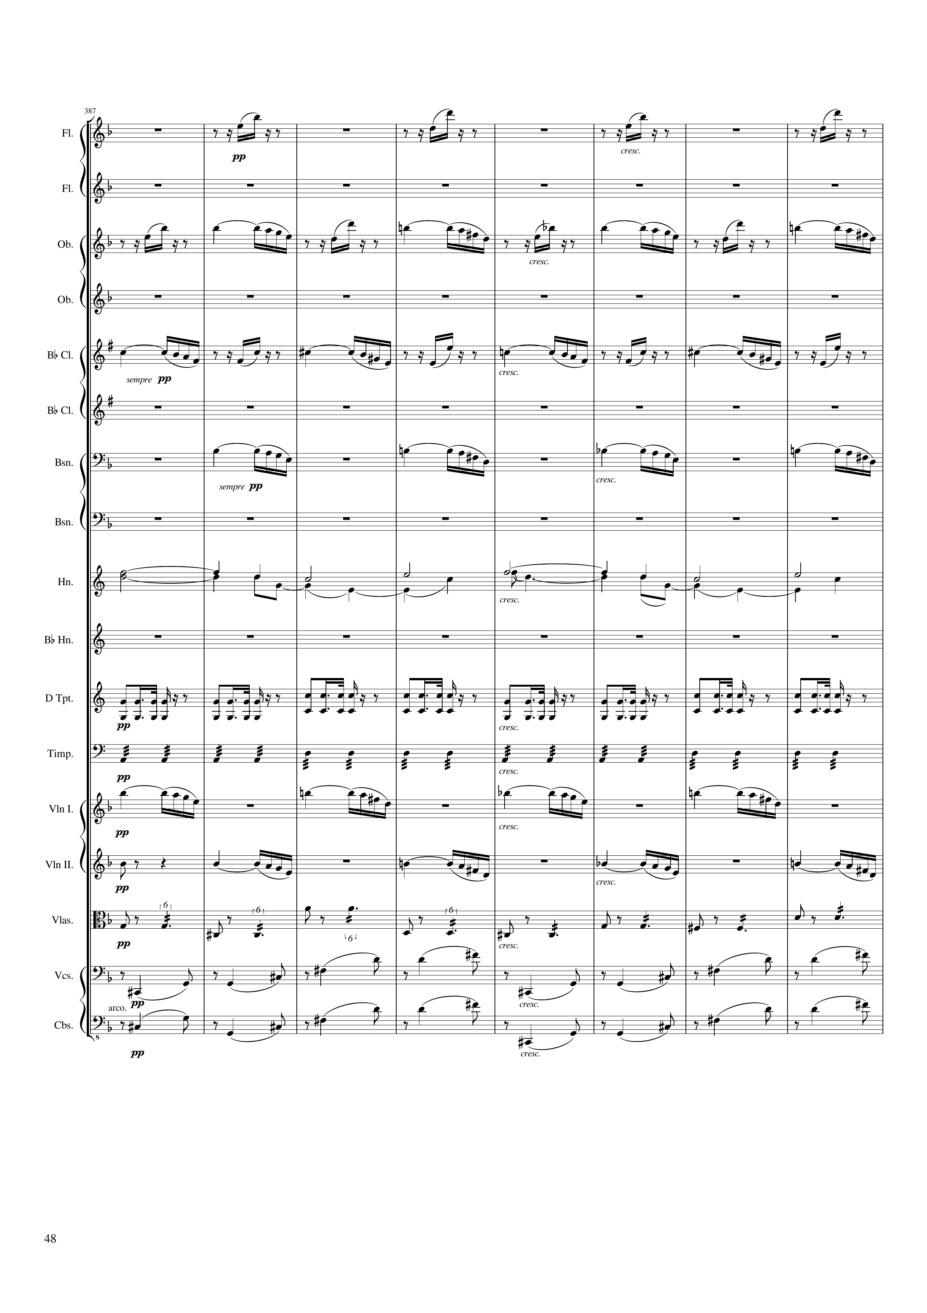
rhythm
mel
mel
mel
harm
rhythm
rhythm
mel
mel
rhythm+harm
rhythm+harm
rhythm+harm
772 | 774 | 776 | 778 | 780 | 782 | 784 | 786
Notes:
14:12

Slide 49
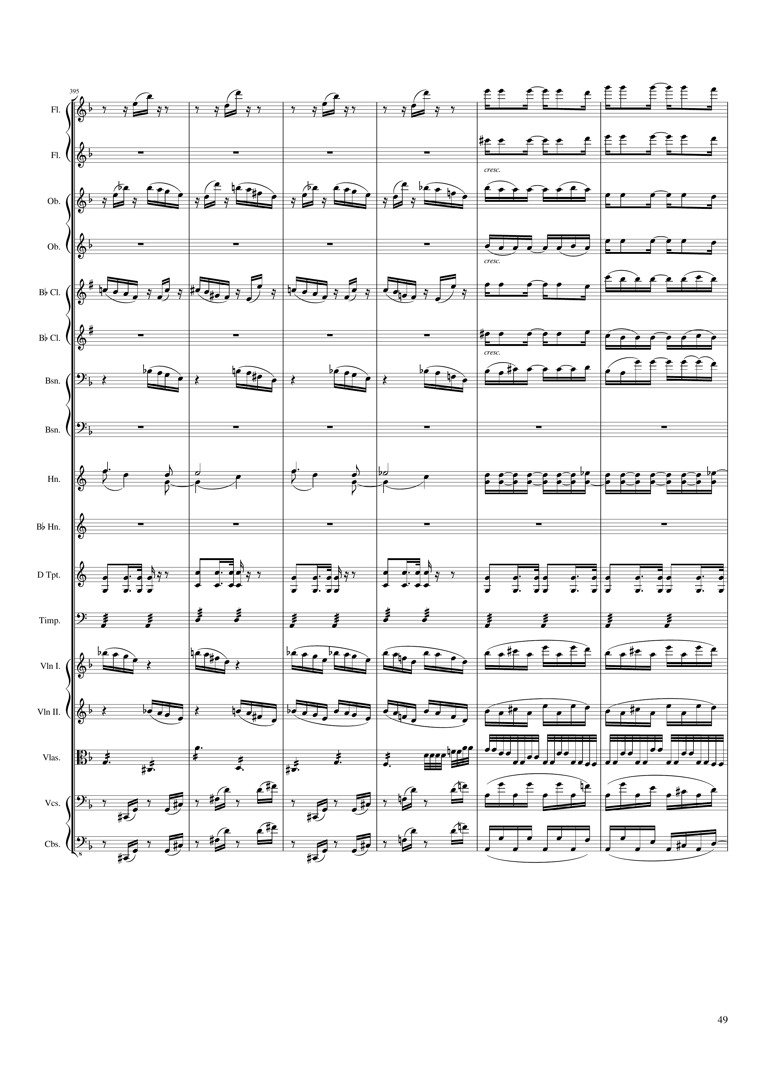
rhythm
rhythm
rhythm
mel
rhythm
rhythm
mel
rhythm
rhythm
mel
rhythm
harm
rhythm
rhythm
rhythm
mel
mel
rhythm+harm
rhythm
rhythm+harm
rhythm
rhythm+harm
rhythm
788 | 790 | 792 | 794 | 796 | 798
Notes:
14:27

Slide 50
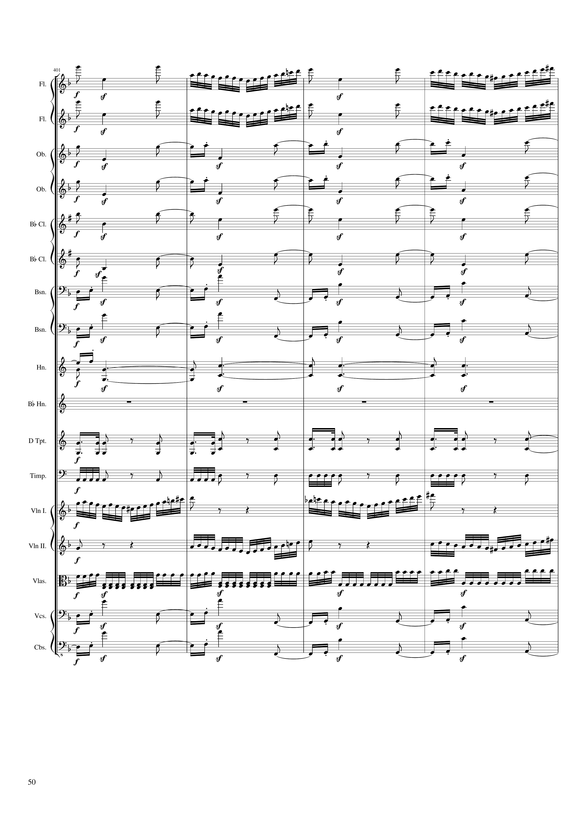
mel+rhythm
mel+rhythm
rhythm+harm
rhythm+harm
rhythm+harm
rhythm+harm
rhythm+harm
rhythm+harm
harm
rhythm
rhythm
mel+rhythm
mel+rhythm
rhythm
rhythm+harm
rhythm+harm
800 | 802 | 804 | 806
Notes:
14:37

Slide 51

mel+rhythm
mel
mel+rhythm
mel+harm
rhythm+harm
mel
rhythm+harm
mel
mel+harm
rhythm+harm
mel+harm
rhythm+harm
mel+harm
rhythm+harm
mel+harm
rhythm+harm
mel+harm
harm
rhythm+harm
rhythm
rhythm
rhythm
rhythm
rhythm
mel+rhythm
mel
mel+rhythm
mel
rhythm
rhythm+harm
rhythm+harm
rhythm+harm
rhythm+harm
rhythm+harm
808 | 810 | 812 | 814 | 816 | 818
Notes:
14:46

Slide 52

mel
rhythm
mel+harm
mel+harm
rhythm
mel
mel+harm
rhythm
mel+harm
mel+harm
rhythm
mel
mel+harm
rhythm
mel+harm
rhythm
mel
mel+harm
rhythm
mel+harm
rhythm
rhythm+harm
rhythm
rhythm
rhythm
rhythm
rhythm
mel
mel
mel
rhythm+harm
mel
rhythm+harm
mel+harm
rhythm+harm
mel+harm
rhythm+harm
rhythm+harm
820 | 822 | 824 | 826 | 828 | 830 | 832
Notes:
14:58

Slide 53

rhythm
mel
rhythm
mel
rhythm
mel
rhythm
mel
rhythm
mel
rhythm
mel
rhythm
mel
rhythm
mel
rhythm
mel
rhythm
rhythm
rhythm
mel
mel
mel+harm
mel
mel+harm
mel
rhythm+harm
mel
834 | 836 | 838 | 840 | 842 | 844 | 846 | 848
Notes:
15:12

Slide 54

mel
mel
mel
mel
harm
mel
harm
mel
rhythm+harm
mel
rhythm+harm
mel
mel
mel
rhythm
harm
rhythm
harm
c
harm
c
rhythm
rhythm
mel
mel
rhythm
mel
rhythm
mel
rhythm+harm
mel
rhythm+harm
850 | 852 | 854 | 856 | 858 | 860 | 862 | 864 | 866
Notes:
15:27

Slide 55

mel
harm
harm
mel
rhythm+harm
mel
harm
harm
mel
rhythm
rhythm
rhythm+harm
rhythm+harm
868 | 870 | 872 | 874 | 876 | 878 | 880 | 882
Notes:
15:44

Slide 56

mel
harm
harm
mel
rhythm+harm
mel
harm
harm
mel
rhythm
rhythm
rhythm+harm
rhythm+harm
884 | 886 | 888 | 890 | 892 | 894 | 896 | 898
Notes:
15:59

Slide 57

mel
mel
mel
rhythm+harm
harm
rhythm
rhythm+harm
mel
harm
rhythm
rhythm+harm
mel
rhythm+harm
rhythm+harm
mel
rhythm+harm
mel
rhythm+harm
mel
mel
rhythm+harm
harm
rhythm
rhythm
harm
rhythm
rhythm
rhythm
mel
rhythm
mel
rhythm
mel
rhythm+harm
mel
rhythm+harm
mel
rhythm+harm
mel
rhythm+harm
mel
rhythm+harm
mel
900 | 902 | 904 | 906 | 908 | 910 | 912
Notes:
16:14

Slide 58

mel
mel
mel
mel+harm
mel
mel+harm
rhythm+harm
mel
mel
mel
mel
rhythm+harm
mel
rhythm+harm
rhythm
rhythm+harm
rhythm
rhythm+harm
rhythm
rhythm+harm
rhythm
rhythm+harm
mel
mel
mel
rhythm+harm
mel
mel
rhythm+harm
mel
mel
rhythm+harm
914 | 916 | 918 | 920 | 922 | 924 | 926 | 928
Notes:
16:28

Slide 59

mel
mel
rhythm+harm
mel
mel
rhythm+harm
mel
mel
rhythm+harm
mel
rhythm+harm
rhythm+harm
mel
harm
rhythm+harm
rhythm+harm
rhythm
rhythm+harm
rhythm
mel
harm
mel
harm
rhythm+harm
harm
rhythm+harm
harm
rhythm+harm
harm
930 | 932 | 934 | 936 | 938 | 940 | 942 | 944 | 946
Notes:
16:43

Slide 60

mel
mel
mel
mel
mel
harm
harm
rhythm
rhythm
harm
mel
harm
mel
harm
mel
harm
mel
harm
mel
948 | 950 | 952 | 954 | 956 | 958 | 960 | 962
Notes:
16:59

Slide 61

mel
mel
mel
mel
mel
mel
mel
mel
harm
rhythm
rhythm
rhythm
rhythm
mel
mel
mel
mel
mel
964 | 966 | 968 | 970 | 972 | 974 | 976 | 978
Notes:
17:14

Slide 62

mel
mel
mel
mel
mel
harm
mel+harm
harm
mel+harm
mel
mel
mel
mel
mel
rhythm
rhythm
rhythm
rhythm
mel
mel+rhythm
mel
mel+rhythm
mel
rhythm
mel
rhythm
mel
rhythm
980 | 982 | 984 | 986 | 988 | 990 | 992
Notes:
17:29

Slide 63

rhythm+harm
mel
rhythm+harm
rhythm+harm
mel
rhythm+harm
rhythm+harm
mel
rhythm+harm
mel
rhythm+harm
mel
rhythm+harm
mel+harm
rhythm+harm
mel
rhythm+harm
mel+harm
rhythm+harm
mel
rhythm+harm
mel+harm
rhythm+harm
mel
rhythm+harm
mel+harm
rhythm+harm
mel
rhythm+harm
mel+harm
rhythm+harm
harm
rhythm
rhythm+harm
rhythm
rhythm+harm
rhythm
rhythm+harm
rhythm
rhythm+harm
mel
rhythm+harm
rhythm+harm
mel
rhythm+harm
rhythm+harm
mel
rhythm+harm
rhythm+harm
mel
rhythm+harm
mel
994 | 996 | 998 | 1000 | 1002 | 1004 | 1006 | 1008 | 1010
Notes:
17:43

Slide 64

mel
mel
mel
mel+harm
mel+harm
mel+harm
mel
rhythm
mel+harm
mel+harm
mel+harm
mel
mel
mel+harm
mel
mel+harm
mel
rhythm
rhythm
rhythm
mel
mel+harm
mel+harm
mel+rhythm
mel+harm
mel+rhythm
mel+harm
mel
1012 | 1014 | 1016 | 1018 | 1020 | 1022 | 1024 | 1026 | 1028
Notes:
18:01

Slide 65

mel
mel
mel
mel
mel
mel+harm
mel
mel
rhythm
mel
mel+harm
mel
mel+harm
mel
mel+harm
mel
mel
mel
mel
mel+harm
rhythm
rhythm
rhythm
mel+rhythm
mel+rhythm
mel+rhythm
mel+rhythm
mel
1030 | 1032 | 1034 | 1036 | 1038 | 1040 | 1042 | 1044
Notes:
18:24

Slide 66

mel
rhythm+harm
mel
rhythm+harm
mel
rhythm+harm
mel
rhythm+harm
mel
rhythm+harm
mel
rhythm+harm
mel
mel
mel+harm
rhythm+harm
rhythm
rhythm+harm
rhythm
rhythm+harm
rhythm
mel+rhythm
mel+rhythm
mel+rhythm
mel+rhythm
mel
1046 | 1048 | 1050 | 1052 | 1054 | 1056 | 1058 | 1060
Notes:
18:41

Slide 67

rhythm+harm
mel
rhythm+harm
mel
rhythm+harm
mel
rhythm+harm
mel
rhythm+harm
mel
rhythm+harm
mel
mel
rhythm+harm
mel
mel
rhythm+harm
mel
rhythm+harm
rhythm
rhythm+harm
rhythm
rhythm+harm
rhythm
rhythm
mel+rhythm
mel
mel+rhythm
mel
mel+rhythm
mel
mel+rhythm
mel
mel
mel
1062 | 1064 | 1066 | 1068 | 1070 | 1072 | 1074 | 1076
Notes:
18:57

Slide 68

mel
mel
mel
mel
mel
mel
mel
mel
rhythm
rhythm
rhythm
rhythm
mel
mel
mel
mel
mel
1078 | 1080 | 1082 | 1084 | 1086 | 1088 | 1090 | 1092
Notes:
19:14

